Slide 1
Psychology, Communication, and The Canadian Workplace
CHAPTER 6: MEMORY
Unless otherwise noted, this work is licensed under a Creative Commons Attribution-NonCommercial-ShareAlike 4.0 International (CC BY-NC-SA 4.0) license. Feel free to use, modify, reuse or redistribute any portion of this presentation.

Slide 2
Learning Outcomes
Upon successful completion of this chapter, you should be able to:
Define and note differences between the following forms of memory: working memory, episodic memory, semantic memory, collective memory.
Describe the three stages in the process of learning and remembering.
Describe strategies that can be used to enhance the original learning or encoding of information.
Describe strategies that can improve the process of retrieval.
Describe why the classic mnemonic device, the method of loci, works so well.

Slide 3
6.1 Introduction
“Memory” is a single term that reflects a number of different abilities: holding information briefly while working with it, remembering episodes of one’s life and our general knowledge of facts of the world, among other types.
Photo by Kelly Sikkema on Unsplash

Slide 4
6.2 Varieties of Memory I
Working memory- the ability to hold information in our minds for a brief time and work with it
Episodic memory—the ability to remember the episodes of our lives
Semantic memory is our storehouse of more-or-less permanent knowledge, such as the meanings of words in a language and the huge collection of facts about the world
Collective memory refers to the kind of memory that people in a group share (whether family, community, schoolmates, or citizens of a state or a country).

Slide 5
6.2 Varieties of Memory II
Three Stages of the Learning/Memory Process
Encoding
Storage
Retrieval
Notes:
encoding information (learning it, by perceiving it and relating it to past knowledge),
storing it (maintaining it over time),
retrieving it (accessing the information when needed).

Slide 6
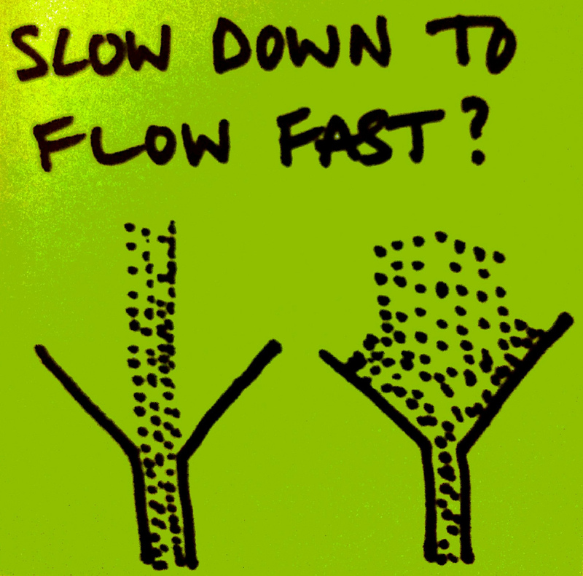
6.2 Varieties of Memory III
Encoding
Encoding refers to the initial experience of perceiving and learning information. Psychologists often study recall by having participants study a list of pictures or words.
Notes:
Encoding in these situations is fairly straightforward. However, “real life” encoding is much more challenging
When you walk across campus, for example, you encounter countless sights and sounds—friends passing by, people playing Frisbee, music in the air. The physical and mental environments are much too rich for you to encode all the happenings around you or the internal thoughts you have in response to them.
Although it requires more effort, using images and associations can improve the process of recoding.

Slide 7
6.2 Varieties of Memory IV
Storage
Notes:
Every experience we have changes our brains. That may seem like a bold, even strange, claim at first, but it’s true. We encode each of our experiences within the structures of the nervous system, making new impressions in the process—and each of those impressions involves changes in the brain.

Slide 8
6.2 Varieties of Memory V
Retrieval
Endel Tulving argued that “the key process in memory is retrieval” (1991, p. 91). Why should retrieval be given more prominence than encoding or storage? For one thing, if information were encoded and stored but could not be retrieved, it would be useless.
Notes:
As discussed previously in this module, we encode and store thousands of events—conversations, sights and sounds—every day, creating memory traces. However, we later access only a tiny portion of what we’ve taken in. Most of our memories will never be used—in the sense of being brought back to mind, consciously.
This fact seems so obvious that we rarely reflect on it. All those events that happened to you in the fourth grade that seemed so important then?
Now, many years later, you would struggle to remember even a few. You may wonder if the traces of those memories still exist in some latent form. Unfortunately, with currently available methods, it is impossible to know.

Slide 9
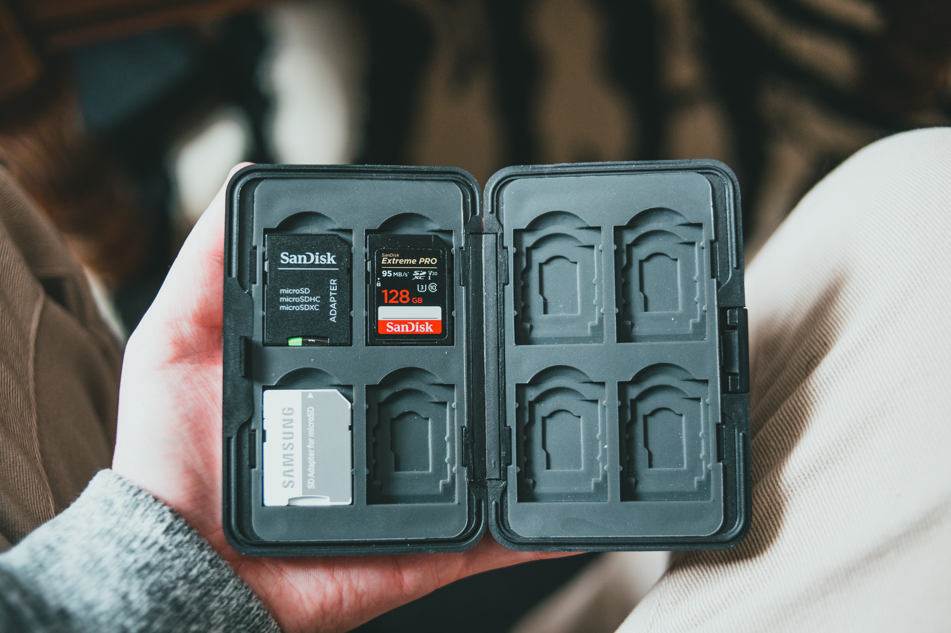
6.3 Putting it All Together: Improving Your Memory
To improve learning and memory, we need to encode information in conjunction with excellent cues that will bring back the remembered events when we need them.
Photo by Erik Mclean on Unsplash
Notes:
Keep in mind the two critical principles we have discussed: to maximize retrieval, we should construct meaningful cues that remind us of the original experience, and those cues should be distinctive and not associated with other memories. These two conditions are critical in maximizing cue effectiveness (Nairne, 2002).

Slide 10
6.4 Key Takeaways
The human memory is capable of astounding feats.
There are different types of memory including our memory for events (episodic memory) and facts (semantic memory).
There are three stages of the memory/learning process: encoding, storage, and retrieval. Failure to encode and forgetting prevent us from accessing information.
Using memory strategies such as mnemonics can help to improve our ability to encode and retrieve information.

