Slide 1
Psychology, Communication, and The Canadian Workplace
CHAPTER 12: PROFESSIONALISM, ETHICS, AND SOCIAL RESPONSIBILITY
Unless otherwise noted, this work is licensed under a Creative Commons Attribution-NonCommercial-ShareAlike 4.0 International (CC BY-NC-SA 4.0) license. Feel free to use, modify, reuse or redistribute any portion of this presentation.

Slide 2
Learning Outcomes
Upon successful completion of this chapter, you should be able to:
Define the terms profession and professionalism.
Understand the importance of respecting one’s coworkers.
Explain the concept of personal responsibility in the workplace.
Define the term “ethics”.
Identify levels of ethics within organizations.
Understand sources of individual and organizational ethics.
Describe different methods of ethical decision-making.
Explain and give examples of the levels of social responsibility for organizations and individuals.

Slide 3
12.1 Professionalism I
What is a Profession?
A profession is an occupation that involves mastery of complex knowledge and skills through prolonged training, education, or practical experience.
Photo by Usman Yousaf on Unsplash
Notes:
Becoming a member of a specific profession doesn’t happen overnight. Whether you seek to be a public relations expert, lawyer, doctor, teacher, welder, electrician, and so on, each profession involves that interested parties invest themselves in learning to become a professional or a member of a profession who earns their living through specified expert activity.

Slide 4
12.1 Professionalism II
What is professionalism?
Professionalism isn’t one thing; it’s a combination of qualities.
Photo by Christina @ wocintechchat.com on Unsplash
Notes:
A professional employee arrives on time for work and manages time effectively. Professional workers take responsibility for their own behavior and work effectively with others. High quality work standards, honesty, and integrity are also part of the package.
Professional employees look clean and neat and dress appropriately for the job. Communicating effectively and appropriately for the workplace is also an essential part of professionalism.

Slide 5
12.1 Professionalism III
The Requirements of Professionalism
Respect for Others
Personal Responsibility
Online Identity Management
Notes:
Professionalism involves the aims and behaviors that demonstrate an individual’s level of competence expected by a professional within a given profession. By the word “aims,” we mean that someone who exhibits professionalism is guided by a set of goals in a professional setting.
Be courteous, polite, and kind to everyone.
Do not criticize or nitpick at little inconsequential things.
Do not engage in patronizing or demeaning behaviors.
Don’t engage in physically hostile body language.
Personal responsibility refers to an individual’s willingness to be accountable for what they feel, think, and behave. Whether we’re talking about our attitudes, our thought processes, or physical/communicative behaviors, personal responsibility is simply realizing that we are in the driver’s seat and not blaming others for our current circumstances.
Our identity management is an important part of our professionalism. Our choice of attire and communication (verbal and non-verbal) are just some examples of how we can create a positive impression in the workplace. Another important, and often overlooked, aspect of our identity management is our digital footprint.

Slide 6
12.2 Ethics I
The word “ethics” actually is derived from the Greek word ethos, which means the nature or disposition of a culture (OED, 1963).
Ethics is the judgmental attachment to whether something is good, right, or just.
Picture Source- Pixabay
Notes:
From this perspective, ethics then involves the moral center of a culture that governs behavior. Without getting too deep, let’s just say that philosophers debate the very nature of ethics, and they have described a wide range of different philosophical perspectives on what constitutes ethics.

Slide 7
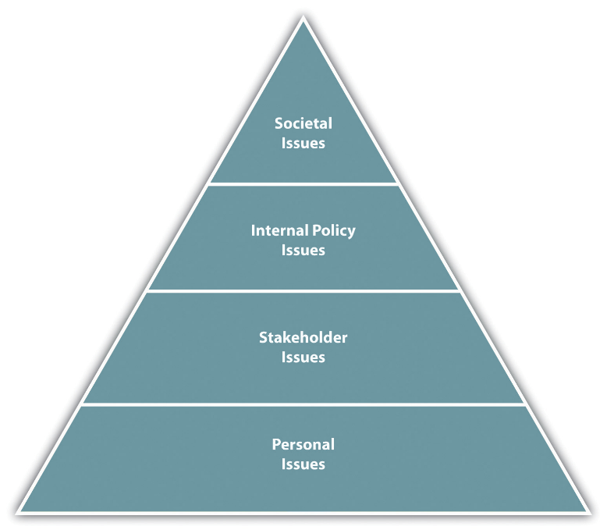
12.2 Ethics II
Four Levels of Ethics in Organizations
Notes:
Societal issues- These are the top-level issues relating to the world as a whole, which deal with questions such as the morality of child labor worldwide.
Stakeholder’s issues- A stakeholder is anyone affected by a company’s actions. In this level, businesses must deal with policies that affect their customers, employees, suppliers, and people within the community.
internal policy issue level of ethics. In this level, the concern is internal relationships between a company and employees. Fairness in management, pay, and employee participation would all be considered ethical internal policy issues.
personal issues. These deal with how we treat others within our organization. For example, gossiping at work or taking credit for another’s work would be considered personal issues. As an employee of an organization, we may not have as much control over societal and stakeholder issues, but certainly we have control over the personal issues level of ethics.

Slide 8
12.2 Ethics III
Sources of Personal Ethics
Religion
Culture
Media
Models
Attitudes.
Experiences.
Notes:
Religion has an influence over what is considered right and wrong. Religion can be the guiding force for many people when creating their ethical framework.
Every culture has a societal set of values. Our culture tells us what is good, right, and moral. In some cultures, bribery or “gifts” is the normal way of doing business.
Advertising shows us what our values “should” be
Our parents, siblings, mentors, coaches, and others can affect our ethics today and later in life. The way we see them behave and the things they say affect our values.
Our attitudes, similar to values, start developing at a young age. As a result, our impression, likes, and dislikes affect ethics, too. For example, someone who spends a lot of time outdoors may feel a connection to the environment and try to purchase environmentally friendly products.
Our values can change over time depending on the experiences we have. For example, if we are bullied by our boss at work, our opinion might change on the right way to treat people when we become managers.
NB- Our personality affects our values, too.

Slide 9
12.2 Ethics IV
Sources of Company Ethics
Sexual harassment policy
Workplace violence
Employee privacy
Misconduct off the job
Conflicts of interest
Insider trading
Use of company equipment
Company information nondisclosures
Expectations for customer relationships and suppliers
Policy on accepting or giving gifts to customers or clients
Bribes
Relationships with competition
Notes:
Since we know that everyone’s upbringing is different and may have had different models, religion, attitudes, and experiences, companies create policies and standards to ensure employees and managers understand the expected ethics.
The code of conduct is a guideline for dealing with ethics in the organization. The code of conduct can outline many things, and often companies offer training in many areas

Slide 10
12.2 Ethics V
Ethical Decision-making
Philosopher’s Approach
The Twelve Questions Model
Picture Source- Pixabay
Notes:
Philosophers and ethicists believe in a few ethical standards, which can guide ethical decision making.
First, the utilitarian approach says that when choosing one ethical action over another, we should select the one that does the most good and least harm.
In the rights approach, we look at how our actions will affect the rights of those around us. So rather than looking at good versus harm as in the utilitarian approach, we are looking at individuals and their rights to make our decision.
The common good approach says that when making ethical decisions, we should try to benefit the community as a whole.
The virtue approach asks the question, “What kind of person will I be if I choose this action?” In other words, the virtue approach to ethics looks at desirable qualities and says we should act to obtain our highest potential.
Laura Nash, an ethics researcher, created the Twelve Questions Model as a simple approach to ethical decision making (Nash, 1981 In her model, she suggests asking yourself questions to determine if you are making the right ethical decision. This model asks people to reframe their perspective on ethical decision making, which can be helpful in looking at ethical choices from all angles.

Slide 11
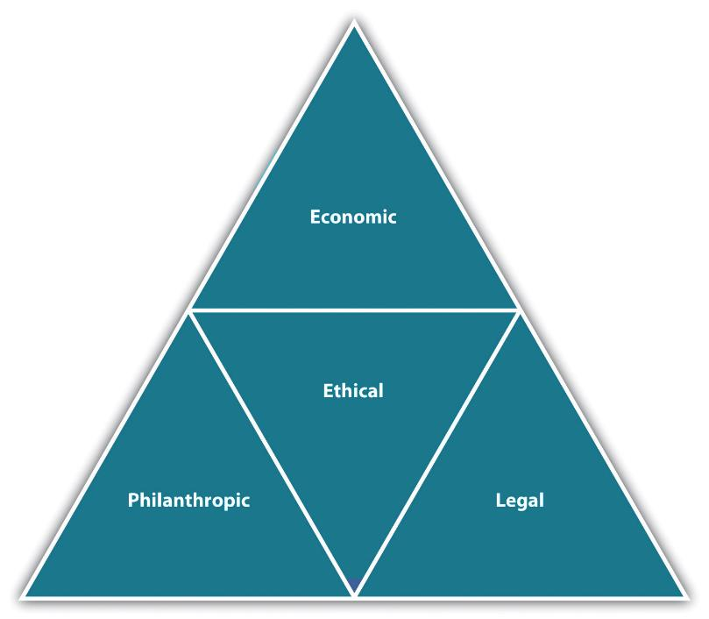
12.3 Social Responsibility
The Four Areas of Social Responsibility
Notes:
Economic aspects. Companies need to maintain strong economic interests so they can stay in business. Being profitable and providing value to shareholders is part of a company being socially responsible.
Legal aspects. A company must follow the law and have a legal obligation to do so. For example, car companies are required to meet a certain level of emissions standards in car production.
Ethical aspects. Acting ethically means going above and beyond the legal requirements and meeting the expectations of society. The ethical expectations (and outrage) of society can encourage companies to act ethically.
Philanthropic aspects. This is the expectation that companies should give back to society in the form of charitable donations of time, money, and goods.

Slide 12
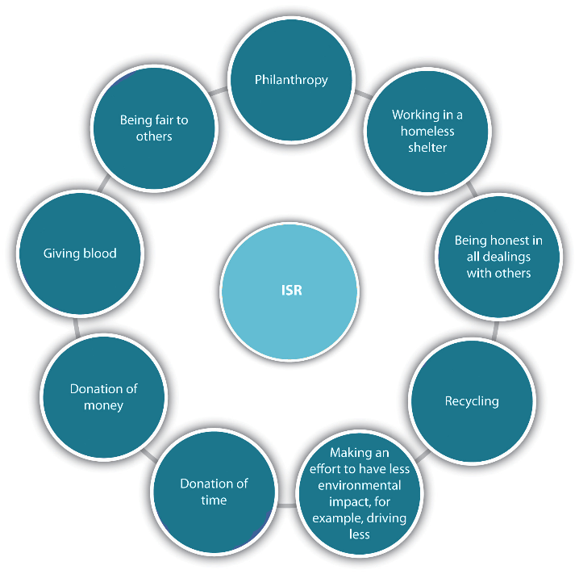
12.3 Social Responsibility II
Individual Social Responsibility
Notes:
Charitable acts, including philanthropy such as donation of money.
Working for the community, such as volunteering, giving blood donations, and working at a food bank or animal shelter.
Supporting issues that affect society, such as advocating political or social issues that can help others—for example, advocating for child labor laws, purchasing fair trade products, recycling.
Individual ethics, such as integrity and honesty. These individual ethics can also include the “golden rule”: treat others how you wish to be treated. This might mean with empathy and a sense of fairness.

Slide 13
12.4 Key Takeaways
A profession is an occupation that involves mastery of complex knowledge and skills through prolonged training, education, or practical experience.
Professionalism, on the other hand, involves the aims and behaviors that demonstrate an individual’s level of competence expected by a professional within a given profession.
Respecting our coworkers is one of the most essential keys to developing a positive organizational experience. There are many simple things we can do to show our respect, but one crucial feature is thinking about the types of langue we use.
Personal responsibility refers to an individual’s willingness to be accountable for what they feel, think, and behave. Part of being a successful co-worker is taking responsibility for your behaviors, communication, and task achievement in the workplace.
Ethics is defined as a set of values that define right and wrong.
There are four levels of ethical issues.
There are four levels of social responsibility

