Slide 1
Psychology, Communication, and The Canadian Workplace
CHAPTER 11: DIMENSIONS OF DIVERSITY AND INTERCULTURAL COMMUNICATION
Unless otherwise noted, this work is licensed under a Creative Commons Attribution-NonCommercial-ShareAlike 4.0 International (CC BY-NC-SA 4.0) license. Feel free to use, modify, reuse or redistribute any portion of this presentation.

Slide 2
Learning Outcomes
Upon successful completion of this chapter, you should be able to:
Define key terms related to the dimensions of diversity.
Understand that employees in Ontario should not be discriminated against in the workplace based on protected grounds.
Describe the benefits and challenges associated with a diverse workforce within an organization.
Explain the process by which we join and participate in a culture such as in the workplace.
Identify dimensions of cultural difference from a sociological perspective.
Explain strategies for how to establish and maintain friendly professional relations with people from different cultures.

Slide 3
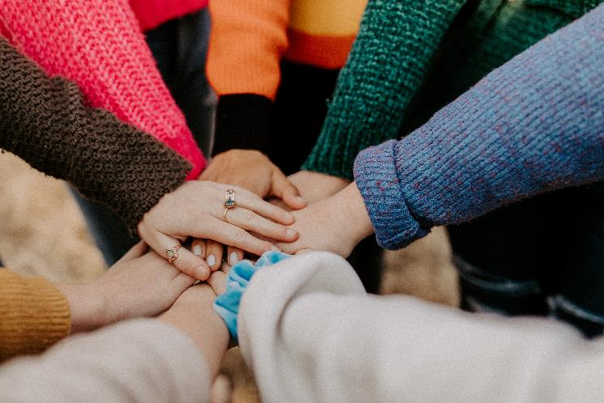
11.1 Diversity and Inclusion
Diversity is “the presence of differences among individuals in a group in terms of various aspects (e.g., gender, attraction, race, class, ability, etc) that may create advantages or barriers to opportunities and resources because of historical and ongoing systems of oppression.
Photo by Hannah Busing on Unsplash
Notes:
It is important to remember that only groups and not individuals should be described as diverse, and that the existence of diversity in any given environment does not necessarily signal that it is an inclusive or equitable environment” (Egale, 2022, p. 17).

Slide 4
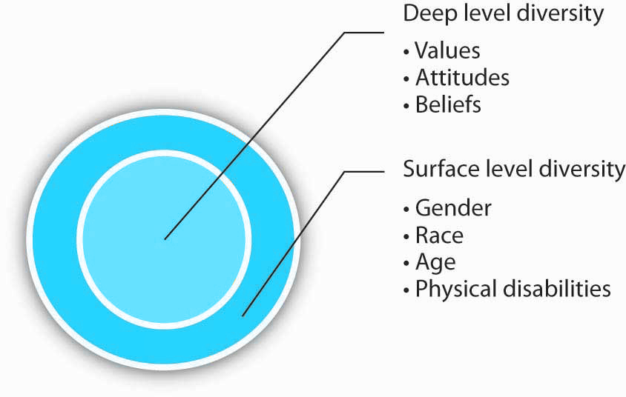
11.1 Diversity and Inclusion II
Surface-level, Deep-level, and Hidden Diversity
Notes:
Surface diversity, deep diversity, and deep diversity are categories of personal attributes—or differences in attributes—that people perceive to exist between people or groups of people.
Surface-level diversity refers to differences you can generally observe in others, like ethnicity, race, gender, age, culture, language, disability, etc. You can often quickly and easily observe these features in a person.
Deep-level diversity, on the other hand, reflects differences that are less visible, like personality, attitude, beliefs, and values. These attributes are generally communicated verbally and non-verbally, so they are not easily noticeable or measurable.
Hidden diversity includes traits that are deep-level but may be concealed or revealed at the discretion of individuals who possess them (Lambert & Bell, 2013). These hidden traits are called invisible social identities (Clair et al., 2005) and may include sexual orientation, a hidden disability (such as a mental illness or chronic disease), racial heritage (Phillips et al., 2009) or socioeconomic status.

Slide 5
11.1 Diversity and Inclusion III
Inclusion means acknowledging systems of oppression, respecting diversity, and providing opportunities for everyone to have a voice (Egale, 2022).
Photo by Tim Mossholder on Unsplash

Slide 6
11.2 Dimensions of Diversity I
Eight Dimensions of Diversity:
Race
Ethnicity
Nationality
Sex
Gender
Sexual Orientation
Religion
Ability

Slide 7
11.2 Dimensions of Diversity
Race
Race is often difficult to talk about, not because of the inherent complexity of the term itself, but because of the role that race plays in society. Race is what we call a loaded word because it can bring up strong emotions and connotations.
Photo by Joeyy Lee on Unsplash
Notes:
Understandings of race fall into two camps: a biological versus a sociopolitical construction of what it means to belong to a particular racial group. A biological construction of race claims that “pure” races existed and could be distinguished by such physical features as eye color and shape, skin color, and hair.

Slide 8
11.2 Dimensions of Diversity II
Ethnicity
Ethnicity refers to a person’s or people’s heritage and history and involves shared cultural traditions and beliefs.
Photo by Agung Pratamah on Unsplash
Notes:
Many Canadians identify with several ethnicities (-Canadian). There has been much debate about whether and how information about race and ethnicity in Canada should be tracked (if at all).

Slide 9
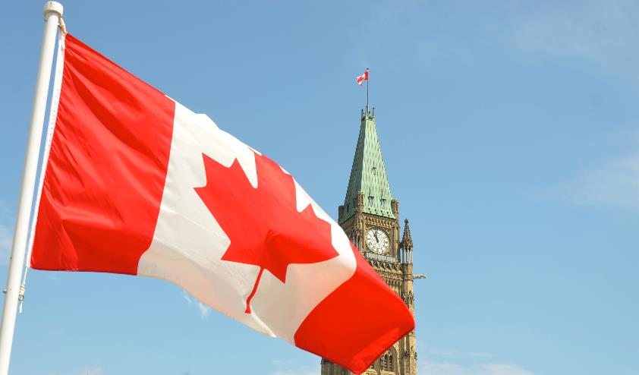
11.2 Dimensions of Diversity III
Nationality
Nationality refers to a people’s nation-state of residence or where they hold citizenship.
Photo by Jason Hafso on Unsplash
Notes:
Most often nationality is derived from the country where one was born, but on occasion people give up their citizenship by birth and migrate to a new country where they claim national identity. For example, an individual could have been born and raised in another country but once they migrate to the Canada and have citizenship, their nationality becomes Canadian.

Slide 10
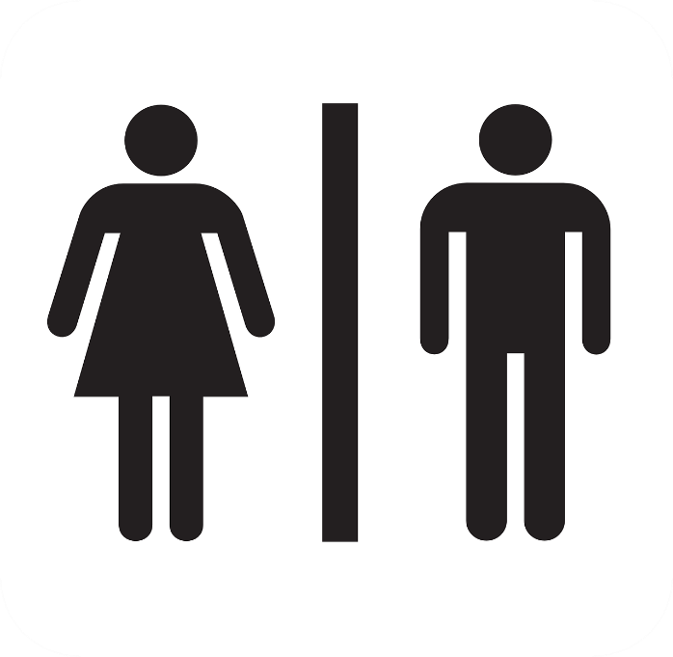
11.2 Dimensions of Diversity IV
Sex
A person’s sex is a label, often designated by doctors at birth as male or female, based on an individual’s genitals, hormones, and/or chromosomes.
Picture Source- Pixabay
Notes:
According to the Intersex Society of North America, “intersex” is a general term used when a person is born with a reproductive or sexual anatomy that doesn’t seem to fit the typical definitions of female or male. For example, a person might be born appearing to be female on the outside but having mostly male-typical anatomy on the inside. Or a person may be born with mosaic genetics, so that some of her cells have XX chromosomes and some of them have XY. It is important to note that male, female, and intersex aren’t discrete categories, just labels based on social convention.

Slide 11
11.2 Dimensions of Diversity V
Gender
Gender is, “the social construction of masculinity or femininity as it aligns with designated sex at birth in a specific culture and time period.” (Pettitt)
Picture Source- Pixabay
Notes:
An individual is said to be cisgender if the gender that they identify is consistent the sex that they were assigned at birth. When an individual does not identify with the gender of the sex that they were assigned at birth, they may identify as transgender.

Slide 12
11.2 Dimensions of Diversity VI
Sexual Orientation
Sexual orientation refers to a person’s preference for sexual or romantic relationships; one may prefer a partner of the same sex, the opposite sex, both, or none.

Slide 13
11.2 Dimensions of Diversity VII
Religion
Employers are required to respect and accommodate an individual’s religion (aka creed).

Slide 14
11.2 Dimensions of Diversity VIII
Ability
It is illegal to harass or discriminate in the workplace because of a visible or hidden disability.

Slide 15
11.3 Diversity in the Workplace – Benefits and Challenges I
Benefits of Diversity
Higher Creativity in Decision Making
Better Understanding and Service of Customers
More Satisfied Workforce
Market Reputation
Lower Litigation Expenses
Higher Company Performance
Notes:
An important potential benefit of having a diverse workforce is the ability to make higher quality decisions. In a diverse work team, people will have different opinions and perspectives. In these teams, individuals are more likely to consider more alternatives and think outside the box when making decisions.
A company with a diverse workforce may create products or services that appeal to a broader customer base. For example, PepsiCo Inc. planned and executed a successful diversification effort in the recent past. The company was able to increase the percentage of women and ethnic minorities in many levels of the company, including management
When employees feel that they are fairly treated, they tend to be more satisfied. On the other hand, when employees perceive that they are being discriminated against, they tend to be less attached to the company, less satisfied with their jobs, and experience more stress at work (Sanchez & Brock, 1996).
Companies that do a better job of managing a diverse workforce are often rewarded in the stock market, indicating that investors use this information to judge how well a company is being managed.
Companies doing a particularly bad job in diversity management face costly litigations. When an employee or a group of employees feel that the company is violating equity laws, they may file a com- plaint. The Ministry of Labour (MOL) acts as a mediator between the company and the person in cases where litigation is claimed due to unfair or unequal hiring practices, and the company may choose to settle the case outside the court.
As a result of all these potential benefits, companies that manage diversity more effectively tend to outperform others. Research shows that there is a positive relationship between racial diversity of the company and company performance.

Slide 16
11.3 Diversity in the Workplace – Benefits and Challenges II
Challenges of Diversity
Similarity-Attraction Phenomenon
Faultlines
Stereotypes
Notes:
There is a tendency for people to be attracted to people similar to themselves (Riordan & Shore, 1997). Research shows that individuals communicate less frequently with those who are perceived as different from themselves (Chatman et al., 1998).
The similarity-attraction phenomenon may explain some of the potentially unfair treatment based on demographic traits.
A Faultline is an attribute along which a group is split into subgroups. For example, in a group with three female and three male members, gender may act as a Faultline because the female members may see themselves as separate from the male members.
An important challenge of managing a diverse workforce is the possibility that stereotypes about different groups could lead to unfair decision making. The assumption that women are more relationship oriented, while men are more assertive is an example of a stereotype.

Slide 17
11.4 Culture I
Intercultural Communication
All communication is intercultural. The term “intercultural communication” may conjure in your mind a picture of two people from different continents speaking or writing to one another.
Notes:
Considering the vast size of Canada and wide variety of cultures from the west coast to the Maritimes, however, or from northern communities to the border-lining south, or from Indigenous peoples to first-generation immigrants, all communication in Canada is intercultural.
Always approach intercultural communication as an opportunity to overcome cultural differences and achieve the cross-cultural understanding you need to be a better person and do your job effectively in a multicultural environment.

Slide 18
11.4 Culture II
Common Cultural Characteristics
Rites of Initiation and Adopting a Common Language
Common Values and Goals
Notes:
Cultures tend to have a ritual for welcoming a new member. Some such rituals may be so informal as to be hardly noticed, such as when you are invited to lunch so your new team members can get to know you.
Cultures all hold values and principles that are commonly shared and communicated by established members to newer ones. Time and length of commitment are associated with an awareness of these values and principles so that new members, whether they are socialized at home, in school, or at work, may not have a thorough understanding of their importance.

Slide 19
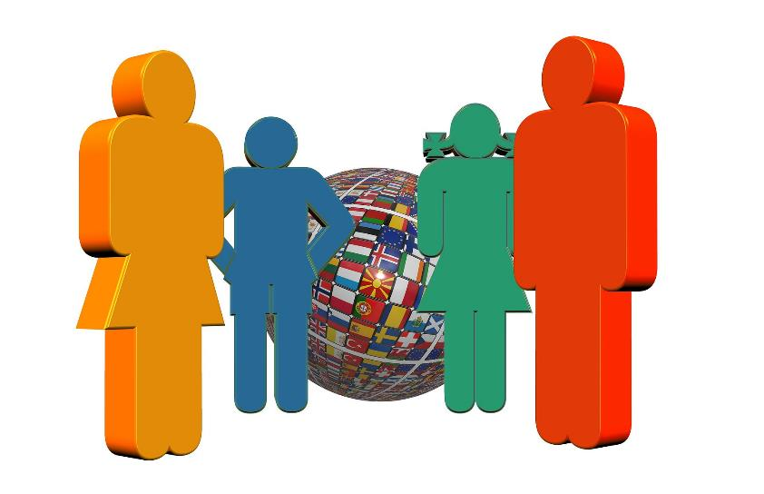
11.4 Culture III
Understanding and Respecting Cultural Differences
Successfully communicating across cultures requires understanding and respecting how the culture or cultures you represent differ from those of the people you’re communicating with.
Picture Source- Pixabay
Notes:
While you may think that you should just follow the golden rule and treat everyone else the way you would like to be treated yourself, the more you travel to distant lands, the more you realize that cultural conventions and expectations for how people would like to be treated are relative. One culture will place a high value on a friendly handshake and eye contact, while you would come off as aggressive or awkward if you did those things well in another.

Slide 20
11.5 Key Takeaways
In this chapter, we learned that there are many sources of human diversity. Some of these characteristics are surface-level and superficial, while other differences are deeper or hidden.
Canada is often celebrated for its policies on equity and multiculturalism. However, within Canadian society there are still ongoing systems of privilege and oppression that impact employment.
Biases and stereotypes based on surface-level characteristics can lead to discrimination in the workplace.
It is illegal to discriminate in Ontario workplaces on the basis of race, ethnicity, nationality, sex, gender, sexual orientation, religion, or ability.
All communication is intercultural communication, which requires an open attitude to understanding and accommodating cultural differences in the workplace to make business connections.
Using mindfulness (attention, intention, and attitude) we can become more culturally competent communicators.

