Slide 1
Psychology, Communication, and The Canadian Workplace
CHAPTER 5: LEARNING
Unless otherwise noted, this work is licensed under a Creative Commons Attribution-NonCommercial-ShareAlike 4.0 International (CC BY-NC-SA 4.0) license. Feel free to use, modify, reuse or redistribute any portion of this presentation.

Slide 2
Learning Outcomes
Upon successful completion of this chapter, you should be able to:
In this chapter, we will:
Define learning.
Describe different theories of learning, including classical conditioning, operant conditioning, and social learning.
Explain ways in which learning theories influence behaviour management in the workplace.

Slide 3
5.1 Learning I
Learning may be defined, for our purposes, as a relatively permanent change in behavior that occurs as a result of experience.
Photo by Tim Mossholder on Unsplash
Notes:
A person is said to have learned something when they consistently exhibit a new behavior over time.
First, learning involves a change in an attitude or behavior. This change does not necessarily have to be an improvement, however, and can include such things as learning bad habits or forming prejudices.
In order for learning to occur, the change that takes place must be relatively permanent

Slide 4
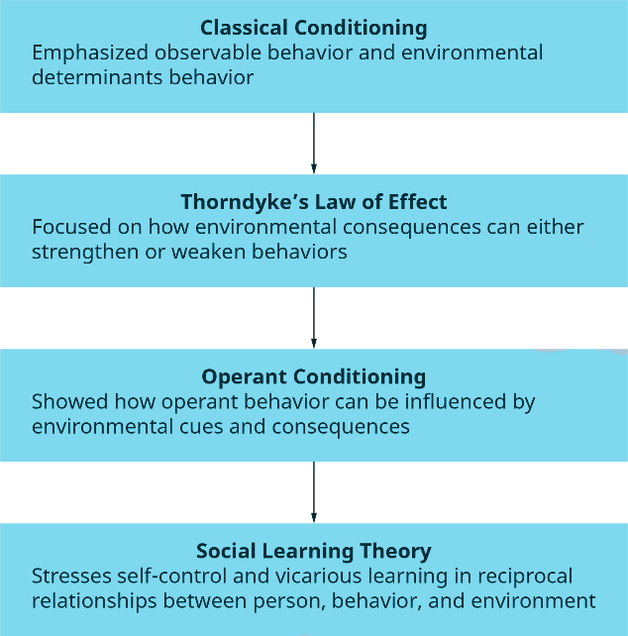
5.1 Learning II
Notes:
We can best understand the learning process by looking at four stages in the development of research on learning
Scientific interest in learning dates from the early experiments of Pavlov and others around the turn of the century.

Slide 5
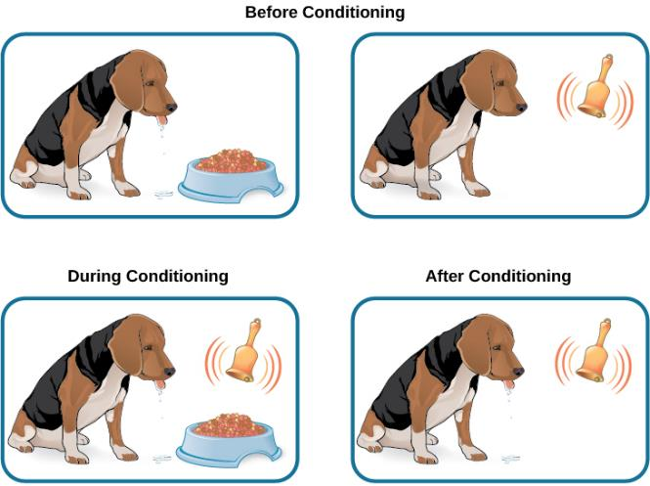
5.2 Classical Conditioning
Classical conditioning is the process whereby a stimulus-response (S-R) bond is developed between a conditioned stimulus and a conditioned response through the repeated linking of a conditioned stimulus with an unconditioned stimulus.
Notes:
Although classical conditioning may seem “old” or “too simple” a theory, it is still widely studied today for at least two reasons:
First, it is a straightforward test of associative learning that can be used to study other, more complex behaviors.
Second, because classical conditioning is always occurring in our lives, its effects on behavior have important implications for understanding normal and disordered behavior in humans.

Slide 6
5.3 Operant Conditioning
Operant conditioning theory is the simplest of the motivation theories. It basically states that people will do those things for which they are rewarded and will avoid doing things for which they are punished.
General Operant Model: Stimulus –> Response –> Consequence
Notes:
Operant conditioning focuses on the learning of voluntary behaviors (Skinner, 1953; Skinner, 1959; Skinner, 1971). The term operant conditioning indicates that learning results from our “operating on” the environment.
According to operant conditioning theory, we learn to behave in a particular fashion because of consequences that resulted from our past behaviors (SKinner, 1953).

Slide 7
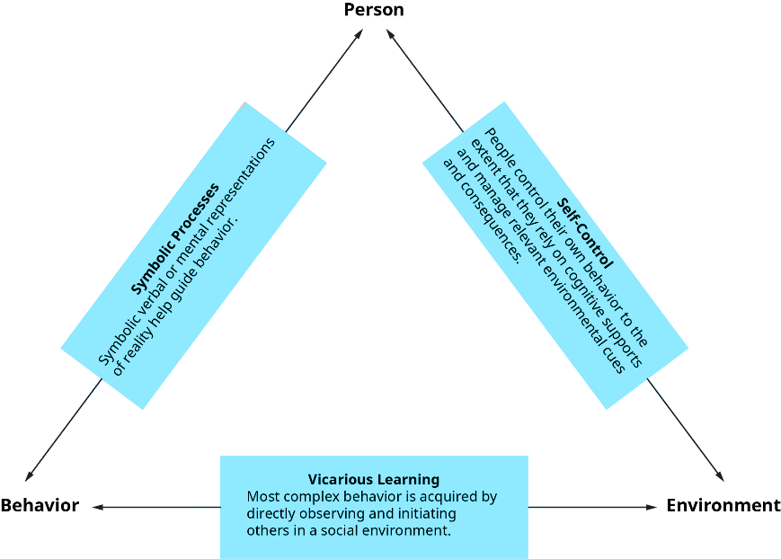
5.4 Social Learning Theory
Social learning theory is defined as the process of molding behavior through the reciprocal interaction of a person’s cognitions, behavior, and environment (Bandura, 1977).
Notes:
Social learning theory shares many of the same roots as operant conditioning. Like Skinner, Bandura argues that behavior is at least in part controlled by environmental cues and consequences, and Bandura uses observable behavior (as opposed to attitudes, feelings, etc.) as the primary unit of analysis
Social learning theory has four central elements: attention, retention, reproduction, and incentives

Slide 8
5.5 Learning at Work I
Major Influences on Learning
An individual’s desire to learn, background knowledge of a subject, and the length of the learning period are some of the components of a learning environment.
Photo by Brooke Cagle on Unsplash
Notes:
Considerable evidence also demonstrates that we can facilitate learning by providing individuals with feedback on their performance. A knowledge of results serves a gyroscopic function, showing individuals where they are correct or incorrect and furnishing them with the perspective to improve.

Slide 9
5.5 Learning at Work II
Organizational Behaviour Management
This is a systematic application of reinforcement theory to modify employee behaviours in the workplace. The model consists of five stages.
Notes:
The process starts with identifying the behaviour that will be modified. Let’s assume that we are interested in reducing absenteeism among employees.
In step 2, we need to measure the baseline level of absenteeism. How many times a month is a particular employee absent?
In step 3, the behaviour’s antecedents and consequences are determined. Why is this employee absent? More importantly, what is happening when the employee is absent?
In step 4, an intervention is implemented. Removing the positive consequences of negative behaviour may be an effective way of dealing with the situation, or, in persistent situations, punishments may be used.
Finally, in step 5 the behaviour is measured periodically and maintained.

Slide 10
5.6 Key Takeaways
Learning is a relatively permanent change in behavior that occurs as a result of experience.
Principles of classical conditioning can help us to understand stimulus-response associations that form in the workplace.
Reinforcement, punishment, avoidance learning, and extinction can all be used in the workplace to change behaviour.
Schedules of reinforcement can be used in the workplace to modify behaviour.
According to social learning theory, we can also learn behaviours through interaction with your thoughts, actions, and environment. We can also observe rewards and consequences from others and model this behaviour in a process called vicarious learning.
Our motivation, previous experiences, and other factors can help us to better understand how and why we learn.
Organizational behaviour management and behavioural self-management can be used to change behaviours in the workplace setting.

