Slide 1
Psychology, Communication, and The Canadian Workplace
CHAPTER 4: MOTIVATION
Unless otherwise noted, this work is licensed under a Creative Commons Attribution-NonCommercial-ShareAlike 4.0 International (CC BY-NC-SA 4.0) license. Feel free to use, modify, reuse or redistribute any portion of this presentation.

Slide 2
Learning Outcomes I
Upon successful completion of this chapter, you should be able to:
Define motivation.
Understand the role of motivation in determining employee performance.
Compare needs and process theories of motivation.
Recognize how fairness perceptions are determined and consequences of these perceptions on motivation in the workplace.
Identify ways to increase motivation in the workplace.

Slide 3
Learning Outcomes II
Explain how employees are motivated according to Maslow’s hierarchy of needs.
Explain how the ERG (existence, relatedness, growth) theory addresses the limitations of Maslow’s hierarchy.
Describe the differences among factors contributing to employee motivation and how these differ from factors contributing to dissatisfaction.
Describe need for achievement, power, and affiliation, and identify how these acquired needs affect work behaviour.
Describe how intrinsic and extrinsic factors influence motivation at work.

Slide 4
Learning Outcomes III
Explain how goal-setting influences motivation.
Describe the three types of fairness that affect employee attitudes and behaviours.
List the three questions individuals consider when deciding whether to put forth effort at work.
Describe how managers can use learning and reinforcement principles to motivate employees.

Slide 5
4.1 Motivation I
Motivation is defined as the desire to achieve a goal or a certain performance level, leading to goal-directed behaviour. Motivation is one of the forces that lead to performance.
Photo by Cristofer Maximilian on Unsplash
Notes:
When we refer to someone as being motivated, we mean that the person is trying hard to accomplish a certain task. Motivation is clearly important if someone is to perform well; however, it is not sufficient.
What inspires employees to provide excellent service, market a company’s products effectively, or achieve the goals set for them? Answering this question is of utmost importance if we are to understand and manage the work behaviour of our peers, subordinates, and even supervisors. Put a different way, if someone is not performing well, what could be the reason?

Slide 6
4.1 Motivation II
Notes:
What inspires employees to provide excellent service, market a company’s products effectively, or achieve the goals set for them? Answering this question is of utmost importance if we are to understand and manage the work behaviour of our peers, subordinates, and even supervisors. Put a different way, if someone is not performing well, what could be the reason?
Job performance is viewed as a function of three factors and is expressed with the equation above (Mitchell, 1982; Porter & Lawler, 1968). According to this equation, motivation, ability, and environment are the major influences over employee performance.

Slide 7
4.1 Motivation III
Motivation has two major components:
Direction: what a person wants to achieve, what they intend to do. It implies a target that motivated people try to “hit.”
Intensity: what we think of as effort. It represents the energy we expend to accomplish something.
Notes:
That target may be to do well on a test. Or it may be to perform better than anyone else in a work group.
If our efforts are getting nowhere, will we try different strategies to succeed? (High-intensity-motivated people are persistent!)
It is important to distinguish the direction and intensity aspects of motivation. If either is lacking, performance will suffer. A person who knows what they want to accomplish (direction) but doesn’t exert much effort (intensity) will not succeed.

Slide 8
4.2 Need-Based Theories of Motivation I
Five Need-Based Theories of Motivation
Maslow’s Hierarchy of Needs
ERG Theory
Two-factor Theory
McClelland’s Acquired Needs
Self-determination Theory
Notes:
Need-based theories describe motivated behaviour as individuals’ efforts to meet their needs. According to this perspective, the manager’s job is to identify what people need and make the work environment a means of satisfying these needs.

Slide 9
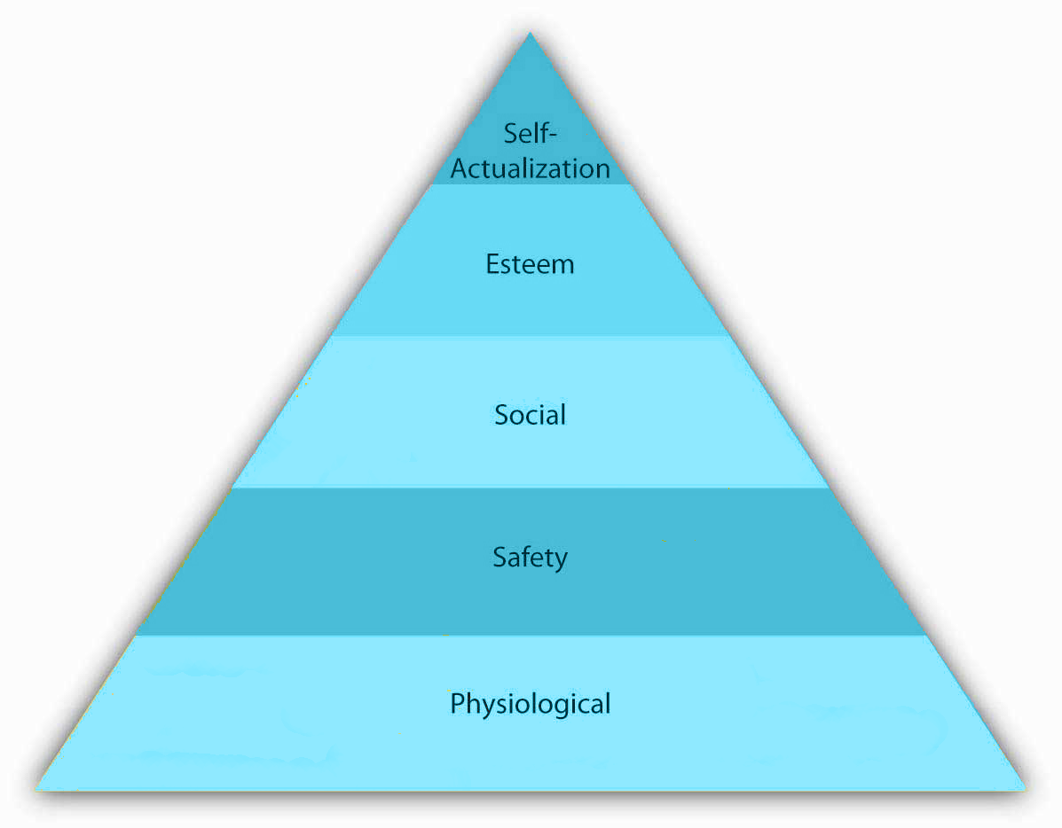
4.2 Need-Based Theories of Motivation II
Abraham Maslow’s hierarchy of needs is an image familiar to most business students and managers.
The theory is based on a simple premise: Human beings have needs that are hierarchically ranked (Maslow, 1943; Maslow, 1954)
Notes:
There are some needs that are basic to all human beings, and in their absence nothing else matters. As we satisfy these basic needs, we start looking to satisfy higher order needs. In other words, once a lower level need is satisfied, it no longer serves as a motivator.
The most basic of Maslow’s needs are physiological needs. Physiological needs refer to the need for food, water, and other biological needs. These needs are basic because when they are lacking, the search for them may overpower all other urges. Imagine being very hungry.
Once physiological needs are satisfied, people tend to become concerned about safety needs. Are they free from the threat of danger, pain, or an uncertain future?
social needs refer to the need to bond with other human beings, be loved, and form lasting attachments with others.
Esteem need refers to the desire to be respected by one’s peers, feel important, and be appreciated
at the highest level of the hierarchy, the need for self-actualization refers to “becoming all you are capable of becoming.” This need manifests itself by the desire to acquire new skills, take on new challenges, and behave in a way that will lead to the attainment of one’s life goals.

Slide 10
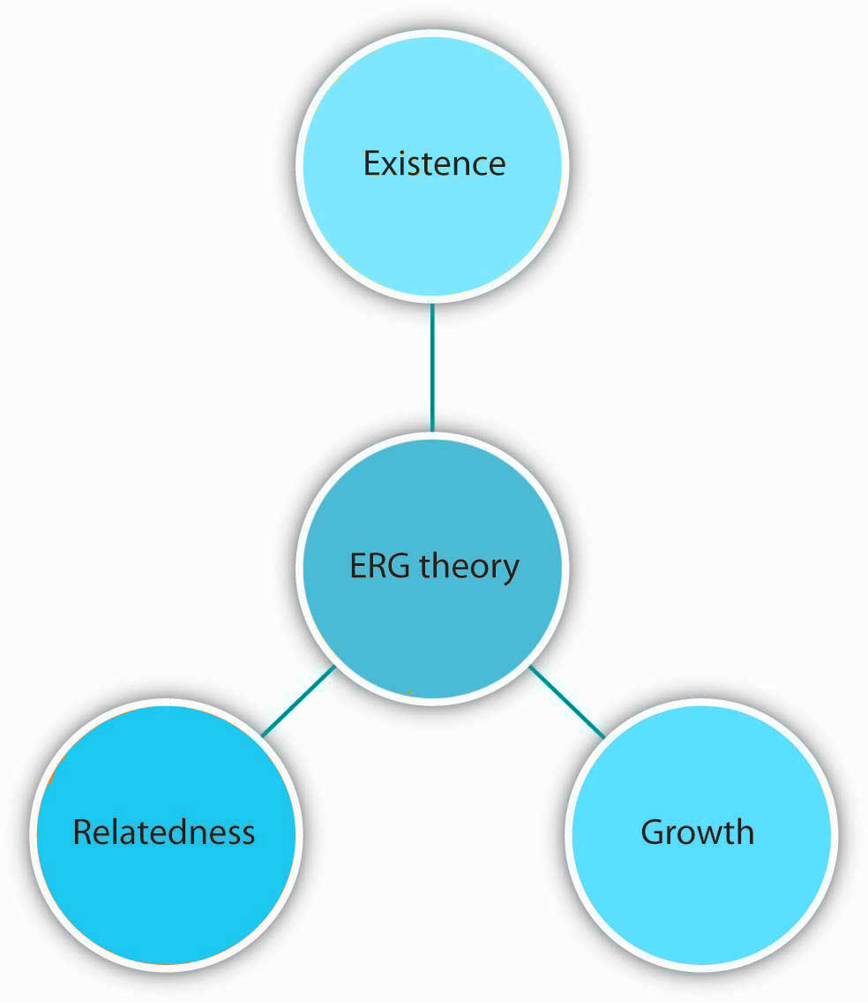
4.2 Need-Based Theories of Motivation III
ERG theory, developed by Clayton Alderfer, is a modification of Maslow’s hierarchy of needs (Alderfer, 1969).
Instead of the five needs that are hierarchically organized, Alderfer proposed that basic human needs may be grouped under three categories, namely, existence, relatedness, and growth.
Notes:
Existence needs include physiological and material safety needs. These needs are satisfied by material conditions and not through interpersonal relations or personal involvement in the work setting.
Relatedness needs include all of Maslow’s social needs, plus social safety and social esteem needs. These needs are satisfied through the exchange of thoughts and feelings with other people.
Growth needs include self-esteem and self-actualization needs. These needs tend to be satisfied through one’s full involvement in work and the work setting.

Slide 11
4.2 Need-Based Theories of Motivation IV
Two-factor Theory
Frederick Herzberg approached the question of motivation in a different way. By asking individuals what satisfies them on the job and what dissatisfies them, Herzberg came to the conclusion that aspects of the work environment that satisfy employees are very different from aspects that dissatisfy them (Herzberg, Mausner, & Snyderman, 1959; Herzberg, 1965).

Slide 12
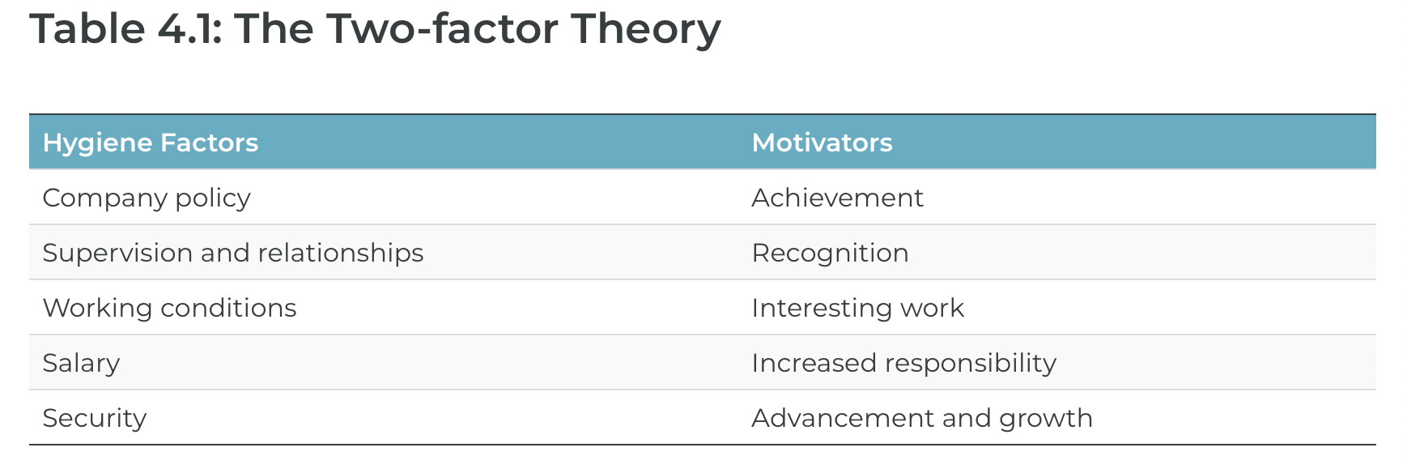
4.2 Need-Based Theories of Motivation V
Notes:
Herzberg labeled factors causing dissatisfaction of workers as “hygiene” factors because these factors were part of the context in which the job was performed, as opposed to the job itself. Hygiene factors included company policies, supervision, working conditions, salary, safety, and security on the job

Slide 13
4.2 Need-Based Theories of Motivation VI
Acquired Needs Theory
David McClelland’s acquired-needs theory is the one that has received the greatest amount of support. According to this theory, individuals acquire three types of needs as a result of their life experiences. These needs are the need for achievement, the need for affiliation, and the need for power.
Notes:
All individuals possess a combination of these needs, and the dominant needs are thought to drive employee behaviour. McClelland believes that these three needs are learned, primarily in childhood.
The need for achievement (nAch) is how much people are motivated to excel at the tasks they are performing, especially tasks that are difficult. Of the three needs studied by McClelland, nAch has the greatest impact.
The need for affiliation (nAff) reflects a desire to establish and maintain warm and friendly relationships with other people. As with nAch, nAff varies in intensity across individuals.
the need for power (nPow), is the need to control things, especially other people. It reflects a motivation to influence and be responsible for other people.

Slide 14
4.2 Need-Based Theories of Motivation VII
Self-Determination Theory
Self-determination theory (SDT) seeks to explain not only what causes motivation, but also how extrinsic rewards affect intrinsic motivation.
In SDT, extrinsic motivation refers to the performance of an activity in order to attain some valued outcome, while intrinsic motivation refers to performing an activity for the inherent satisfaction of the activity itself.
Notes:
SDT specifies when an activity will be intrinsically motivating and when it will not. Considerable numbers of studies have demonstrated that tasks are intrinsically motivating when they satisfy at least one of three higher-order needs: competence, autonomy, and relatedness.

Slide 15
4.3 Process-Based Theories I
Four Process-Based Theories
The Basic Goal-Setting Model
Equity Theory
Expectancy Theory
Reinforcement Theory
Notes:
A separate stream of research views motivation as something more than action aimed at satisfying a need. Instead, process-based theories view motivation as a rational process.
Individuals analyze their environment, develop thoughts and feelings, and react in certain ways. Process theories attempt to explain the thought processes of individuals who demonstrate motivated behaviour.

Slide 16
4.3 Process-Based Theories II
Goal theory states that people will perform better if they have difficult, specific, accepted performance goals or objectives.
Notes:
The first and most basic premise of goal theory is that people will attempt to achieve those goals that they intend to achieve. Thus, if we intend to do something (like get an A on an exam), we will exert effort to accomplish it.
The second basic premise is that difficult goals result in better performance than easy goals. This does not mean that difficult goals are always achieved, but our performance will usually be better when we intend to achieve harder goals.
Another premise of goal theory is that specific goals are better than vague goals. We often wonder what we need to do to be successful.
A key premise of goal theory is that people must accept the goal.

Slide 17
4.3 Process-Based Theories III
Equity Theory
According to this theory, individuals are motivated by a sense of fairness in their interactions. Moreover, our sense of fairness is a result of the social comparisons we make. Specifically, we compare our inputs and outcomes with other people’s inputs and outcomes.
Notes:
We perceive fairness if we believe that the input-to-outcome ratio we are bringing into the situation is similar to the input-to-outcome ratio of a comparison person, or a referent
Inputs are the contributions people feel they are making to the environment. In the previous example, the person’s hard work; loyalty to the organization; amount of time with the organization; and level of education, training, and skills may have been relevant inputs.
Outcomes are the perceived rewards someone can receive from the situation. For the hourly wage employee in our example, the $10 an hour pay rate was a core outcome. There may also be other, more peripheral outcomes, such as acknowledgment or preferential treatment from a manager.
Summary: employees are demotivated when they view reward distribution as unfair. Perceptions of fairness are shaped by the comparisons they make between their inputs and outcomes with respect to a referent’s inputs and outcomes. Following equity theory, research identified two other types of fairness (procedural and interactional) that also affect worker reactions and motivation.

Slide 18
4.3 Process-Based Theories IV
Expectancy Theory
Notes:
According to expectancy theory, individual motivation to put forth more or less effort is determined by a rational calculation in which individuals evaluate their situation (Porter & Lawler, 1968; Vroom, 1964). According to this theory, individuals ask themselves three questions.
The first question is whether the person believes that high levels of effort will lead to outcomes of interest, such as performance or success. This perception is labeled expectancy.
The second question is the degree to which the person believes that performance is related to subsequent outcomes, such as rewards. This perception is labeled instrumentality.
Finally, individuals are also concerned about the value of the rewards awaiting them as a result of performance. The anticipated satisfaction that will result from an outcome is labeled valence.
Summary: employees are motivated when they believe that their effort will lead to high performance (expectancy), when they believe that their performance will lead to outcomes (instrumentality), and when they find the outcomes following performance to be desirable (valence).

Slide 19
4.3 Process-Based Theories
Reinforcement Theory
Reinforcement theory is based on the work of Ivan Pavlov on behavioural conditioning and the later work of B. F. Skinner on operant conditioning (Skinner, 1953).
According to reinforcement theory, behaviour is a function of its outcomes. Imagine that even though no one asked you to, you stayed late and drafted a report.
Notes:
Reinforcement theory is based on a simple idea that may be viewed as common sense. Beginning at infancy we learn through reinforcement. If you have observed a small child discovering the environment, you will see reinforcement theory in action.
Despite the simplicity of reinforcement, how many times have you seen positive behaviour ignored, or worse, negative behaviour rewarded? In many organizations, this is a familiar scenario. People go above and beyond the call of duty, yet their actions are ignored or criticized

Slide 20
4.4 Influencing Motivation at Work
The emotional intelligence skill of self-awareness is the key to understanding your own motivations. It isn’t until we understand our own emotions that we can begin to understand what we need to do to motivate ourselves personally and professionally.
Notes:
Of course, the more motivated we are, the more likely we are to experience career success.
Most, if not all, managers want to hire and promote people who show extensive motivation in their job. This is impossible to do if we do not first identify what actually motivates us as individuals.
When we are happier we tend to show better human relations skills, and this happiness can come in part from understanding our own motivations and making sure we choose a career path that matches with our motivations.

Slide 21
4.5 Key Takeaways
Motivation can be understood in terms of the direction and intensity of our efforts.
Our performance in the workplace can be understood by examining not only motivation, but also ability and environmental factors.
Several theories view motivated behaviour as attempts to satisfy needs.Based on this approach, managers would benefit from understanding what people need so that the actions of employees can be understood and managed.
Other theories explain motivated behaviour using the cognitive processes of employees. Employees respond to unfairness in their environment, they learn from the consequences of their actions and repeat the behaviours that lead to positive results, and they are motivated to exert effort if they see their actions will lead to outcomes that would get them desired rewards.
None of these theories are complete on their own, but each theory provides us with a framework we can use to analyze, interpret, and manage employee behaviours in the workplace and design strategies to increase motivation in the workplace.
A variety of strategies are used in the workplace to increase motivation including pay, training, job design, empowerment, and “perks”..

