Slide 1
Strategic Project Management: A Practical Introduction for HR Professionals
Chapter 9: Project Closure and Evaluation
Unless otherwise noted, this work is licensed under a Creative Commons Attribution-NonCommercial-ShareAlike 4.0 International (CC BY-NC-SA 4.0) license. Feel free to use, modify, reuse or redistribute any portion of this presentation.

Slide 2
9.1 Learning Objectives
By the end of this chapter you should be able to:
Discuss the importance of getting the fundamentals right and keeping them right throughout a project.
Explain the value of project reviews and audits.
Describe issues related to correcting course mid-project and decisions about terminating a project.
Discuss the project closure phase.
Recognize the importance of concluding a project with lesson learned.

Slide 3
9.2 Reasons for Closing Projects
Low profitability and/or lowered market potential
Competing projects become a higher priority
Severe delays to schedule
Change in market needs
Technical issues that cannot be resolved
Increase in damaging costs
High uncertainty of technical success or commercial pain
HR Role
Human Resources could assist with the decision to terminate a project (not in a direct manner), rather facilitate the process with the team
Act as guides in the situation
Can help the team make the decision, plan a different outcome, and ensure commitment
Support the team on an emotional level if project is terminated
Notes:
If an audit reveals that it’s time to terminate a project, then it’s important to realize that this is not necessarily a bad thing:
Determining whether to terminate a project can be a very difficult decision for people close to a project to make. Your perspective on a project has a huge effect on your judgment of its overall success. That is why a review conducted by an objective, external auditor can be so illuminating.

Slide 4
9.2 Supporting Team through Termination of Projects
HR needs to be sensitive to the feelings of the group/team
HR needs to listen, use verbal and non-verbal communication, show empathy, focus on issues not feelings
Provide a structure and process that leads to a shared conclusion about the project
Control the flow of the meeting, ask questions, may provide direct interventions
Debrief with individuals post project, set new personal goals
Create a culture of respect and teamwork going forward that aligns with the strategic goals of the organization

Slide 5
9.3 Contract Closing and Audits
Project Closure
Just as a project comes to a close contract also comes to a close.
Contract closure updates the project records, detailing the final results of the work on the project.
Contract closure process is to provide formal notice to the seller.
Project Audit
Is formal review of the project that assesses the standards of the project management, ensures the standards were met
Carried out by the Project Manager and team, Human Resources (if they were involved with the project from the beginning), financial department, and any other involved stakeholders
Acceptance of the product/service is required by the customer/vendor
Notes:
Quality audits have been performed during the course of the project, and the vendor was given the opportunity to make corrections earlier in the process than the closing phase. It’s not a good idea to wait until the very end of the project and then spring all the problems and issues on the vendor at once. It’s much more efficient to discuss problems with your vendor as the project progresses because it provides the opportunity for correction when the problems occur.
Procurement Contracts - The performance of suppliers and vendors is reviewed to determine if they should still be included in the list of qualified suppliers or vendors. The choice of contract for each is reviewed to determine if the decision to share risk was justified and if the choice of incentives worked.

Slide 6
9.4 Releasing the Resources
Releasing the Project Team
Team members return to their functional work or a new project, or if consultants are released
A celebration of a successful project is a great opportunity at this phase
Human Resources would complete the transition for the team
Releasing Final Payments
If the supplier has met all the contractual obligations, including fixing problems and making repairs as noted on a punch list, the project team signs off on the contract and submits it to the accounting department for final payment.
Releasing Materials and Equipment
Equipment and materials returned
Notes:
The final payment is usually more than a simple percentage of the work that remains to be completed. Completing the project might involve fixing the most difficult problems that are disproportionately expensive to solve, so the final payment should be large enough to motivate the vendor to give the project a high priority so that the project can be completed on time.

Slide 7
9.4 Human Resources Role for Re-Entry
Meet with the team to develop timeliness for return to regular work
Meet with individuals to discuss return to work plan
Develop a return to work plan (dates, salary/benefits, new goals)
Provide references for individuals for future
Inform Functional Manager of the return to work plan
Document the return to work plan
If an external hire, the contract is finalized and paid in full for work completed

Slide 8
9.5 Reporting
The Final Report provides a final summary of the project performance
It could include the following:
Summary of project and deliverables
Data on performance related to schedule, costs, quality
Summary of the final product/service
Risks encountered and how they were managed
Recommendations (for future projects)
Lessons Learned
Appendix

Slide 9
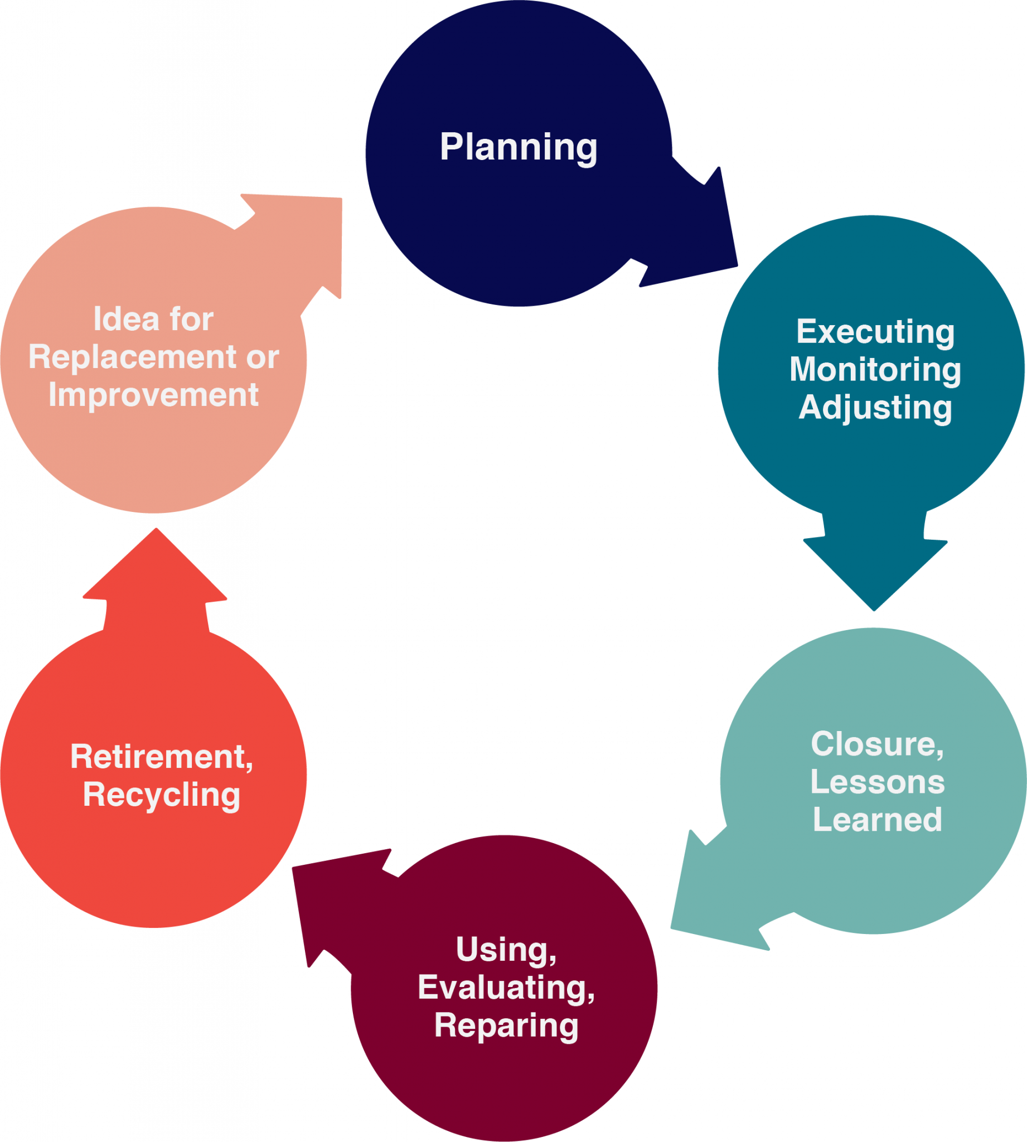
9.5 Closure Phase Tasks
Project closure is traditionally considered the final phase of a project. It includes tasks such as:
Transferring deliverables to the customer.
Cancelling supplier contracts.
Reassigning staff, equipment, and other resources.
Finalizing project summarizing the project’s ups and downs.
Making the documentation accessible to other people in your organization.
Figure 9‑1: Seen from a living order perspective, closure is an extension of the learning and adjusting process that goes on throughout a project.
Notes:
The close-out report provides a final summary of the project performance. It should include the following:
Summary of the project and deliverables
Data on performance related to schedule, cost, and quality
Summary of the final product, service, or project and how it supports the organization’s business goals
Risks encountered and how they were mitigated
Lessons learned
If project closure is done thoughtfully and systematically, it can help ensure a smooth transition to the next stage of the project’s life cycle, or to subsequent related projects.

Slide 10
9.5 HR and Lessons Learned
The Close-Out Workshop or Lessons Learned Workshop is an opportunity to end the project with the team
Human Resources would design and facilitate the workshop
Not a time to make recommendations, rather a time to reflect back
Review: what went well? What did not go well? Identify areas of improvement
Summarized into a Close Out Report
The Lessons Learned Report could be used by project teams in the future to better plan the outcomes of their project

Slide 11
9.6 Retrospectives
Retrospectives are a new process for closure of projects
Human Resources would design and send out questionnaires (operational impacts, impact the project has on the culture of the organization)
Answered anonymously and confidentially
Answers are analyzed and a report completed
Some of the issues might be: inner team conflict, poor organization, time management, discrimination, poor leadership,
Human Resources Specialist would meet with the team individually to discuss
Human Resources would facilitate a Retrospectives Workshop

Slide 12
9.6 Retrospectives Process
The Human Resources Specialist would facilitate a Retrospective Workshop
Team would review the results of the questionnaire and add any important information
Team would prioritize the information (issues)
They are often not called ”issues” as it denotes negativity. Rather promote a positive spin on the issue, may be called Lessons. Example: Time management could have been improved by (example included)
The Lesson is designated an owner (someone who has familiarity with the Lesson)
This person serves as a Contact person for anyone wishing more information
They may provide a more detailed reports, speak to other employees of future projects
The goals is to provide information that will benefit future projects to improve

Slide 13
9.7 Performance Evaluation
The purpose for the performance evaluation is to assess the project manager and the team on work performance and contribution to the project
Similar to traditional performance evaluations
Structured, formal, fair, in-depth process that promotes growth and development

Slide 14
9.7 Steps in the Performance Evaluation Process
Development of an evaluation form
Define the guidelines for feedback
Identification of the performance measures
Create reward and disciplinary steps
Establish a schedule

Slide 15
9.8 Performance Appraisals
Individual Performance Reviews:
Team Performance Reviews:
Project Manager Review:
HR meets with each team member separately (may work with Project Manager who is involved in the meetings)
HR meets with the entire team in a workshop setting, including the Project Manager, to review team successes and setbacks
HR meets with Project Manager to review progress, successes, setbacks based on performance as well as budgets, deadlines, process improvements, relationships, communication, risk management, customer satisfaction. Other stakeholders may be involved in the Project Manager Review

