Slide 1
Strategic Project Management: A Practical Introduction for HR Professionals
Chapter 7: Scheduling, Resources and Budgets
Unless otherwise noted, this work is licensed under a Creative Commons Attribution-NonCommercial-ShareAlike 4.0 International (CC BY-NC-SA 4.0) license. Feel free to use, modify, reuse or redistribute any portion of this presentation.

Slide 2
7.1 Learning Objectives
By the end of this chapter, you should be able to:
Define terms related to scheduling.
Demonstrate how cost and time are summarized in a WBS.
Demonstrate the process of decomposition and numbering used to create a WBS.
Explain the difference between a deliverable and work package.
Differentiate top-down estimation and bottom-up methods.
Define basic terms such as budget, estimate, price, cost, and value.
Discuss the relationship between cost and budget.
Explain basic concepts related to budgeting.
Identify different types of costs, and discuss issues related to contingency funds, profit, and cost estimating.
Explain the benefits of contingencies.

Slide 3
7.2 Scheduling Resources, Benefits, Constraints
Resources are people, materials and equipment that come together to complete a project.
Project Managers need to ensure all the resources required are available for the project.
Constraints are when the resources are not available or limited.
Project Managers need to balance the resources and constraints to ensure success.
Once people, materials or equipment are placed on the schedule, it is important they are allocated as needed.
Project managers use a classification of scheduling in two ways: Time-constrained resources and Resource-constrained.
Notes:
Time-constrained resources: This would mean there is an imposed time frame for the project (the time cannot be changed.) Example: Planning a wedding. Once the date is decided, it will not change. Or, planning a New Year’s Eve party. We must hold it on January 31st.
Resource-constrained: There is an assumptions that all the resources will be available when and where they are needed. If the resources are not available or not adequate, the project could be delayed. Example: Two people are scheduled to paint a room. The contractor scheduled 8 hours with 2 people. One person was sick. Now, it will take 1 person 16 hours to paint the room. The cost is “time which is money”, and the contractor may need to pay the 1 person overtime.
Benefits of Scheduling People, Materials, Equipment
If resources are time-constrained or resource-constrained, it is important for Project Managers to plan a schedule ahead of time. This leaves time to look at different options.
Resource schedules allow time to prepare budgets and work plans (tasks, activities). Project Managers then can quickly assess if unanticipated events occur.
Project Managers can predict how much flexibility they have with resources over a period of time. This would be helpful if team members are sick or need to removed themselves from the project for a period of time.

Slide 4
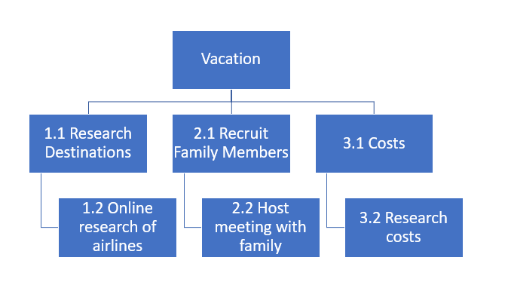
7.3 Work Breakdown Structures
The Work Breakdown Structure (WBS) is a hierarchical outline of all the deliverables involved in completing a project.
The WBS is part of a project scope statement.
The creation of a WBS is one of the first steps in organizing and scheduling the work for a project.
Figure 7‑1: The WBS is an outline that shows how the deliverables, sub-deliverables and work packages relate to the final project.

Slide 5
7.3 Deliverables vs. Work Packages
Deliverables and sub-deliverables are things such as physical objects, software code, or events. In a WBS, deliverables and sub-deliverables are represented by nouns.
Work packages are assignable units of work that will be performed to create the related deliverable. Work packages are action oriented and will be represented by phrases containing verbs.
Notes:
A work package can be assigned to one particular project team member, one outside contractor, or another team. The work packages maybe further broken down into activities or tasks by the project team or the experts who will perform that work (see WBS dictionary later in this section).

Slide 6
7.3 WBS Numbering or Coding
Project managers use the WBS during project execution to track the status of deliverables and work packages.
The items in a WBS are numbered so it is easy to understand the deliverable, or sub-deliverable, to which any particular work package is related.
Decomposition is the process used to break the project scope of work into the deliverables, sub-deliverables, and work packages involved in completing the project.

Slide 7
7.4 Defining Activities
An activity is a process of further breakdown of the work package elements of the work breakdown structures (WBS)
It documents the specific activities needed to fulfill the deliverables detailed in the Work Breakdown Structure (WBS)
These activities are not the deliverables themselves but the individual units of work that must be completed to fulfill the deliverables.
Notes:
Activity definition uses everything we already know about the project to divide the work into activities that can be estimated.

Slide 8
7.5 Time Estimation
Estimates have a huge influence on a project and are a large source of project risk.
Helps with good decisions about approval
Helps schedule the work
Determines how long the project with take to complete
Decide if it is worth doing the project
Helps to decide how much money is needed for project
Helps stakeholders know how well the project is moving forward

Slide 9
7.5 Top Down (Macro) Estimation
Top-down, or macro, estimation methods allow for a quick estimate of project costs based on historical information.
Analogous Estimating
Parametric Estimating
Learning Curves
Notes:
These methods are not extremely accurate but provide a relatively fast way to make an estimate of the time and costs required for a project.
Top-down, or macro, estimation methods allow for a quick estimate of project costs based on historical information.

Slide 10
7.5 Bottom Up (Micro) Estimations
Bottom up, or micro, estimation techniques are used when the project is approved or is very likely to be approved.
Bottom up estimates are more accurate, detailed and take more time to generate.
Single Point Estimate
Three Points Estimate
Notes:
All estimates contain risk. If estimates are too low, then a project will take more time and money to complete than what was budgeted.
Bottom up, or micro, estimation techniques are used when the project is approved or is very likely to be approved.

Slide 11
7.6 Managing the Schedule
The project schedule is important as it serves as a baseline to measure time and costs.
There are 2 common, visual methods to display schedules:
The Gantt Chart
The Network Diagram

Slide 12
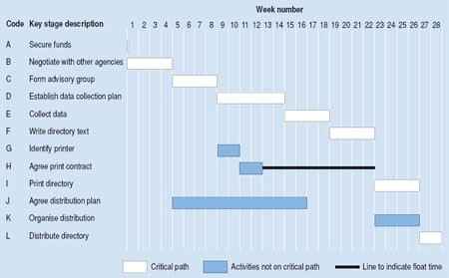
7.6 The Gantt Chart
A Gantt chart is a type of bar chart, developed by Henry Gantt, that illustrates a project schedule.
These charts display the start and finish dates of the terminal elements and summary elements of a project
Figure 7‑5: Gantt Chart
Notes:
Gantt charts are easy to read and are commonly used to display schedule activities.
These charts display the start and finish dates of the terminal elements and summary elements of a project. Terminal elements and summary elements comprise the work breakdown structure of the project.

Slide 13
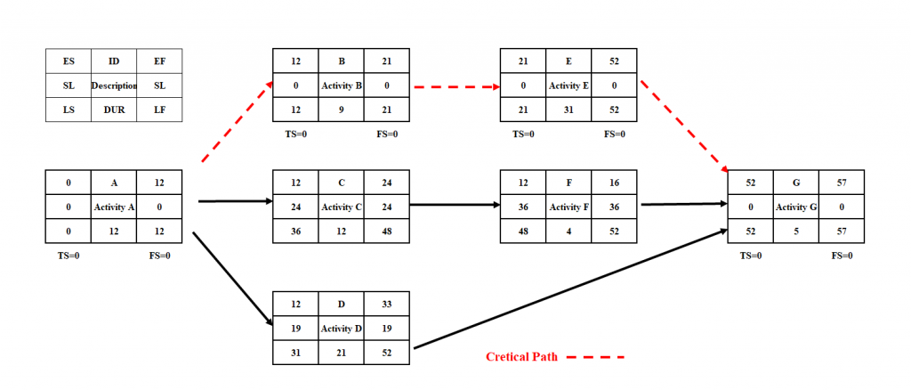
7.6 The Network Diagram
The network diagram is a way to visualize the interrelationships of project activities
Figure 7‑6: An example of an activity on node (AON) diagram
Notes:
Network diagrams provide a graphical view of the tasks and how they relate to one another.
The tasks in the network are the work packages of the WBS. All of the WBS tasks must be included in the network because they have to be accounted for in the schedule.
Leaving even one task out of the network could change the overall schedule duration, estimated costs, and resource allocation commitments.

Slide 14
7.7 Estimating Resources
Primary resources are people, equipment, and often, places, money, or anything else that you need in order to do all of the activities that you planned for.
The goal of activity resource estimating is to assign resources to each activity in the activity list.
Resource management is the efficient and effective deployment of an organization’s resources when they are needed.
One resource management technique is resource leveling. It aims at smoothing the stock of resources on hand, reducing both excess inventories and shortages.

Slide 15
7.8 Estimating Costs
Types of costs:
Direct Costs
Indirect Costs
Direct Project Overhead Costs
General/Administrative Overhead Costs
An expense traced directly to the project (product/service) ie. Trainer’s wages
An expense not directly related to the project, yet costs of the project ie. Purchase of audio/visual equipment
An expense tied to specific resources in the organization that are used in the project ie. Photocopier
Indirect costs of running a business that supports the project ie. IT support

Slide 16
7.8 Tools for Estimating Cost
Determination of Resource Cost Rates
Vendor Bid Analysis
Reserve Analysis
Cost of Quality
Notes:
Determination of Resource Cost Rates: People who will be working on the project all work at a specific rate. Any materials you use to build the project (e.g., wood or wiring) will be charged at a rate too. Determining resource costs means figuring out what the rate for labor and materials will be.
Vendor Bid Analysis: Sometimes you will need to work with an external contractor to get your project done. You might even have more than one contractor bid on the job. This tool is about evaluating those bids and choosing the one you will accept.
Reserve Analysis: You need to set aside some money for cost overruns. If you know that your project has a risk of something expensive happening, it is better to have some cash available to deal with it. Reserve analysis means putting some cash away in case of overruns.
Cost of Quality: You will need to figure the cost of all your quality-related activities into the overall budget. Since it’s cheaper to find bugs earlier in the project than later, there are always quality costs associated with everything your project produces. Cost of quality is just a way of tracking the cost of those activities. It is the amount of money it takes to do the project right.

Slide 17
7.9 Understanding Budgets
A budget is a decision made on the amount of money that will be spent on a project and how it will be spent.
A Project Budget is a combination of all the activities’ milestones and tasks in the project.
It is important to the project to:
Secure the funding
Financial viability in a direct way to the company
Cost control can be maintained

Slide 18
7.10 Creating a Project Budget
A simple budget can be created in 5 steps:
Break project into small tasks and milestones
Estimate each task and milestone
Add the estimates all together
Add in any contingencies/taxes/other costs
Seek Approval

Slide 19
7.11 Contingency Funds
In addition to creating the project plan, you need to create a contingency plan, which is a plan for addressing key possible obstacles to project success.
A contingency plan typically includes a contingency fund, which is an amount of resources set aside to cover unanticipated costs.
No matter how thoroughly you plan a project, you will inevitably miss at least a few small issues.
A contingency fund is not designed to manage major deviations or scope changes.

Slide 20
7.12 Managing Budgets
Project Manager manages the budget once approved
Project Manager is responsible to monitor financial performance of the project and make financial decisions
The budget is evaluated regularly as to whether the project is ahead, behind or on track with spending
Reports are completed on “actual spending” within a certain period of time (monthly, quarterly, yearly)
When a budget is overspent, the Project Manager needs to take corrective action

