Slide 1
Strategic Project Management: A Practical Introduction for HR Professionals
Chapter 6: Risk Management
Unless otherwise noted, this work is licensed under a Creative Commons Attribution-NonCommercial-ShareAlike 4.0 International (CC BY-NC-SA 4.0) license. Feel free to use, modify, reuse or redistribute any portion of this presentation.

Slide 2
6.1 Learning Objectives
By the end of this chapter, you should be able to:
Distinguish between risks and issues.
Describe the role of risk management in project success.
Identify types of risks.
Explain the risk management process.
Describe the five responses in risk management.

Slide 3
6.2 Risk Management and Project Success
Successful project managers manage the differing perceptions of risk, and the widespread confusion about its very nature, by engaging in systematic risk management.
Risk management is the process of identifying, quantifying, and managing the risks that an organization faces.
Project management can be thought of as an exercise in risk management .
The tasks specifically associated with risk management include
Identifying the types of risk exposure within the company
Measuring those potential risks through Risk Assessment
Proposing means to Mitigate, Transfer, Avoid, Retain the risks through Risk Response Matrix (contingency plan)
Notes:
Perhaps the most important risk management tool is your own ability to learn about the project. The more you know about a project, the better you will be at foreseeing the many ways the project could go awry and what the consequences will be if they do, and the better you will be at responding to unexpected challenges.

Slide 4
6.2 Risk Matrix
Risk is identified by the impact and probability (severity) the risk will have on the project through a Risk Matrix.
Figure 6‑1: A risk matrix is a tool engineers often use to manage risk

Slide 5
6.3 The 5 Steps of the Risk Management Process
Risk Management Planning
Risk Identification
Risk Assessment
Risk Response Plan
Monitoring and Controls
Notes:
A risk mitigation plan is designed to eliminate or minimize the impact of the risk events—occurrences that have a negative impact on the project. Identifying risk is both a creative and a disciplined process.

Slide 6
6.3 Risk Management Planning
Project Manager and group (can include Human Resources and other stakeholders) build a plan
They come to an agreement on the parameters and risk levels of the project
The results are documented

Slide 7
6.3 Risk Identification
First step in the process
The use of a checklist is a disciplined process; a brainstorm session is informal
Risks can be identified from prior projects
Examples of risks include: technical, cost, schedule, client, contractual, weather, financial, political, environmental, people
A Risk Breakdown Structure (RBS) can be used to organize the risks (similar to a WBS)
Notes:
You can use the same framework as the work breakdown structure (WBS) for developing a risk breakdown structure (RBS). A risk breakdown structure organizes the risks that have been identified into categories using a table with increasing levels of detail to the right.
After the potential risks have been identified, the project team then evaluates each risk based on the probability that a risk event will occur and the potential loss associated with it. Not all risks are equal. Some risk events are more likely to happen than others, and the cost of a risk can vary greatly.

Slide 8
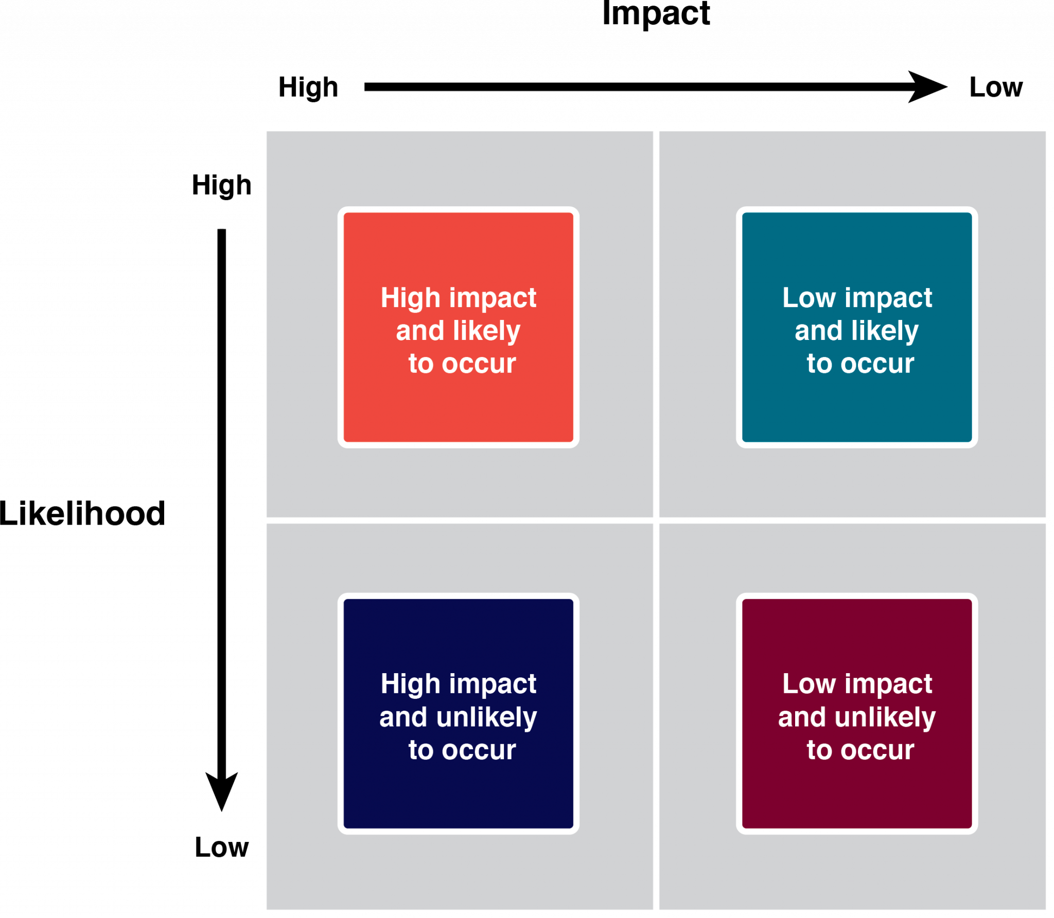
6.3 Risk Assessment
Developing an understanding of which potential risks have the greatest possibility of occurring and can have the greatest negative impact on the project
Figure 6‑2: Risk and Impact

Slide 9
6.3 Risk Assessment Matrix
Risk Event | Likelihood | Impact | Detection Difficulty | Risk Rating | When
Risk Event: What is the actual risk event that you have identified?
Likelihood: How likely is the event to occur? Scale: 1 = Not Likely to 5 = Very Likely
Cost Impact: What is the cost of the event? Scale: 1 = Low cost to 5 = High Cost
Time Impact: How much time will be lost? Scale: 1 = Little Time to 5 = Lots of Time
Scope Impact: How will the event effect the quality of the project? Scale: 1 = Little Effect to Major Effect
Risk Rating: Multiply the individual ratings from each category to get an overall Risk Rating

Slide 10
6.3 Risk Assessment Example
My Winter Vacation to the South in January
Risk Event | Likelihood | Impact | Detection Difficulty | Risk Rating | When
1.Weather | 3 | 4 | 4 | 48 | 2 weeks
2.Brother cancels | 1 | 4 | 2 | 8 | 3 months
3.Lose my job, no money | 1 | 2 | 4 | 8 | 3 months
4.covid | 4 | 5 | 5 | 100 | 1 month
(multiple the numbers after your estimation)

Slide 11
6.3 Risk Response Plan
Reduces the impact of an unexpected event.
It’s the Plan B if Plan A isn’t working or fails
The project team mitigates risks in various ways:
Risk avoidance (don’t do it)
Risk sharing/retain/accept (oh well! We are going ahead anyway!)
Risk reduction/mitigate (reduce the risk)
Risk transfer (get somebody else to do it)
Notes:
Risk avoidance usually involves developing an alternative strategy that has a higher probability of success but usually at a higher cost associated with accomplishing a project task.
Risk sharing involves partnering with others to share responsibility for the risky activities.
Risk reduction is an investment of funds to reduce the risk on a project.
Risk transfer is a risk reduction method that shifts the risk from the project to another party.

Slide 12
6.3 Risk Response Matrix
Event | Response | Contingency | Trigger | Responsibility
1. | Mitigate:
2. | Transfer:
3. | Avoid:
4. | Retain:
Risk Event: What is the actual risk event that you are planning for
Response: How do expect to respond to that event – Mitigate, Share, Avoid, Transfer or Retain
Contingency: What do you do if your initial response doesn’t work (Plan B)
Trigger: When do you implement your contingency (Plan B)
Responsibility: Who is responsible for initiating the contingency (Plan B)

Slide 13
6.3 Risk Response Plan Example: My Vacation
Event | Response | Contingency | Trigger | Responsibility
1. Weather | Mitigate: Plan to stay in Toronto day ahead of flight | Book a hotel, drive to Toronto the day ahead of the storm | Watch The Weather Network 3 days prior to my trip | Debbie
2. Brother cancels | Transfer: Ask a friend to go | Call me friend when and if my brother cancels | He calls me to cancel | my brother
3. Lose my job, no money | Retain: I will go anyway, I have money in my bank account and a credit card | Go on trip anyway, Use my credit card | Only if I lose my job | Debbie
4. covid | Avoid: Cancel | Get a coupon for a trip in the future; plan new trip | When I read the news, watch the cases, follow the regulations for travel | Debbie

Slide 14
6.3 Monitoring and Control of Risk
Monitor, track and report any changes
Watching for Triggers
A simple chart is used to make a list

Slide 15
6.4 Contingency Plan, Risk Response Plan
The project risk plan balances the investment of the mitigation against the benefit for the project.
The project team often develops an alternative method for accomplishing a project goal when a risk event has been identified that may frustrate the accomplishment of that goal. These plans are called contingency plans.

Slide 16
6.4 Human Resources and Risk Management
Help build the entire 5 step Risk Management Plan
Facilitate the process of the 5 step Risk Management Plan
Provide training for the team in Risk Management
Set up the Risk Management Plan and invite external stakeholders
Add risks that include Human Resources issues that include poor employee behaviour, team losing a member, team sickness, discipline of team members, handling discrimination, security risks, employee disparity in salaries, injury on the job
Offer solutions to the above HR issues in the Contingency Plan
HR involved helps protect the team members and the organization

Slide 17
6.5 Risks in Project Phases
Project risk is dealt with in different ways depending on the phase of the project. Those phases include:
Initiation
Planning Phase
Implementation Phase
Closeout Phase

