Slide 1
Strategic Project Management: A Practical Introduction for HR Professionals
Chapter 5: Project Life Cycle, Scope, Chapters, Proposals
Unless otherwise noted, this work is licensed under a Creative Commons Attribution-NonCommercial-ShareAlike 4.0 International (CC BY-NC-SA 4.0) license. Feel free to use, modify, reuse or redistribute any portion of this presentation.

Slide 2
5.1 Learning Outcomes
By the end of this chapter you should be able to:
Explain the importance of understanding a project’s context, and the potential for that context to change as you begin the initiation process.
Describe the living order approach to project planning.
Explain the importance of designing good monitoring practices.
Describe elements of effective project monitoring and controlling.
Decide what to monitor and when, and list some useful items to monitor.
Distill monitoring information into reports that are useful to different stakeholders.
Identify the process of project closure.

Slide 3
5.2 Initiation
Life Cycle: The phases that the project progresses through from beginning to end. It is the foundation of the project.
The four major phases include:
Initiation
Planning
Execution (Implementation)
Closure
Other significant phases/pieces: Selection, Scheduling, Monitoring & Control

Slide 4
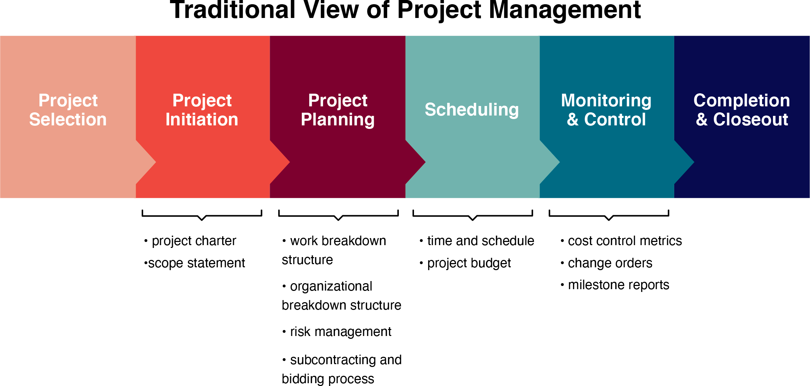
5.2 Selection of Projects
Figure 5‑1: Project phases

Slide 5
5.2 Human Resources and Project Management Selection
Determined by a team of people (executives) and given a priority
Some projects may be eliminated
Criteria is developed to prioritize or eliminate based on importance to the organization

Slide 6
5.2 Phase 1: Initiation Phase
Marks the official beginning of the project
The team is selected for the project
Resources are established ( people, material, equipment)
Finances are approved
Human Resources may be involved in the hiring of team, including Project Manager, designing job descriptions, creating a structure for the team, training the team

Slide 7
5.3 Phase 2: Project Planning
The heart of the project life cycle
Planning creates a strategic framework for the project
Everyone knows how they are involved, where they are headed, and how they will get there
Project plans are documented
Deliverables and requirements are defined
Project schedule is created
The plan creates ways to manage time, cost, changes, risk, controls
Human Resources creates an onboarding plan, ensures everyone is working together, has a clear vision of their personal involvement, helping with time lines (schedules), sets up the performance review system and reviews with the team, establishes rewards for post project, reviews the “release” of employees’ plan post project

Slide 8
5.4 Phase 3: Execution or Implementation Phase
Plan goes into motion (the work gets performed)
Controls and communication are maintained between stakeholders
Progress is monitored continuously
Adjustments are recorded
Team meetings are held, other meetings are held
Complete reports as necessary
Human Resources would create a Communication Plan, and assist in monitoring progress (at the Project Manager’s discretion), ensure status reports are distributed, assist with coordination resources, monitor performance

Slide 9
5.5 Monitoring
Monitor: is about gathering data
Controlling: is about analyzing data and taking corrective action, if needed
Monitor resources through leadership and teamwork
Continue to gather, analyze and make adjustments with data (keep the project on track)
Review and monitor schedules and budgets
Continue with documentation and reporting
Share progress and setbacks with stakeholders
Human Resources is less involved in this stage. However, they may monitor communication and performance

Slide 10
5.6 Phase 4: Closing Processes
Before closure, the customer needs to approve the product/service
Reports are written, and records are archived
Lessons learned are compiled
Outstanding bills are paid
Team is released from the project
Facilities are shut down, as necessary
Audit is prepared
Evaluation of team completed
Human Resources would be involved with the team to help with Lessons Learned, retrospectives, evaluation of individuals, the team, the Project Manager

Slide 11
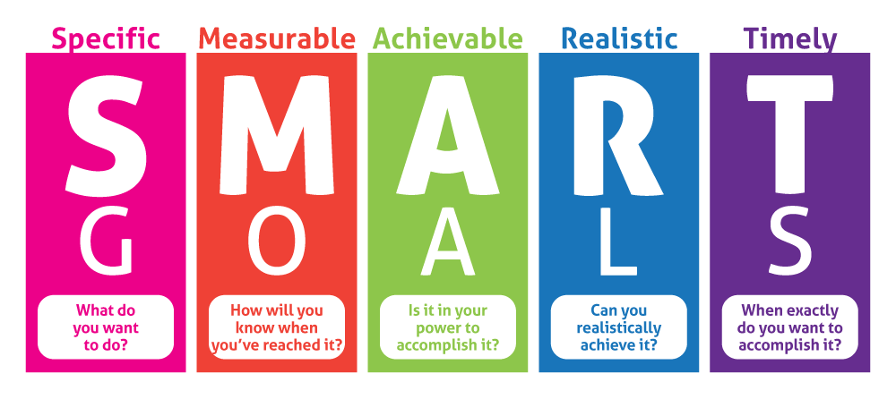
5.7 S.M.A.R.T. Goals in Projects
Established in the initiation phase
Specific: Clearly defined goals
Measurable: Goals are able to be measured and quantifiable
Assignable: The work is assigned to individuals with expertise
Realistic: Ideas are practical and achievable
Time-related: Length of time it takes to complete task/project
Figure 5.2: Smart Goals by Fanshawe College, CC BY-NC-SA 4.0
Human Resources would be involved in training the team in S.M.A.R.T. goals, and following through on ensuring the team meets the goals established. This could either be through performance reviews, or general follow up workshops.

Slide 12
5.8 Project Scope
Designed at the beginning of the project
Definition of all the work that meets the objectives of the project
A clear picture of all the work that needs to happen on the project
Must be kept up-to-date and documented throughout the project
Who? What? When? Where? Why? Costs
Example: A party is planned for my parents on September 15th, 2022 from 6:00pm-12:00pm at the ABC Community Centre for their anniversary at a cost of $2,000.00 There will be a dinner and a band.

Slide 13
5.8 Deliverables
The project’s objectives in quantifiable terms
Everything that is produced (what will the project deliver?)
Includes all the products/services the team will deliver to the customer
Deliverables are tangible outcomes, measurable results
Must be specific and verifiable
Example: Invitations, Venue, Band, Dinner

Slide 14
5.8 Project Requirements
Specific conditions of the deliverables
Describes what the deliverable should look like and “do”
Must be measurable, testable, related to business needs and opportunities
6 different requirements: functional, non-functional, technical, business, user, regulatory
Example: Venue must have a functional kitchen, Band must provide own equipment, Caterer must provide vegetarian options

Slide 15
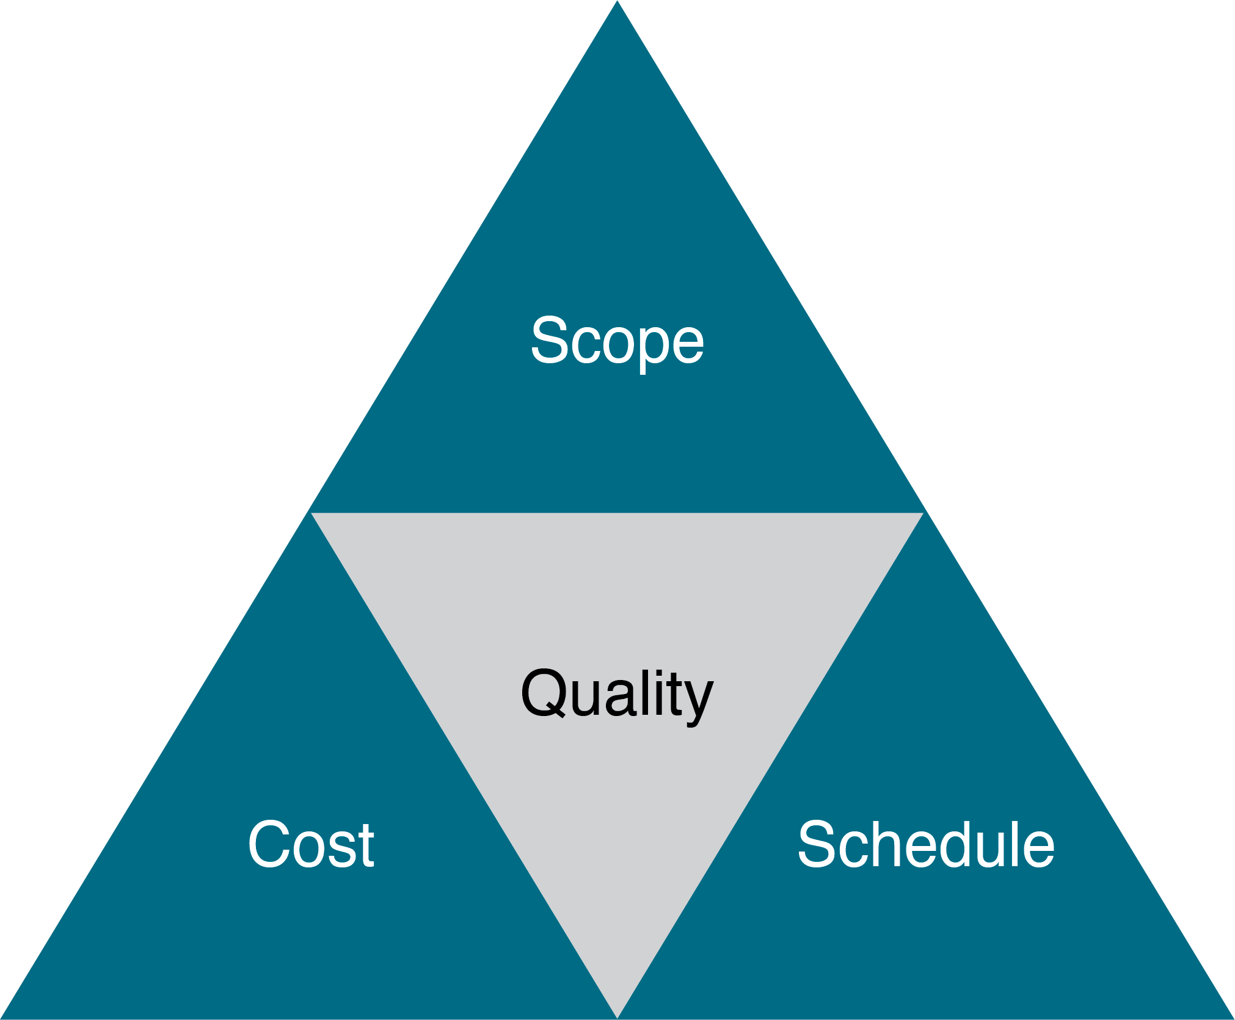
5.9 Managing the Scope
Time (schedule), cost (budget), scope (outcome) are known as the triple constraints
If one constraint changes, something else must change (trade off)
As the scope evolves, changes may happen
Example: If the cost of each dinner for the party is $50.00 (1250.00 total) and I increase the number of people in my Scope from 25 to 30 guests for the party, the cost will increase for each dinner (1500.00 total.)
Figure 5:5:A schematic of the triple constraint triangle. Adapted from “The Triad Constraints” by John M. Kennedy T., CC BY-SA 3.0.

Slide 16
5.9 Creating a Clear Scope Statement (interchangeable with Project Charter)
A description of the project’s purpose, includes business needs
A description of the project and how it will be accomplished
A business case explaining the benefits to the organization
Conditions the product/servce must satisfy the customer’s acceptance, can include the business requirements
Deliverables (usually tangible)
Milestones (significant events that occur at a certain time-must have an end point
What is excluded?
Constraints
Assumptions (what do you believe to be true?)
Risks: What could go wrong?
Technology planned to use
Roles of the team
Authority

Slide 17
5.10 Project Charter
A project charter, project definition, or project statement is a statement of the scope, objectives, and participants in a project
The purpose of a project charter is to:
Provide an understanding of the project, the reason it is being conducted, and its justification.
Establish early on in the project the general scope.
Establish the project manager and his or her authority level. A note of who will review and approve the project charter must be included.
The project Charter should include background, business case and business requirements, goals, assumptions, constraints, risks, deliverables, milestones, key stakeholders, and authorization

Slide 18
5.12 Request for Proposals and Contracts
Document that describes a project’s needs and asks for solutions from qualified vendors
In return, the potential vendor provides a detailed plan for executing the proposed project
A decision is made which vendor to choose and negotiates a contract (agreement with terms to complete a project)
Human Resources can play may different roles with RFP/Contracts from helping design the RFP/Contract, posting it on social media, helping to interview the vendors, help to train the vendor and offer orientation to the project/organization

