Slide 1
Strategic Project Management: A Practical Introduction for HR Professionals
Chapter 4: Project Team
Unless otherwise noted, this work is licensed under a Creative Commons Attribution-NonCommercial-ShareAlike 4.0 International (CC BY-NC-SA 4.0) license. Feel free to use, modify, reuse or redistribute any portion of this presentation.

Slide 2
4.1. Learning Objectives
By the end of this chapter you should be able to:
Identify the basic needs of our team members.
Explain the stages that a project team goes through and be able to identify the role that a project manager should try to play during each stage.
List advantages of teams and strong leadership.
Discuss the role of trust in building a team, and describe behaviours that help build trust.
List motivators and de-motivators that can affect a team’s effectiveness.
Explain issues related to managing transitions on a team.
Describe the advantages of diverse teams and provide some suggestions for managing them.

Slide 3
4.2 Successful Team
As Laufer et al. (2018) explain in their book Becoming a Project Leader, “When it comes to projects, one thing is obvious: ‘right’ does not mean ‘stars.’ Indeed, one of the primary reasons for project ‘dream teams’ to fail is ‘signing too many all-stars.’” More important than an all-star is a project team member fully committed to the project goals.

Slide 4
4.3 Developing Team
Define the purpose of the team and the project (set goals)
Measure the team’s performance (establish metrics and reporting, monitoring performance
Reward the team (as a motivator, and post project rewards
Conduct team building exercises
Provide motivation
Understand and teach team development characteristics
Teach skill development in project team compatibility: cooperation, communication, consoling, and conflict resolution
Photo by Jason Goodman, Unsplash License

Slide 5
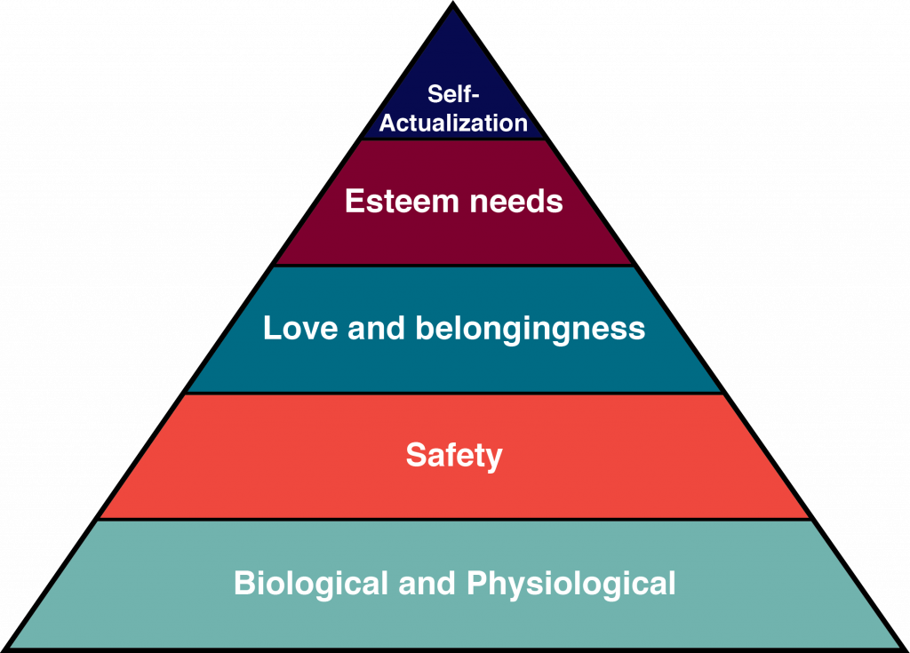
4.3 Maslow’s Hierarchy of Needs
Biological and Physiological: What a person needs to survive, such as food, water, and shelter.
Safety: The need to be safe, have financial security and protection against accidents and illness.
Love and Belongingness: The need to be loved by one’s family and community.
Esteem: The need to be respected and valued by others.
Self-Actualization: The desire to become the best self you can.
Figure 4‑1: Maslow’s Hierarchy of Needs
Notes:
Basic Needs: Maslow’s Hierarchy of Needs
Abraham Maslow provided a model to understand basic human needs which is usually represented as a pyramid (see Figure 13-1). Each need builds on the others: A person’s esteem needs are not that important if they are struggling with meeting the biological need to eat. Here are each of the levels in Maslow’s hierarchy:

Slide 6
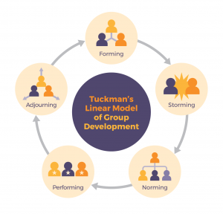
4.3 Tuckman’s Stages of Team Development
Forming: group comes together, little agreement how to approach the project, require a lot of guidance
Storming: team is figuring out their roles, conflict and power struggles may ensue, yet a clear vision, require support and coaching
Norming: develop consensus regarding roles, processes and approach; require facilitation
Performing: clear vision and purpose, meeting performance goals/milestones/benchmarks; require less supervision
Adjourning: collect lessons learned, transition to other work; require recognition and support to transition
“Tuckman’s Linear Model of group development” by eCampus Ontario CC BY-SA 4.0

Slide 7
4.4 Human Resources and Supporting Teams to Building Trust
Trust is based on beliefs related to their own ability, integrity and disposition to be “good”
Trust is fragile
HR provides trust building exercises with team and Project Manager
Image by Anemone123, Pixabay License
Notes:
To build believable performances, actors start by figuring out their characters’ motivations—their reasons for doing what they do. As a team leader, you can use the same line of thinking to better understand your team members. Start by asking this question: Why do your team members do what they do? Most people work because they have to, of course. But their contributions to a team are motivated by issues that go way beyond the economic pressures of holding onto a job.

Slide 8
4.4 Human Resources Helping Teams to Develop Communication Skills
Teaching two-way communication tools to project teams helps increase positive communication
Formal Communication: questionnaires, surveys, mentoring programs, suggestion boxes, bulletin boards, email, handbooks, meetings
Information Communication: chatting, grapevine (information sharing ie lunch room), unofficial discussions, advice, small talk at beginning of meetings, telling stories
Human Resources is in a good position to create opportunities to share and gather important information with teams
Face-to-Face Communication: Send and receive messages simultaneously, offers feedback instantaneously, easy to interpret, captures body language
Virtual Communication: Geographically dispersed, interact sending messages with meeting physically, save time and costs, convenient, team can be flexible with schedules, no physical space required

Slide 9
4.5 Team Motivation
Ensure teams have a sense of purpose
Ensure teams have clear performance metrics
Assign the right tasks to the right people
Encourage individual achievement, along with team achievement
Do not take anything personally
Provide mentoring
Be consistent and follow through
Image by Gerd Altmann, Pixabay License

Slide 10
4.6 Diversity, Inclusion, and Leadership
The rationale for putting together a team is to combine different people, personalities, and perspectives to solve a problem.
Diverse teams are more effective than homogenous teams because they are better at processing information and using it to come up with new ideas.
Good teamwork depends, ultimately, on a leader with a clear understanding of what it means to lead
Photo by rawpixel.com, CC0 1.0
Notes:
The rationale for putting together a team is to combine different people, personalities, and perspectives to solve a problem. Difference is the whole point. Diverse teams are more effective than homogenous teams because they are better at processing information and using it to come up with new ideas. According to David Rock and Heidi Grant, diverse teams tend to focus more on facts, process those facts more carefully, and are more innovative (Rock, 2016). What’s more, researchers investigating creativity and innovation have consistently demonstrated “the value of exposing individuals to experiences with multiple perspectives and worldviews. It is the combination of these various perspectives in novel ways that results in new ideas ‘popping up.’ Creative ‘aha’ moments do not happen by themselves” (Viki, 2016). In his book: The Difference: How the Power of Diversity Creates Better Groups, Firms, Schools, and Societies, Scott Page (2007) puts it like this:

