Slide 1
Strategic Project Management: A Practical Introduction for HR Professionals
Chapter 2: Culture and Structures of Organizations
Unless otherwise noted, this work is licensed under a Creative Commons Attribution-NonCommercial-ShareAlike 4.0 International (CC BY-NC-SA 4.0) license. Feel free to use, modify, reuse or redistribute any portion of this presentation.

Slide 2
2.1 Learning Outcomes
By the end of this chapter you should be able to:
Describe the different types of organizational structures
Explain the relative advantages and disadvantages of each structure as it relates to project management
Define terms related to business and HR strategy and portfolios
Discuss basic concepts related to strategy
Distinguish between strategy and operational effectiveness
Discuss issues related to aligning projects with strategy
Explain the three broad categories of projects
Identify project selection methods.

Slide 3
2.2 Structures
Figure 2‑1: Project Manager Authority and Organization Type
Notes:
There are three broad structures by which an organization can be organized:
Functional
Projectized
Matrix
Organizations may change their structure to increase success on a project.
They can also create a dedicated project terma which gives the same benefits without the cost, and risk.

Slide 4
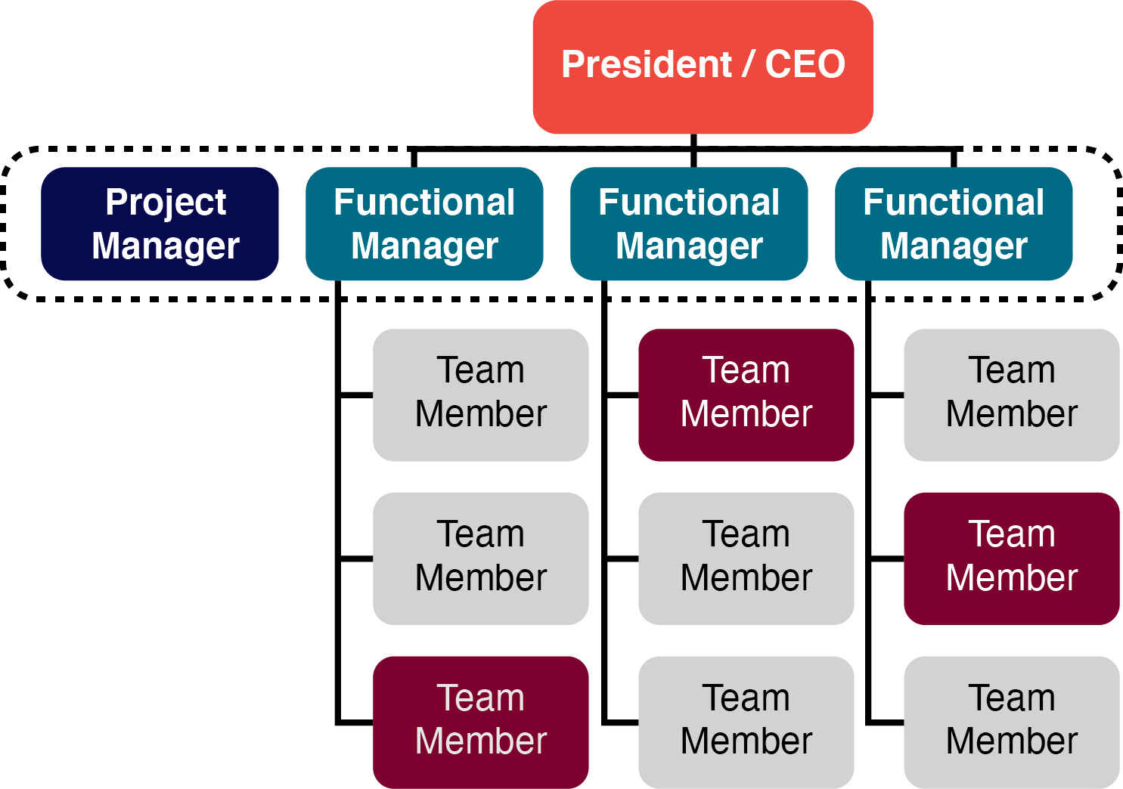
2.2 Functional Organizations
Traditional functional departments might include:
Human resources
Accounting
Procurement
Marketing
Sales
Shipping
Figure 2‑2: Functional Organization Structure
Notes:
Large organizations are traditionally organized by function into various departments, with staff in each department reporting to a departmental manager or head of department.

Slide 5
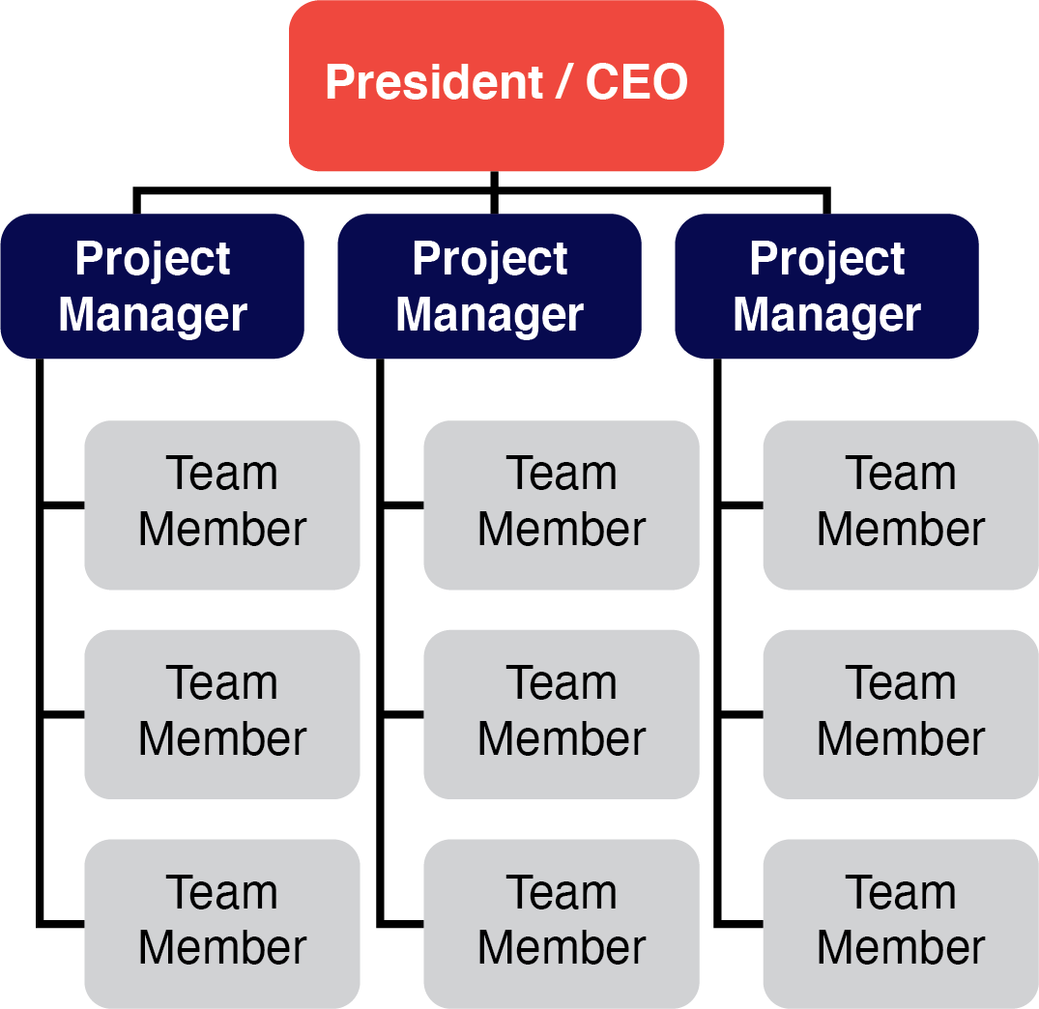
2.2 Projectized Organization
Projectized Organization may include:
Most of energy and resources are focused on projects
Project Manager has authority
There are units, departments who report to the Project Manager
Employees are assigned to specific projects
Loyalty and focus in on the project
Employees need to be adaptable (to leadership differences and skills)
Figure 2‑4: Projectized Organizations

Slide 6
2.2 Matrix Organizations
A matrix structure tries to combine the strengths a functional organization provides for operations management with the strengths a projectized organization provides for project management.
Figure 2‑5: Matrix Organization

Slide 7
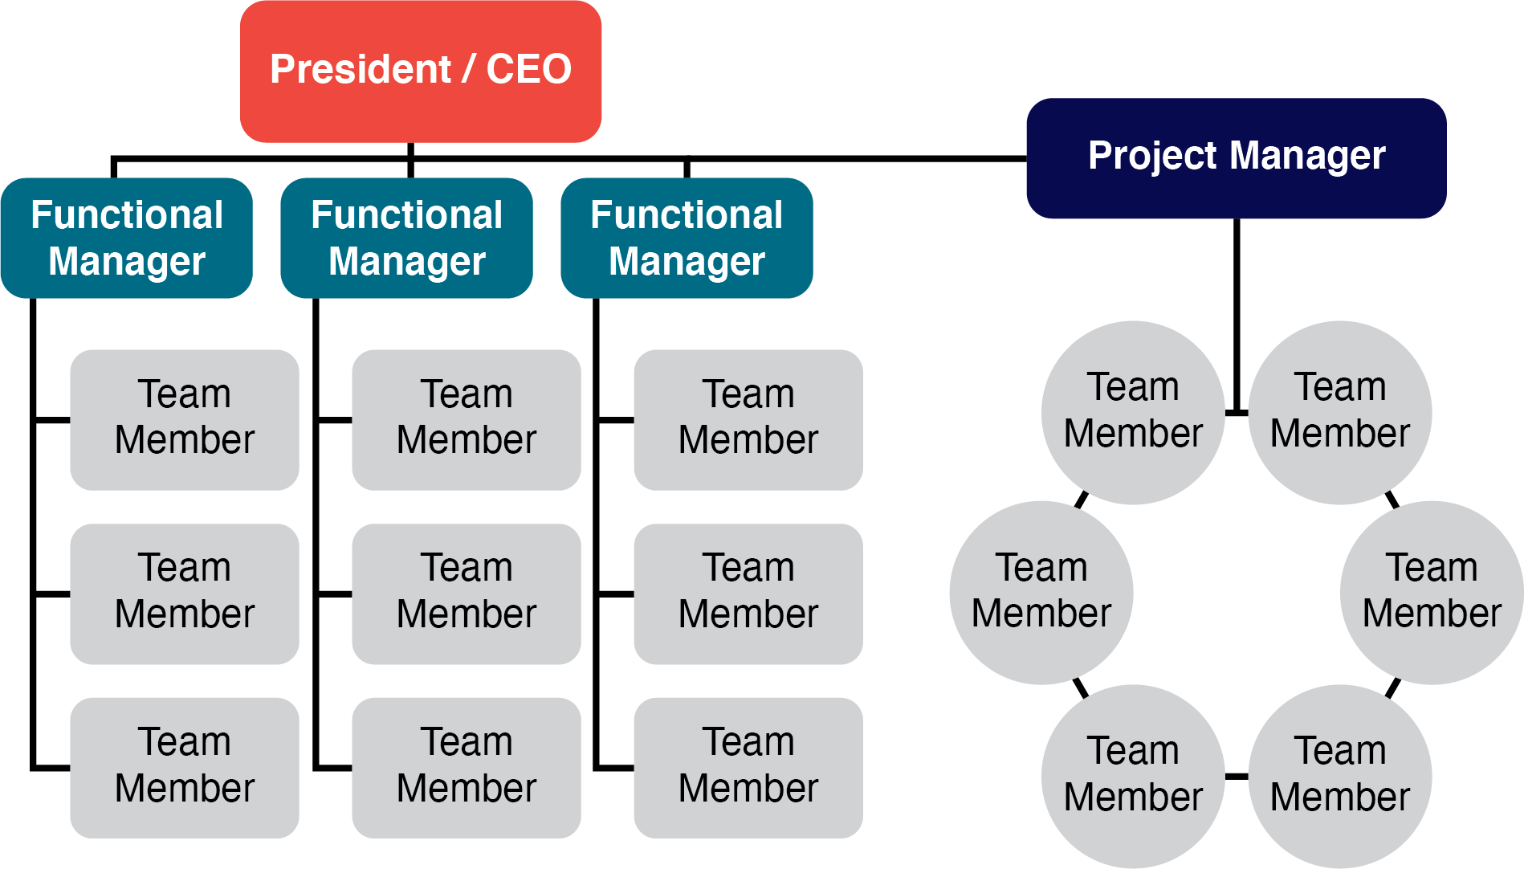
2.2 Dedicated Project Team
Dedicated teams may include:
Projects are carried out, however, the company does not want to change its structure
Project Manager has authority over the assigned team and a particular project
May be located in separate space/office
Project Manager reports to the CEO
Figure 2‑6: Dedicated Project Team

Slide 8
2.3 What is Organizational Culture?
Corporate (organizational) culture refers to the beliefs, attitudes, and values that the organization’s members share and the behaviors consistent with them.
It sets one organization apart from another (how the people interact, judge; and how the members of the organization view the company.
"Culture” by Nick Youngson is licensed under CC BY-SA 3.0
Notes:
When working with internal and external customers on a project, it is essential to pay close attention to relationships, context, history, and the corporate culture.
Corporate culture sets one organization apart from another, and dictates how members of the organization will see you, interact with you, and sometimes judge you.

Slide 9
2.3 Human Resources and Culture
HR is strongly connected to the culture of an organization and helps to develop the culture
HR facilitates the changing environment of organizations, and in turn, the changing culture
Examples: performance of employees, knowledge sharing, building trust, creating learning opportunities, aligning employee and management vision and mission, recruitment of specific people whose values/beliefs align with the organization
All these examples result in a strong culture

Slide 10
2.4 Strategy and Effective Project Management
Choose the right projects
Strategy is an expression of its mission and overall culture.
Be competitive
HR must align with strategy and develop complementary goals through recruitment and selection, training, compensation, succession plan
Hire the right people! Pay them well! Training them well! Offer them security! Be transparent with communication!
“Strategy” by Nick Youngson is licensed under CC BY-SA 3.0
Notes:
The essence of strategy is that you must set limits on what you’re trying to accomplish. The company without a strategy is willing to try anything. (Hammonds, 2001)

Slide 11
2.5 Project Selection
Factors that Affect Project Selection
Project selection is influenced by the available resources.
When money is short, organizations often terminate existing projects and postpone investing in new ones.
An organization’s project selection process is also influenced by the nature of the organization.
Size is a major influence on an organization’s project selection process.
Human Resources plays a vital role in making sure organizations articulate their purpose and values for the organization and projects.
Notes:
An organization’s project selection process is also influenced by the nature of the organization.

Slide 12
2.5 The Project Selection Process I
Staged Learning: a process where the project goes through several screening steps and phases for approval. During each phase, the project is refined, and decisions are made about moving forward or termination
Set-based Concurrent Engineering: Develops multiple solutions along the way of development until the final selection.
Image by StartupStockPhotos, Pixabay License

Slide 13
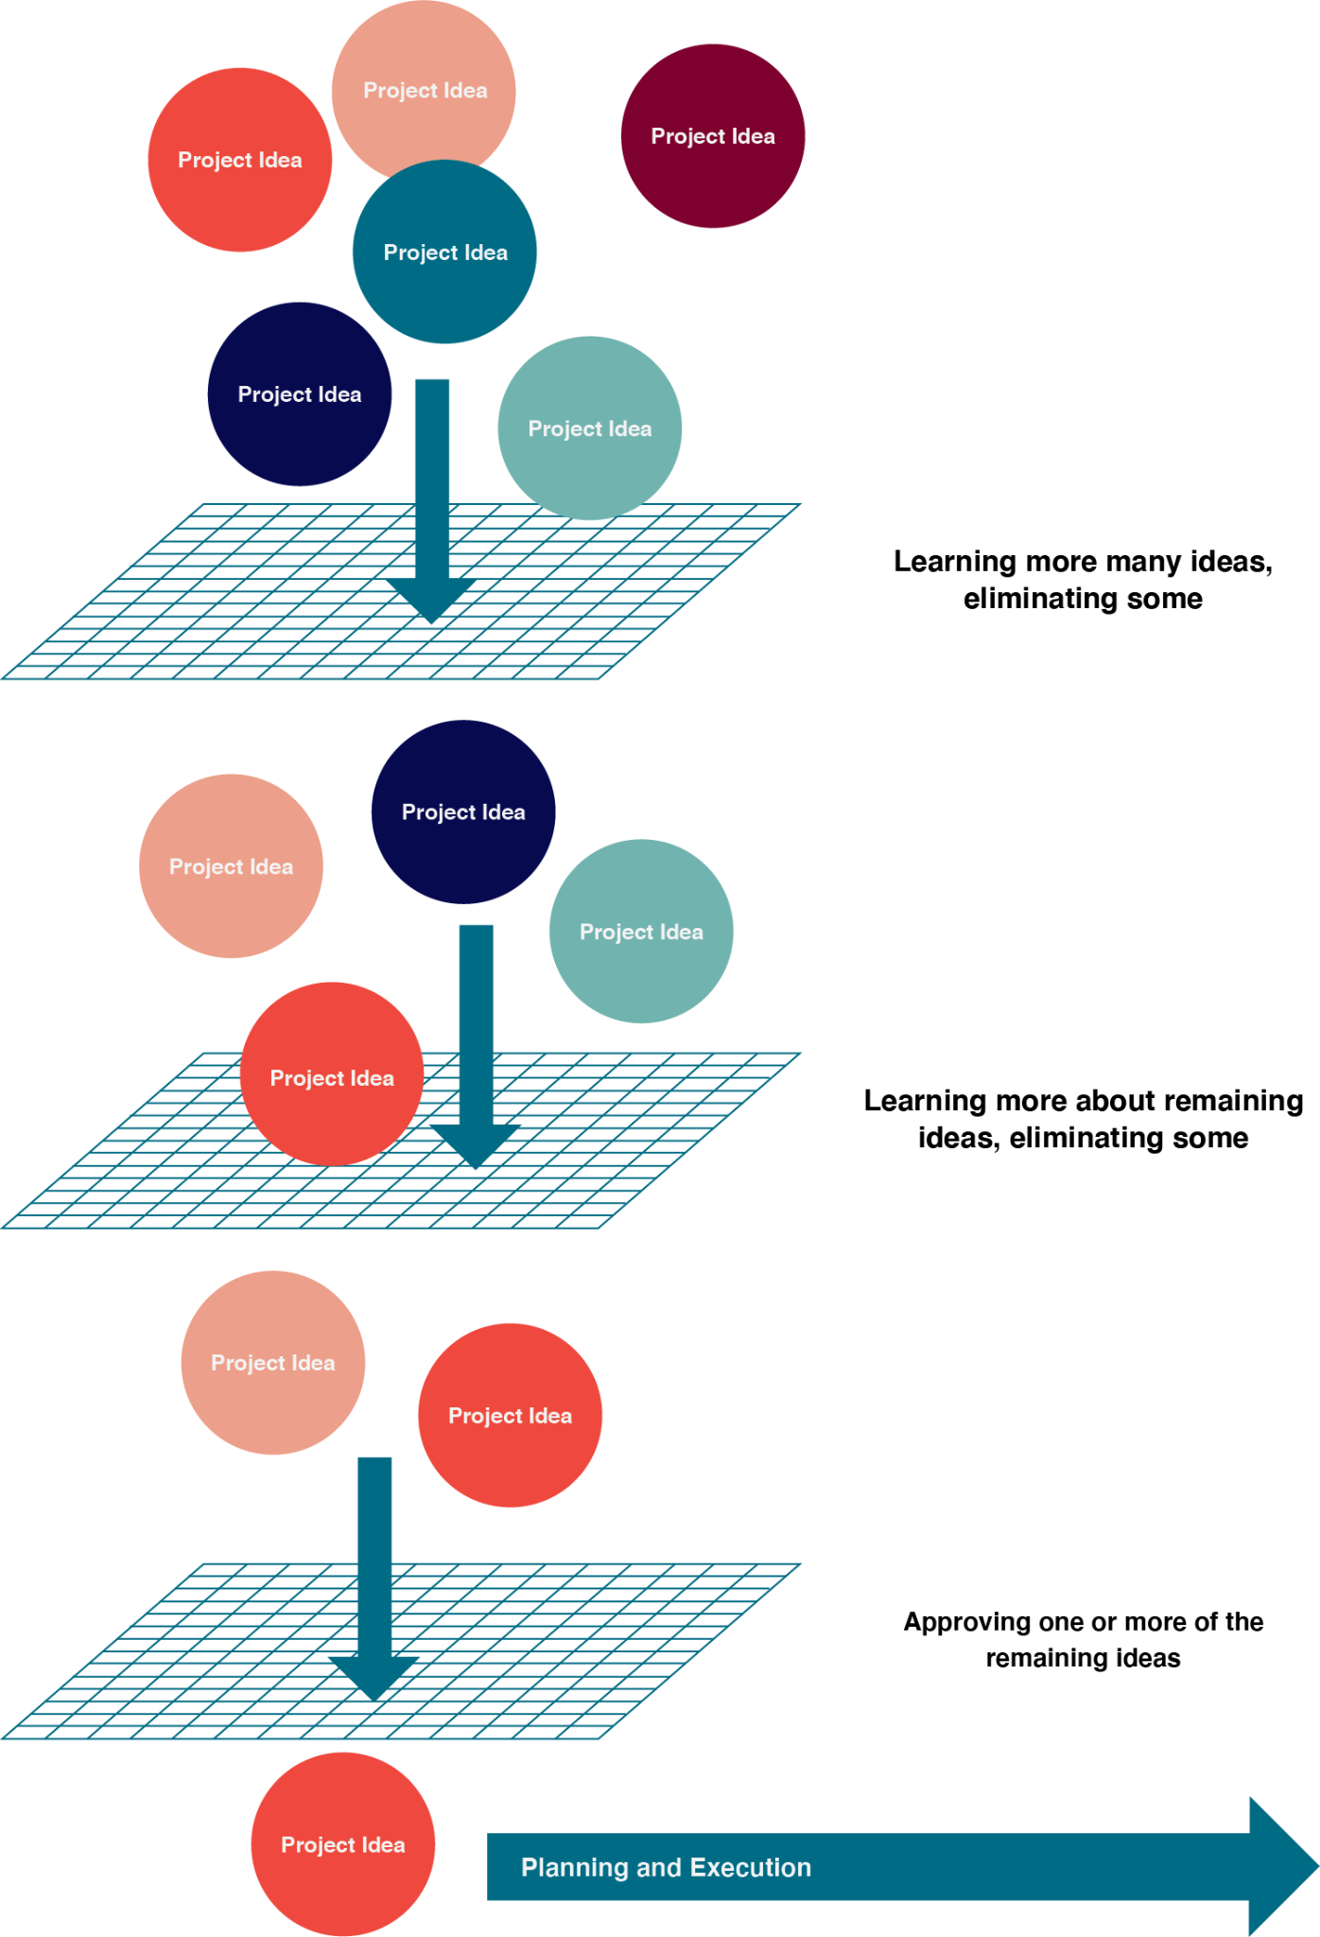
2.5 The Project Selection Process II
Project selection process as a series of screens that reduce a plethora of ideas, opportunities, and needs to a few approved projects.
Figure 2‑9: A project selection process can be seen as a series of screens

Slide 14
2.5 Project Selection Methods
Murder Boards
Qualitative Scoring Methods
Economic Scoring Methods
Constrained Optimization Methods
A group of experts attempt to “murder” a project proposal by pointing out its flaws and weaknesses.
Scoring methods can take a variety of factors into account.
These methods assess the ability of the project to help the bottom line, either by increasing profits or reducing costs.
Mathematically intensive means of analyzing a series of projects and are not easily generalized.

