Slide 1
Strategic Project Management: A Practical Introduction for HR Professionals
Chapter 11: Agile PM
Unless otherwise noted, this work is licensed under a Creative Commons Attribution-NonCommercial-ShareAlike 4.0 International (CC BY-NC-SA 4.0) license. Feel free to use, modify, reuse or redistribute any portion of this presentation.

Slide 2
11.1 Learning Objectives
By the end of this presentation you should be able to:
Explain the difference between traditional and Agile project management.
Explain fundamentals of Agile software development, including sprints and product stories.
Explain Agile project scope.
Discuss issues related to sustainable procurement in Agile projects.
Explain the role of self-organizing teams in Agile.
Describe challenges related to resource allocation in Agile.

Slide 3
11.2 Definition
Agile is iterative (repeating) short process focused on customer feedback and satisfaction.
Agile is favoured for software development.
Agile products can be brought to market quickly and then improved with updates.
Agile development is a learning process whereby the project team create a shared understanding of features they can create in the product/service, given the allotted time and money
It is a living order approach to project management
In the beginning there may be uncertainty and unknowns

Slide 4
11.2 Many flavours of Agile
Agile Scrum
Extreme Programming
Rapid Product Development
Designed for completing complex projects
Emphasizes short development cycles with frequent releases of software for evaluation
Emphasizes “simultaneous, coordinated activities by multi-functional teams, striving for smooth transitions between phases for the most rapid time-to-market” (ORC International: Expert Advisory Services)
Notes:
Scrum is the most widely used form of Agile. When people talk about Agile, they are usually talking about Scrum.
You can read more about Rapid Product Development in this “Introduction to Rapid Product Development.”

Slide 5
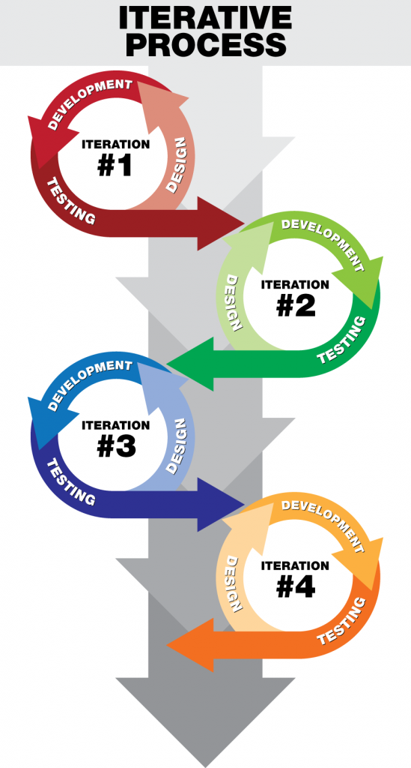
11.2 Iterative Process
Project specifications evolve along with the customer’s satisfaction
Project starts with a conversation between project team and customer as to what the customer wants the product/service to do
Project team creates pieces of the project
After a cycle (a scrum) the customer tries out the product/service
The customer offers suggestions for improvement
Project team goes back to development until the product/service is complete
Figure 11‑1: Iterative Process

Slide 6
11.3 Scope in Agile
Robert Merrill, an Agile coach advises taking a three-part approach to scope on Agile projects, determining the following:
Minimum viable features
Features we cannot think about right now.
Everything else.
Image by Markus Winkler, Pixabay License
Notes:
1)Minimum viable feature include - deliver on schedule and budget. Or, the project should be cancelled.
2)eatures we can’t think about now—Although these might be featuring the client wants, they are not something we can create, and so we can’t waste time and mental energy thinking about them.
3)Everything else—This is our unpredictability buffer, which we maintain to protect schedule and budget.
Note that these categories are not frozen; they can be changed during each iteration planning cycle. Scope in an Agile project is variable, but carefully and visibly managed.

Slide 7
11.4 Agile Procurement
Agile procurement is a collaborative approach that focuses on outcomes.
Procurement processes naturally follow or even mandate a negotiation-based approach that is directly at odds with the kind of living order thinking found in the Agile Manifesto, which emphasizes ‘collaboration over contract negotiation’” (pers. comm., June 15, 2018)
Some organizations and governments are beginning to rethink their procurement processes in hopes of making them more Agile and, as a result, less costly.

Slide 8
11.5 Agile Teams
Agile software development was founded as a way to help team members work together more efficiently and companionably. Three of the twelve founding principles of the methodology focus on building better teams:
The most efficient and effective method of conveying information to and within a development team is face-to-face conversation.
The best architectures, requirements, and designs emerge from self-organizing teams.
At regular intervals, the team reflects on how to become more effective, then tunes and adjusts its behavior accordingly (Beedle et al., 2001).

Slide 9
11.5 Self-Organizing Teams
Group of motivated individuals who work together toward a goal
Have the ability and authority to make decisions
Adapt quickly to changing demands
Generally, the team have cross-functional skills (no designated roles)
They decide who will perform each function
Relies on a Team Leader to guide the team
Image by Mohamed Hassan, Pixabay License

Slide 10
11.5 Human Resources and Self-Organizing Teams
Recruitment and selection of team members based on skills sets
Supporting the team to organize under the Agile Management approach
Help team learn about their strengths/weaknesses through assessments and personality tests
Identify gaps in the team and how to improve
Train the team in feedback, communication, etc.
Support team with peer reviews, evaluation
Ongoing help with communication, re-training, or may become part of the self-organizing team

Slide 11
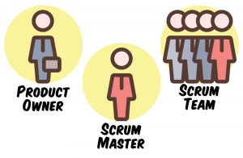
11.6 Roles and Responsibilities
Product Owner: Customer who ensures the outcome of the project is successful
Development Team: Group who works together to deliver the product/service
Scrum Master: Helps the team learn and apply the Scrum process to meet the goals, keep the customer up to date and involved, may or may not be a Manager, serves the team, remove obstacles, protect team from outside interference, coach/guide/educate, motivate and encourage the team
Scrum Roles by Fanshawe College, CC-BY-NC-SA

Slide 12
11.6 Human Resources and Scrum in Motion
Design the Roles and Responsibilities document (similar to a job description, however, less detailed)
Recruitment and selection of team
Training team in the Scrum Process and Scrum Meetings

Slide 13
11.7 Scrum Process and Meetings
Holistic approach
Faster way to develop products/services than traditional project management
Holds a series of meetings throughout the project (several phases)
Team stays in close touch with each other
The project is continual trial and error
Similar to the game of rugby (the team all move in one direction to the goal post)

Slide 14
11.7 Scrum Meetings
Release Meeting
Sprint Planning
Daily Scrum
Sprint Review
Sprint Retrospective
Establish goals, expectations, risks, features to be developed, develop a “backlog” (a list of everything that needs completed)
Negotiate where to start, what features are most important, who is responsible, timing to complete the feature, break down the pieces of the project, everything is recorded, goals cannot be changed until the next Sprint
The core of Agile project management, daily meetings
“Show and tell” specific work completed
Reflection on how well the team think the sprint went, set up an action plan to improve

Slide 15
11.7 Daily Scrum
Team meets daily, same place, same time
Meetings last 15-20 minutes
Team meets standing in a circle
Everything is written on a whiteboard, recorded later
Core questions asked (what happened since last time we met? What will happen between now and next Scrum? Are there any obstacles?)
Team decides what to do, not Scrum Master
Scrum Master ensures the logistics/obstacles are handled

Slide 16
11.8 Estimating Resources
In Agile, estimating capacity can be especially difficult
Agile project managers (or Scrum masters) exert minimal direct influence on day-to-day work.
Agile project managers must practice good resource capacity management by “planning your workforce and building a skill inventory in exact proportion to the demand you foresee”
Notes:
Difficulties in estimating a team member’s capacity for work on a project is something every project manager faces.
Agile managers exert minimal influence - because teams are supposedly self-organizing—that is, free to manage their work as a group, and pull work when they are ready for it.
It lets you optimize productivity and as a concept perfectly complements the Agile methodology” (Gupta, 2017).

