Slide 1
Strategic Project Management: A Practical Introduction for HR Professionals
Chapter 1: Introduction to Project Management for Human Resources
Unless otherwise noted, this work is licensed under a Creative Commons Attribution-NonCommercial-ShareAlike 4.0 International (CC BY-NC-SA 4.0) license. Feel free to use, modify, reuse or redistribute any portion of this presentation.

Slide 2
1.1 Learning Outcomes
By the end of this chapter you should be able to:
Define the characteristics of a project and its relationship to Human Resources.
Compare the difference between traditional and Agile project management.
Describe how program management differs from project management.
List the functions of a Project Management Office and Project Portfolio Management.
Explain the difference between a Project Lifecycle and the PMI Project Processes.
Explain the three broad categories of projects.

Slide 3
1.2 What is a Project?
A project:
Is a temporary endeavour
Has a specific objective
Has customers or stakeholders
Has constraints (time, cost, scope)
Has measures for success
Includes some uncertainty
Has a beginning and an end
Image by Firmbee, Pixabay License
Notes:
the end is reached when the project’s objectives have been achieved or when the project is terminated because its objectives will not or cannot be met, or when the need for the project no longer exists.
Definition by Project Management Institute
Watch the video on What is a Project for more information on how these six aspects help define what a project is and is not.

Slide 4
1.2 What is a Program?
Program is a collection of projects that can be conducted, simultaneously or sequentially.
Example of program: diploma or a degree in supply chain/accounting/human resources.
Each subject is a project, and the entire degree/diploma is the program.
In business, a program might be your regular everyday job.

Slide 5
1.2 What is an Operation?
Operations are ongoing and repetitive.
Involve work that is continuous without an ending date and with the same processes repeated to produce the same results.
Operation by Nick Youngson CC BY-SA 3.0 Pix4free

Slide 6
1.2 Operations vs Projects
Projects are different from ongoing operations.
Project management addresses temporary endeavors.
Operations management focuses on improving ongoing operations.
Examples:
Constructing a new factory is a project
Producing bicycle tires in that factory is an operation

Slide 7
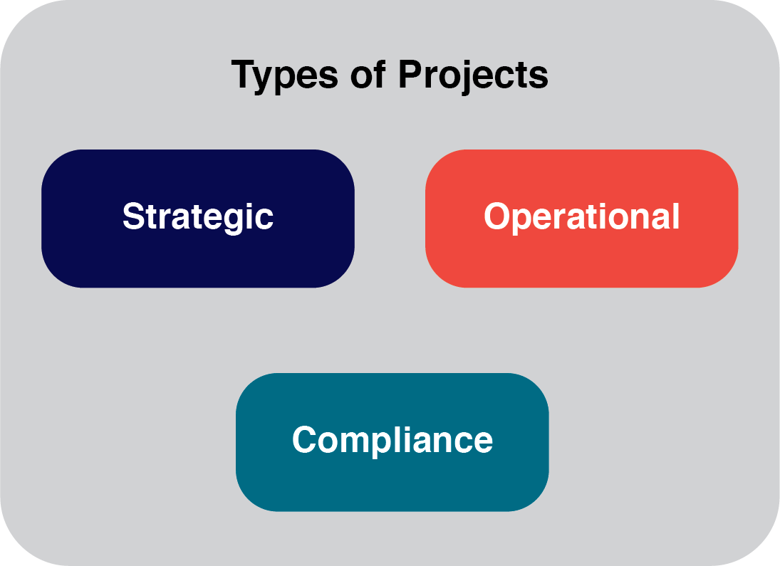
1.3 Categories Of Project Management
Strategic Projects: Something new and innovative.
Operational Project: Improves a current operation.
Compliance: Projects must be done in order to comply with an industry or governmental regulation or standard.
Figure 1‑1: Three broad categories of projects
Notes:
Strategic Projects involve creating something new and innovative. A new product, a new service, a new retail location, a new branch or division, or even a new factory might be a strategic project, because it will allow an organization to gain strategic advantage over its competitors.
• Operational Projects improve current operations. These projects may not produce radical improvements but[DS1] they will reduce costs, get work done more efficiently, or produce a higher quality product.
• Compliance Projects must be done in order to comply with an industry or governmental regulation or standard. Often there is no choice about whether to implement a project to meet a regulation, but there may be several project options to consider, any of which would result in meeting compliance requirements
[DS1]improvements, but

Slide 8
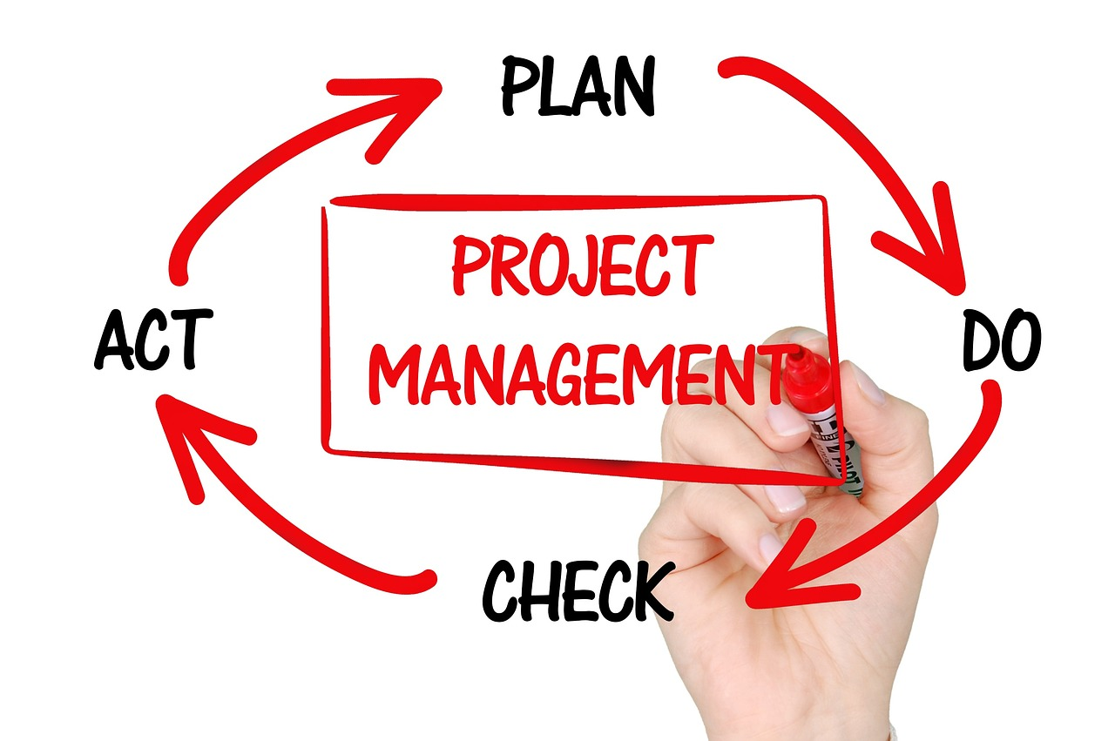
1.3 Traditional Project Management
The tools and techniques used in modern project management began to develop during the post-WW2 industrial boom of the 1950s.
These tools were used to complete large industrial and military projects, where the scope of work was well defined.
Image by Pete Linforth, Pixabay License
Notes:
The post-WW2 industrial boom of the 1950s that is what project managers started to develop the tools and techniques used in modern project management. These tools were used to complete large industrial and military projects, where the scope of work (what we need to accomplish in a project) was well defined.
EXAMPLE- he scope of what we have to do can be planned out well when we are constructing an apartment building, making a nuclear submarine missile, or building an oil refinery.

Slide 9
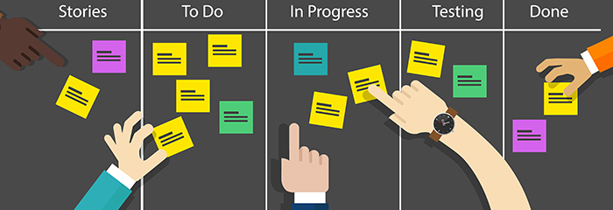
1.3 Agile Project Management
Is iterative (repetitive)
Uses short development cycles.
Features of high value are developed first, and a working product/software can be reviewed and tested at the end of the cycle.
This Photo By Unknown author is licensed under CC BY-SA
Notes:
Agile techniques use short development cycles in which features of high value are developed first and a working product/software can be reviewed and tested at the end of the cycle (20-40 days).

Slide 10
1.4 Aspects of Project Management
Project Management has been around since building pyramids in the 19th century.
1950s defense projects drove a scientific and data-driven management approach that began the science of modern-day project management.
Planning, design, scheduling are considered the science of project management.
Communication and managing people are the art of project management.

Slide 11
1.4 Project Management Institute
Project management Institute (PMI)
Non-profit organization to share best practices, and professional development opportunities.
Project Management Body of Knowledge (PMBOK)
Codified standards for project management. Used as a reference guide.
Notes:
The PMBOK guide is organized into nine knowledge domains:
Project Integration Management
Project Scope Management
Project Time Management
Project Cost Management
Project Quality Management
Project Human Resource Management
Project Communications Management
Project Risk Management
Project Procurement Management
Project Stakeholder Management

Slide 12
1.4 Project Constraints
Cost
Balance between “use it or lose it” budget.
Scope
Purpose of the project
Quality
Standards and criteria for project outcome
Risk
Probability and impact of negative events
Resources
Required for completion
Time
Estimates of time to complete the project

Slide 13
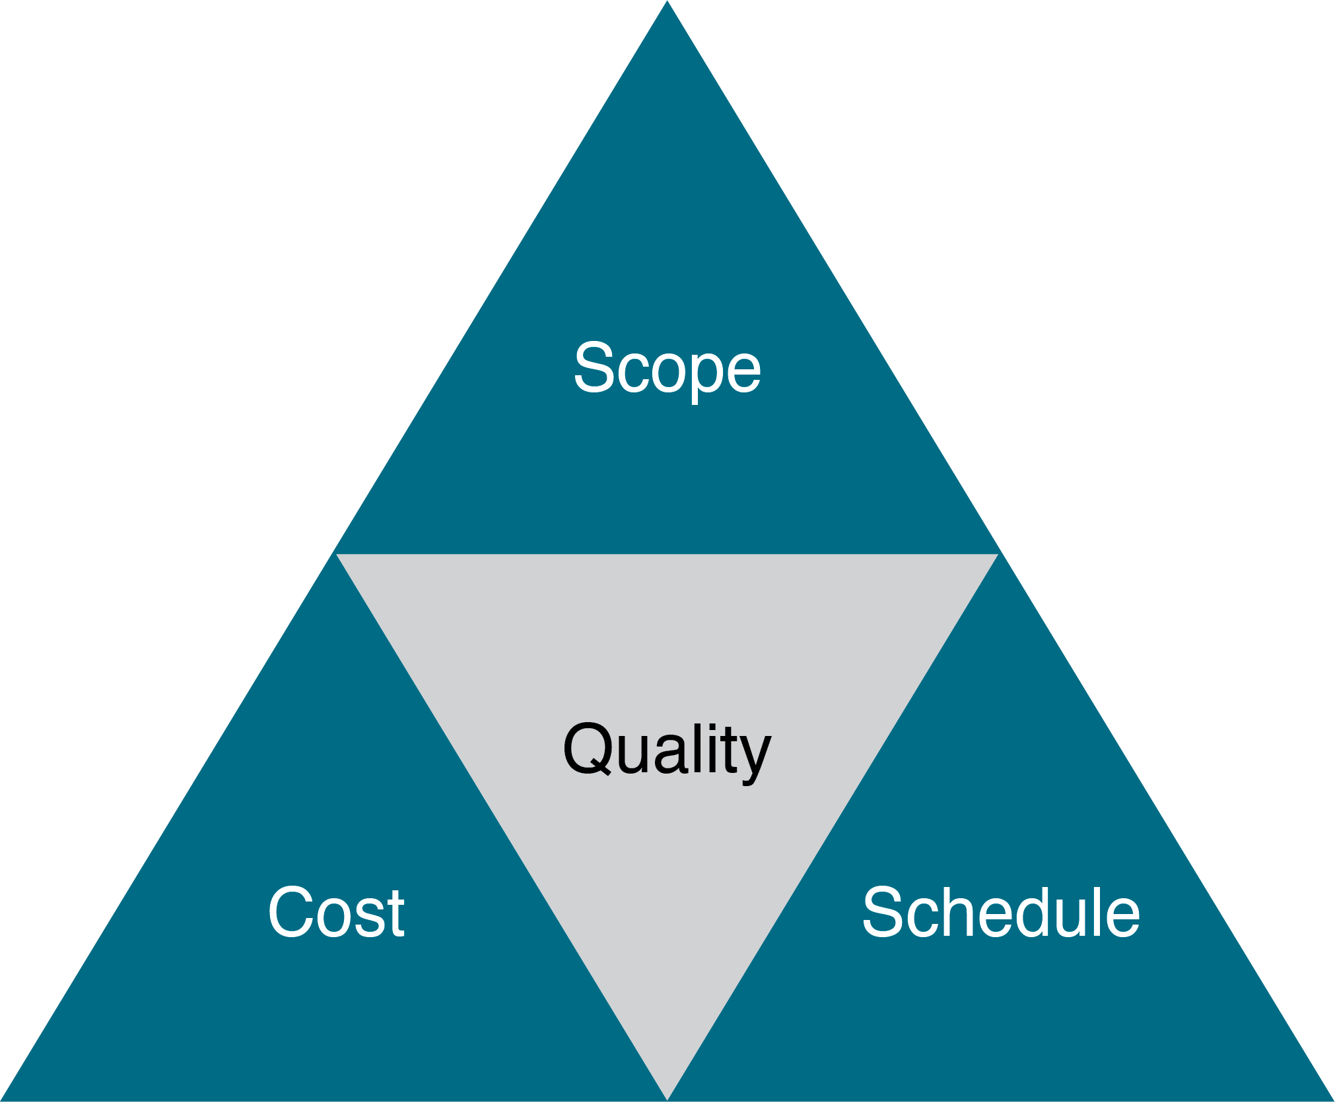
1.4 Project Priority
Figure 1-2: A schematic of the triple constraint triangle. Adapted from The triad constraints by John M. Kennedy T., CC BY-SA 3.0 license.
Notes:
These are the primary competing project constraints that you have to be most aware of. The triple constraint is illustrated in the form of a triangle to visualize the project work and see the relationship between the scope/quality, schedule/time, and cost/resource
Your project may have additional constraints that you must face, and as the project manager, you have to balance the needs of these constraints against the needs of the stakeholders and your project goals.

Slide 14
1.5 Life Cycle
The project manager and project team have one shared goal:
To carry out the work of the project for the purpose of meeting the project’s objectives.
Every project has a beginning, middle, and an ending that is either successful or unsuccessful.
A standard project typically has the following four major phases: initiation, planning, implementation, and closure.

Slide 15
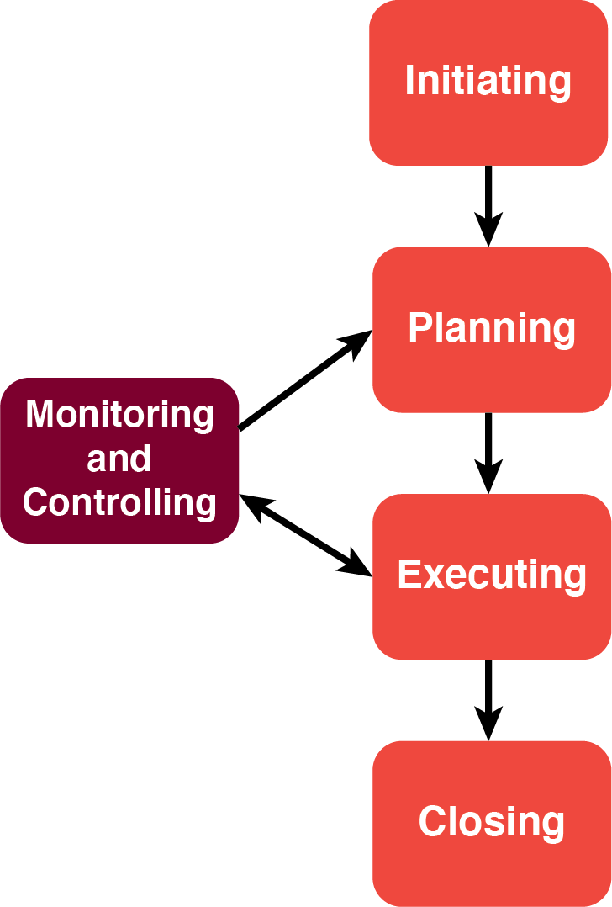
1.5 Four Major Phases of a Project
Initiation Phase: Identify the need and address the solution.
Planning Phase: more details related to the solution, ”the steps”, scope, costs, deliverables, milestones, timeframes, risks, measurement
Implementation Phase: ”put into motion”, progress is monitored, people carry out the tasks, performance is measured, modifications are made, stakeholders are kept informed, reports are created,
Closing Phase: product/service is released to customer, contracts terminated, resources released, evaluation, documents archived
Figure 1‑3: Project management phases. CC BY-SA 3.0
Notes:
During the first of these phases, the initiation phase, the project objective or need is identified; this can be a business problem or opportunity.
The next phase, the planning phase, is where the project solution is further developed in as much detail as possible and the steps necessary to meet the project’s objective are planned.
During the third phase, the implementation phase, the project plan is put into motion and the work of the project is performed. It is important to maintain control and communicate as needed during implementation.
During the final closure, or completion phase, the emphasis is on releasing the final deliverables to the customer, handing over project documentation to the business, terminating supplier contracts, releasing project resources, and communicating the closure of the project to all stakeholders.

