Slide 1
8P39 Problems of the Day
2017-2018

Slide 2
Problem of the Day
Coins & More Coins
Stasi collected $1.60 from each customer on her paper route.
Mr. Killip paid her with nickels, dimes, and quarters. He gave her 19 coins in all.
How many of each kind of coin could he have given her?
Session 3

Slide 3
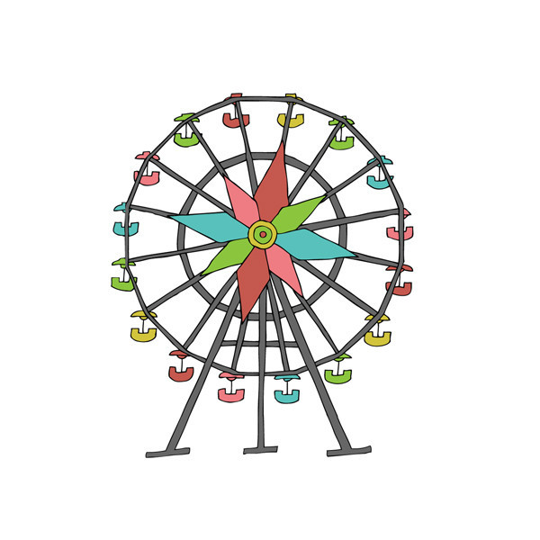
Problem of the Day Rides at Fun Park
12 Friends are at Fun Park. There are many rides at the park. The Tilty Whirl has cars that hold two people each. The Ferris Wheel has cars that hold four people each. The Roller Coaster has cars that hold six people each. The Water Log has cars that hold five people each. All cars must be filled with people before a ride starts. The friends do not want to share a ride with anyone they do knot know. Which rides can the friends ride? Show all of your mathematical thinking.
Session 4

Slide 4
Rides at the Fun Park …
What are all the different combinations of rides that the friends can go on?

Slide 5
Problem of the Day Handshake Problem
Ten people are at a party, and you want everyone to meet (shake hands with) everyone else at the party. How many handshakes will it take?
Session 5

Slide 6
Problem of the Day
Tangram Puzzle Problem
A tangram is worth $40. what is the dollar value of each piece? Name the piece and be prepared to justify its value.
Session 6

Slide 7
Tangram Puzzle
Use all 7 pieces with no overlapping or gaps and make a square. *No ASR’s Needed*
Session 6

Slide 8
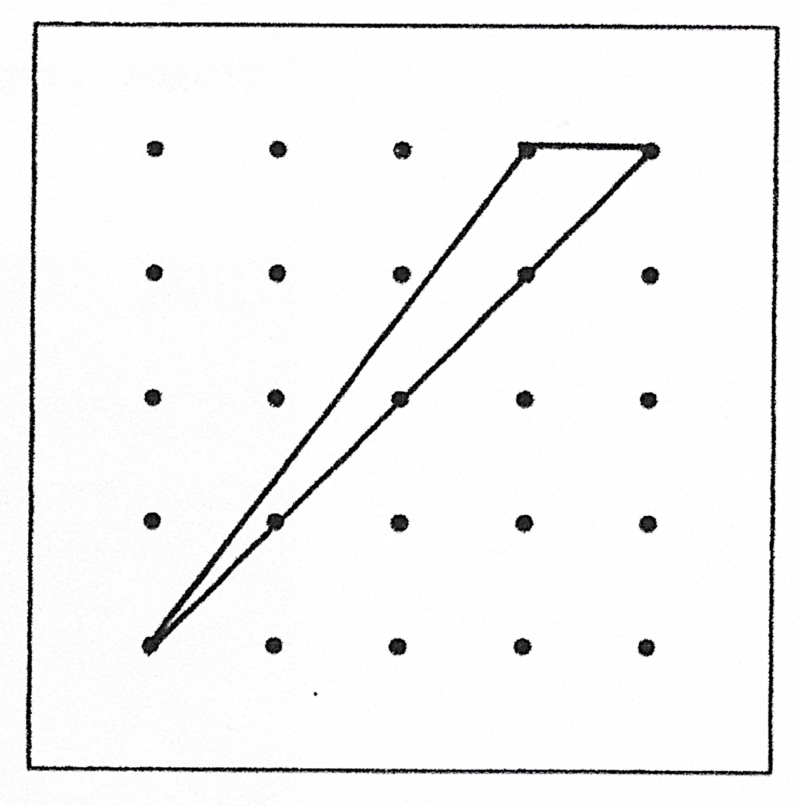
No Pegs Allowed
Gigi was making triangles on a (5x5) geoboard. She made the triangle shown below and was surprised that none of the geoboard’s pegs was inside her triangle. She began to wonder “How many different triangles can I make with no pegs inside?” How many can she make?
Session 7

Slide 9
Problem of the Day “Area/Perimeter”
Assume that the edge of each square is 1 unit.
Without changing the configuration of the 6 initial squares…
Add squares so that the figure has a perimeter of 18. Squares must match on whole edges.
What is the fewest number of squares you must add to make a perimeter of 18?
What is the largest number of squares you can add and still keep a perimeter of 18?
Explain!
Session 8

Slide 10
Problem of the Day
Tug of War – Round 1
TIE
4 Acrobats TIE 5 Grannies
Tug of War – Round 2
TIE
Ivan(Wonder Dog) TIES 2 Grannies and 1 Acrobat
Session 9

Slide 11
Tug of War Continued…
Tug of War – Round 3
?
Ivan and 3 Grannies ? 4 Acrobats
Session 9

Slide 12
Problem of the Day How Many Sandwiches?
Students in Mr. Attribute’s class were going on a picnic. They made sandwiches from items that were in their refrigerator. They did not count all the sandwiches, but they did take a survey and recorded the ingredients in the various sandwiches that they made. From the following information, can you help them determine how many sandwiches were made?
A sandwich does not have more than one piece of any one ingredient, although it may contain several different ingredients.
Thirteen sandwiches had a slice of cheese.
Fourteen had a slice of salami.
Thirteen had a slice of tomato.
Eight had a slice of cheese and a slice of tomato.
Three had only a slice of salami.
Five had a slice of tomato, a slice of cheese, and a slice of salami.
Eight had a slice of tomato and a slice of salami.
Session 10

