Slide 1
Information Systems for Business & Beyond
Chapter 7 - Systems Development
Unless otherwise noted, this work is licensed under a Creative Commons Attribution-NonCommercial-ShareAlike 4.0 International (CC BY-NC-SA 4.0) license. Feel free to use, modify, reuse or redistribute any portion of this presentation.

Slide 2
7.1 Learning Outcomes
Upon successful completion of this chapter, you will be able to:
Define systems development;
Explain the overall process of developing new systems;
Explain the differences between system development methodologies;
Discuss the components of a feasibility analysis;
List the different types of programming languages used to develop software;
Clarify some of the issues surrounding the development of mobile applications;
Compare the build vs buy decision; and
Identify the four primary implementation policies.

Slide 3
7.2 Systems Development
Systems development could be seen as the simple process of writing programs to solve the needs of users. However, in reality this process is not that simple. End users may know what they want, but lack the technical expertise to bring the idea to life.
Notes:
Using a systems development methodology can help mitigate these challenges and support development success.

Slide 4
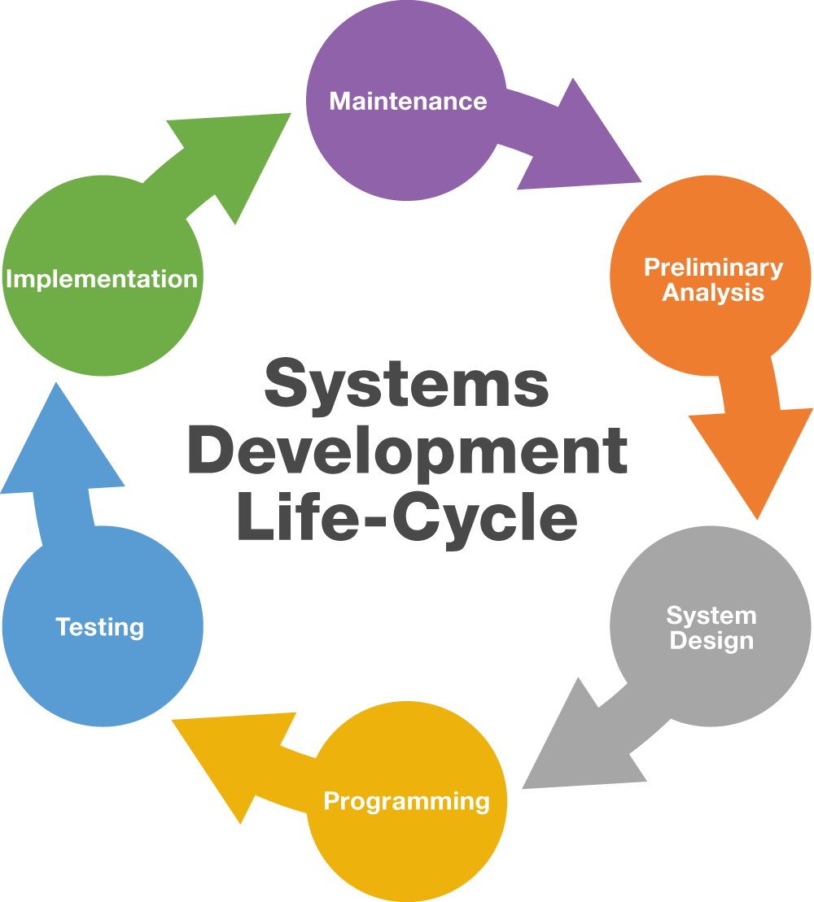
7.3 Systems Development Life Cycle
Notes:
The Systems Development Life Cycle (SDLC) was first developed in the 1960s to manage large software projects running on corporate mainframes. This approach to software development is structured and risk averse, designed to manage large projects that include multiple programmers and systems.

Slide 5
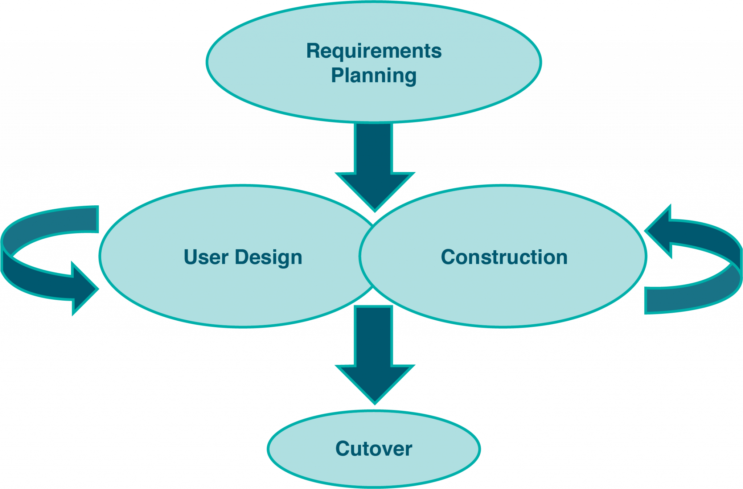
7.4 Other Development Methods
Rapid Application Development
Rapid Application Development (RAD) focuses on quickly building a working model of the software, getting feedback from users, and then using that feedback to update the working model.
Notes:
The RAD methodology consists of four phases.

Slide 6
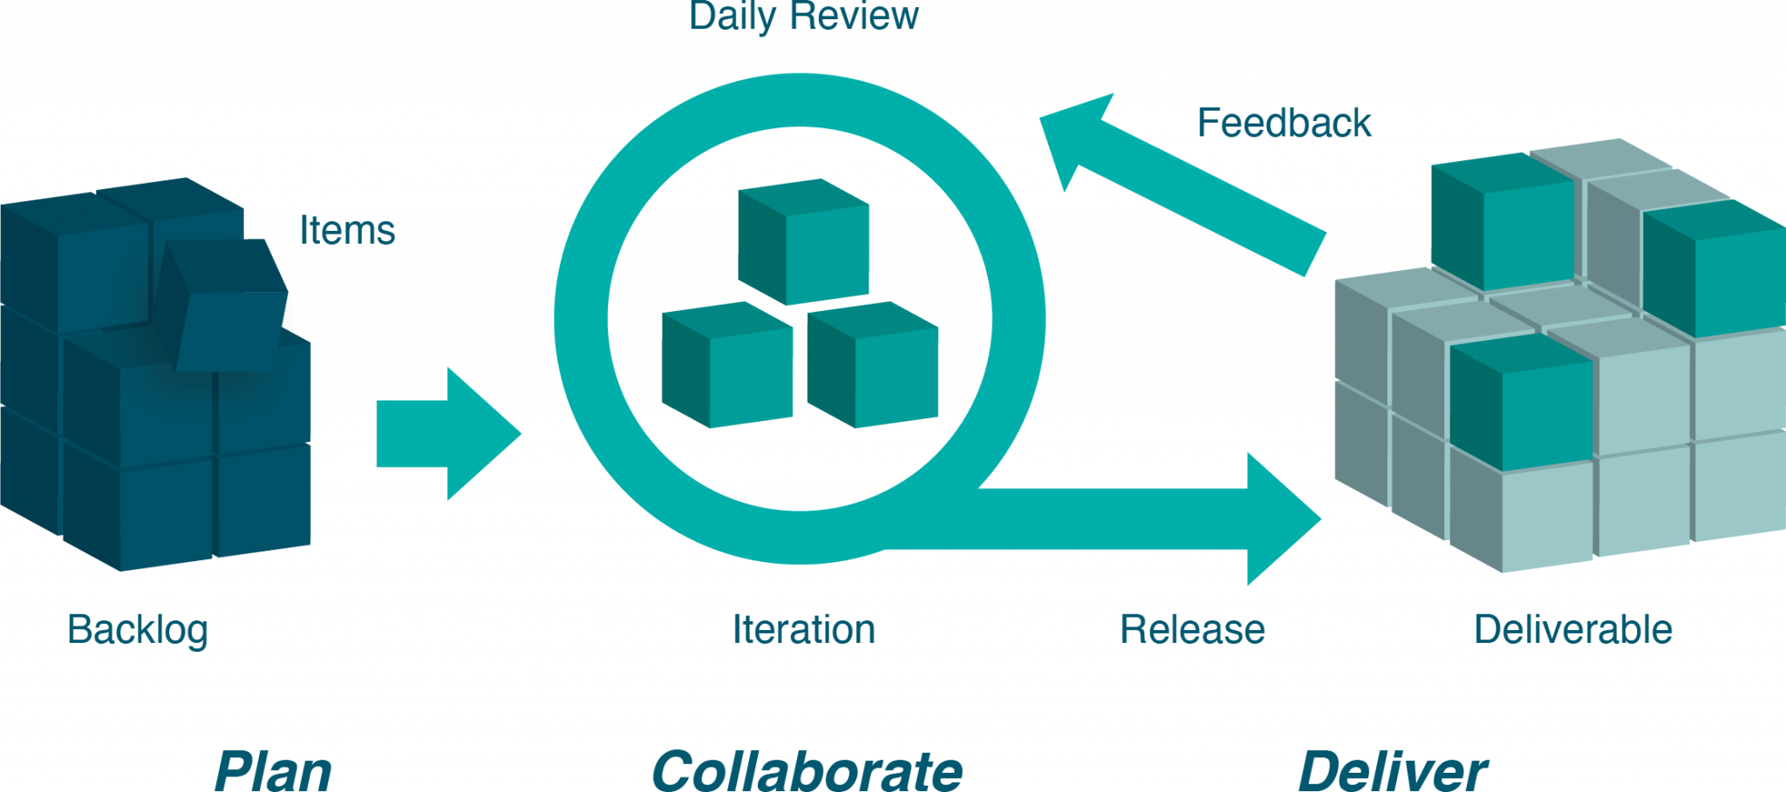
7.4 Other Development Methods cont.
Agile Methodologies
Agile methodologies are a group of methodologies that utilize incremental changes with a focus on quality and attention to detail.
Notes:
Each increment is released in a specified period of time (called a time box), creating a regular release schedule with very specific objectives.

Slide 7
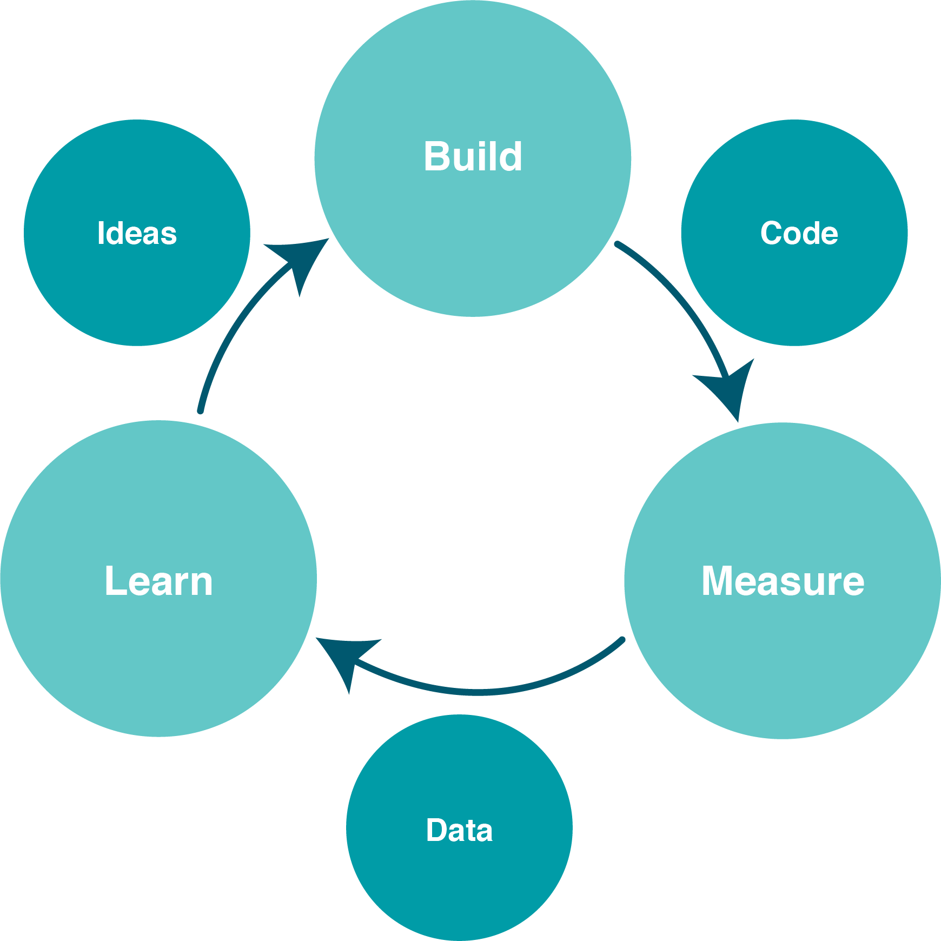
7.4 Other Development Methods Cont.
Lean Methodology
Lean focuses on taking an initial idea and developing a Minimum Viable Product (MVP)
Notes:
The MVP is a working software application with just enough functionality to demonstrate the idea behind the project. Once the MVP is developed, the development team gives it to potential users for review.

Slide 8
7.5 Feasibility
Regardless of the development method, the scope and objectives of the new system should be investigated to determine feasibility. New applications normally originate from end-user requests and are weighed against the other requests for information systems resources before approval to develop the system is granted.

Slide 9
7.5 Feasibility Cont.
In order to ensure that the new system would be of greater benefit to the organization than other competing requests for proposals, a feasibility study must be performed covering the following three major areas:
Economic Feasibility
Technical Feasibility
Operational Feasibility

Slide 10
7.6 Design
The key to successful information systems is good design. Different people use the word design in different contexts. When information systems professionals speak of design, they are referring to business processes.
Photo by Balázs Kétyi on Unsplash

Slide 11
7.7 Building A Mobile App
In many ways building an application for a mobile device is exactly the same as building an application for a traditional computer. Understanding the requirements for the application, designing the interface, and working with users are all steps that still need to be carried out.

Slide 12
7.8 Programming
Programming is the process of creating a set of logical instructions for a digital device to follow using a programming language. The process of programming is sometimes called “coding” because the developer takes the design and encodes it into a programming language which then runs on the computer.
Notes:
A programming language is an artificial language that provides a way for a developer to create programming code to communicate logic in a format that can be executed by the computer hardware.

Slide 13
7.9 Build Vs. Buy
When an organization decides that a new program needs to be developed, they must determine if it makes more sense to build it themselves or to purchase it from an outside company. This is the “build vs. buy” decision.

Slide 14
7.9 Build Vs. Buy
Advantages
There are many advantages to purchasing software from an outside company.
1.First, it is generally less expensive to purchase software than to build it.
2. Second, when software is purchased, it is available much more quickly than if the package is built in-house.

Slide 15
7.9 Build Vs. Buy Cont.
Disadvantages
First, the same software you are using can be used by your competitors.
Second, if you purchase software from a vendor and then customize it, you will have to manage those customizations every time the vendor provides an upgrade.

Slide 16
7.10 Implementation And Maintenance
Once a new system is developed or purchased, the organization must determine the best method for implementation. Convincing a group of people to learn and use a new system can be a very difficult process.
There are several different methodologies an organization can adopt to implement a new system. Four of the most popular are:
Direct Cutover
Pilot Implementation
Parallel Operation
Phased Implementation

Slide 17
7.11 Key Takeaways
Software development is about solving business problems.
Developing new software applications requires several steps, from the formal SDLC process to more informal processes such as agile programming or lean methodologies.
In end-user computing, software development happens outside the information technology department.
Conducting a feasibility analysis is important to ensure the new system will be a good investment.
Programming languages have evolved from very low-level machine-specific languages to higher-level languages that allow a programmer to write software for a wide variety of machines.
Most programmers work with software development tools to make the software development more efficient.
Some companies choose to purchase software to save development costs and speed implementation.
When implementing new software applications, there are several different types of implementation methodologies that must be considered.

