Slide 1
5.1 Introduction to Patents

Slide 2
Scene 1
Starts of with a picture of a Fitbit
Lightboard scene (no pictures) - Close up shot of speaker talking about FitBit and how the technology stems from a patent

Slide 3
Scene 2
“Patents are a type of intellectual property.” → Sliding Image of Canadian Patent
No lightboard video for this

Slide 4
Scene 3
According to the World Intellectual Property Office, intellectual property refers to “creations of the mind – everything from works of art to inventions, computer programs to trademarks and other commercial signs.” → Show Definition on slide with sliding background
Agreed – lightboard video showing definition

Slide 5
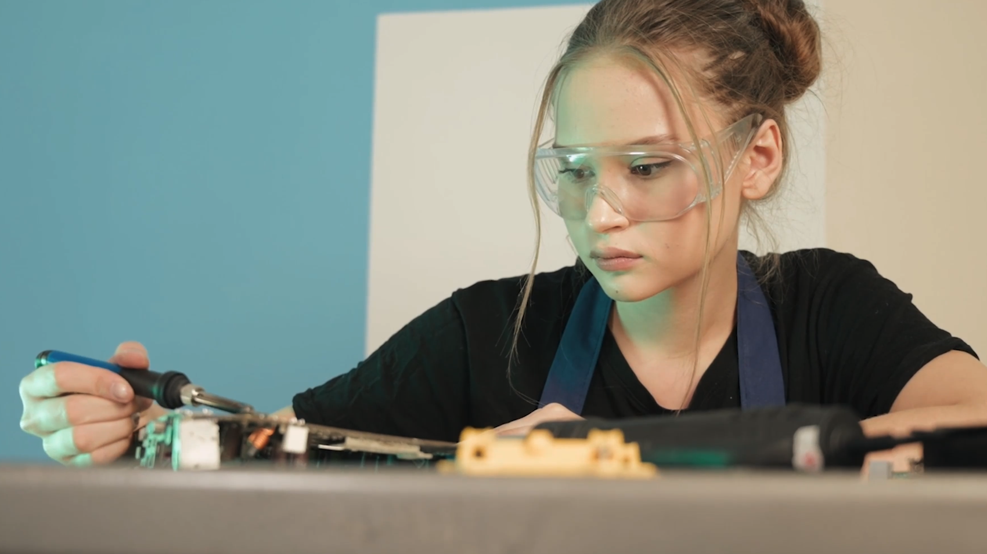
Scene 4
Intellectual property rights allow creators, who might be for example, inventors, artists, or businesses, to control how their work is used. → Show scenes of engineer and business people
I’d say we can probably combine Scene 3 and 4 together, followed by a post-edit like you suggested

Slide 6
Scene 5
Some types of intellectual property include → Display text of bullet point over top video related to topic
Lightboard video showing 4 types of IP
Zoom in on Patents

Slide 7
Scene 6
We can define a patent as a type of intellectual property that provides the patent holder with certain rights to protect their invention. These rights pertain only to the country where the patent was issued and are for a limited period of time. → Show screen with patent definition printed
I like it – no video here, just a post-edit with the patent definition

Slide 8
Scene 7
A patent gives the patent holder the exclusive right to the invention being patented. Others cannot make, use, sell, or distribute the invention without the permission of the patent holder, and if they do then the patent holder can seek damages. → Cut to Speaker
Can this be combined with Scene 6 as a continuation

Slide 9
Scene 8
So, what can you patent? → Cut to Speaker
Maybe incorporate the Lightboard by writing directly on it – almost like a mind-map that follows from “what can you patent?”

Slide 10
Scene 9
No lightboard – show the words: new, useful and inventive (post-edit)

Slide 11
Scene 9
In Canada, patents protect inventions that are: → Display bullet points over videos/images (not sure)

Slide 12
Scene 10
An invention in Canada must also meet three criteria to be patentable: → Cut to Speaker

Slide 13
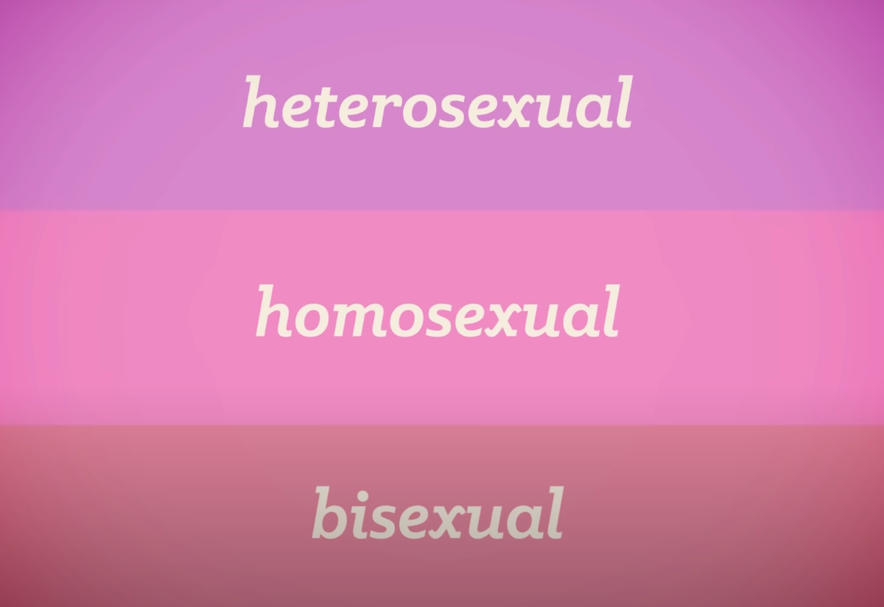
Scene 11
it must be new, useful, and inventive.→ Display points in stackable rectangles that build on top of each other (one idea)

Slide 14
Scene 12
An invention is new if it is the first in the world. It is useful if it has a function, so it does something that is useful. And it is inventive if it requires some creativity or imagination, so that the invention is not obvious to someone who works in the field of the invention.→ Cut to speaker

Slide 15
Scene 13
When a patent is published, there are benefits for the patent holder, in the form of the exclusive right to their invention. But there are also benefits for the rest of society, as patents must provide a full description of the invention. → Cutaway to video montage over speaker voice

Slide 16
Scene 13
Because they provide a high level of detail about inventions, patents can be a useful source for when you want to identify and understand recent inventions and technologies.
You can learn from the latest technologies that inventors have developed and use these to inspire your own ideas, while of course making sure not to infringe on any patents! Because they provide detailed descriptions of inventions that often are not published anywhere else, patents are a unique and valuable source of information for engineering research.
Check out the next module where we learn how to read a patent
→ Cut to Speaker

Slide 17
Scene 14
You can learn from the latest technologies that inventors have developed and use these to inspire your own ideas, while of course making sure not to infringe on any patents! Because they provide detailed descriptions of inventions that often are not published anywhere else, patents are a unique and valuable source of information for engineering research. → Cut to Speaker

Slide 18
5.2 Reading a Patent

Slide 19
Scene

