Slide 1
ECE Community Survey
Fall 2024

Slide 2
114 Total Responses

Slide 3
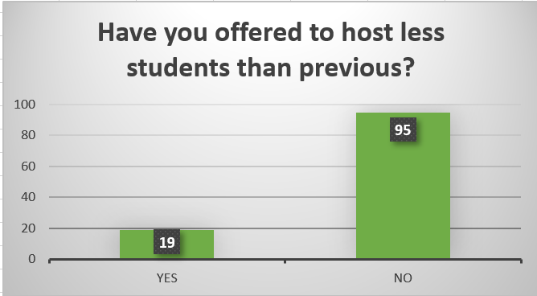

Slide 4
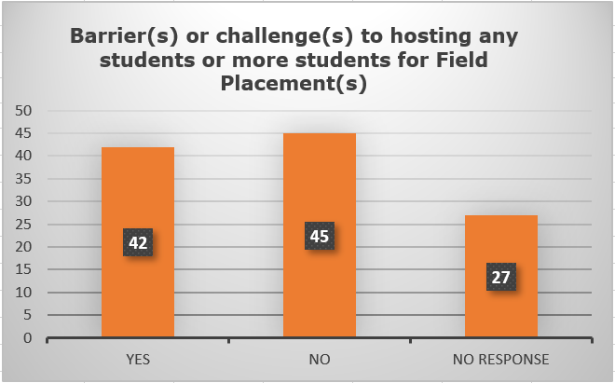

Slide 5
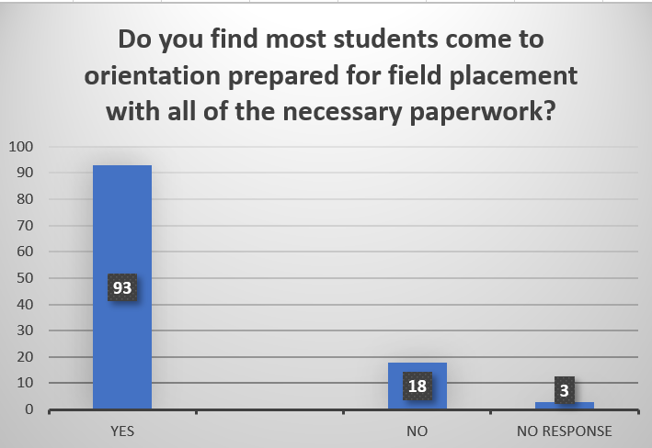

Slide 6
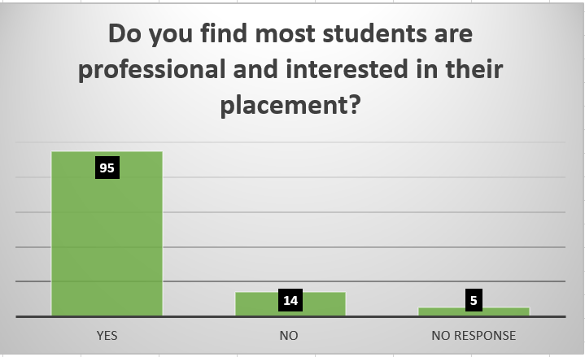

Slide 7
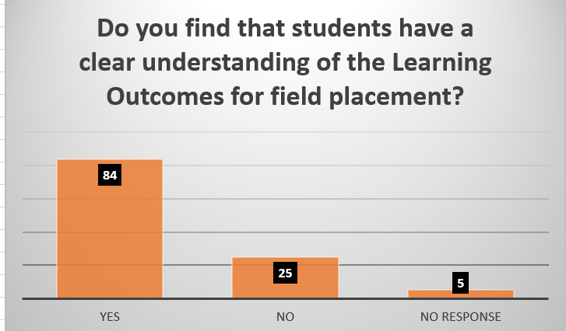

Slide 8
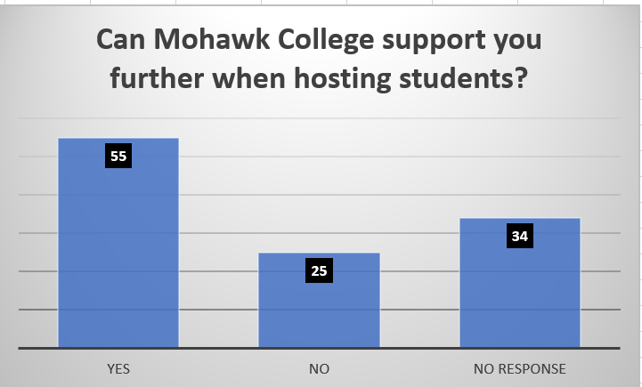

Slide 9
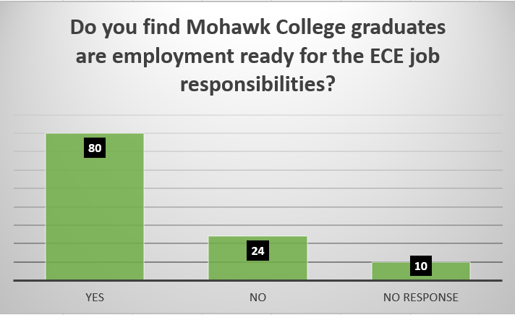

Slide 10
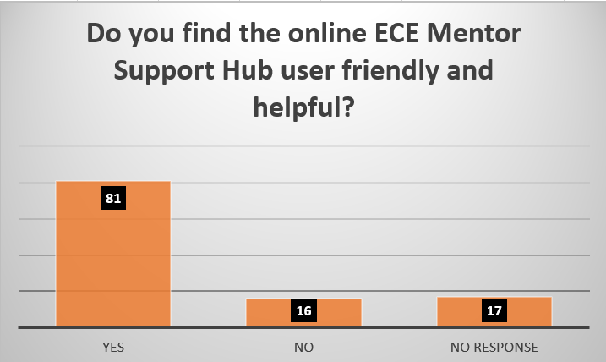

Slide 11
Thanks to our Community Partners for their support and feedback in informing our practices and shaping what we do for Field Placements.
Mohawk College ECE Team

