Slide 1
Communication Essentials for College
Chapter 5
Summary slides created to accompany Communication Essentials for College by Jen Booth, Emily Cramer & Amanda Quibell, Georgian College.
Slide Design by: Shaima, Georgian College OER Design Studio, funded by eCampus Ontario/VLS 2
Except where otherwise noted, all material is licensed under CC BY NC 4.0

Slide 2
Chapter 5: Rhetorical Modes
5.1 – Comparison and Contrast
5.2 – Cause and Effect
5.3 – Persuasion
5.4 – Rhetorical Modes: Exercises
Notes:
Chapter 5: Rhetorical Modes was taken directly from Chapter 5.1 of Communication Essentials for College by Jen Booth, Emily Cramer & Amanda Quibell under a CC BY-NC 4.0 License. No changes were made.

Slide 3
5.1 – Comparison and Contrast
Learning Objectives
Determine the purpose and structure of comparison and contrast in writing.
Explain organizational methods used when comparing and contrasting.
Understand how to write a compare-and-contrast essay.
Notes:
Learning Objectives were taken directly from Chapter 5.1 of Communication Essentials for College by Jen Booth, Emily Cramer & Amanda Quibell under a CC BY-NC 4.0 License. No changes were made.

Slide 4
The Purpose of Comparison and Contrast in Writing
Comparison is discussing similar elements whereas contrast is looks at different elements
In a comparison-and-contrast essay you analyze two or more subjects and connect them in a meaningful way that does not state the obvious and reveals the subjects similarities or differences

Slide 5
The Structure of a Comparison and Contrast Essay
Essay begins with thesis stating the selected subjects for comparison and/or contrast and the reason for doing so
Organizational structure of essay depends on purpose, audience and nature of your topic

Slide 6
The Structure of a Comparison and Contrast Essay (Continued 1)
A compare-and-contrast essay can be organized in two ways:
Organized by the subjects which are discussed one after the other
Organized by the individual points which discusses each subject in relation to the point
Notes:
For a diagram and further explanation visit chapter 5.1 of Communication Essentials for College by Jen Booth, Emily Cramer & Amanda Quibell under a CC BY-NC 4.0 License.

Slide 7
The Structure of a Comparison and Contrast Essay (Continued 2)
Some examples phrases you can use for comparison essay are: similarly, both, one similarity, and likewise
Some examples phrases you can use for contrast essay are: unlike, while, in contrast, and one difference.

Slide 8
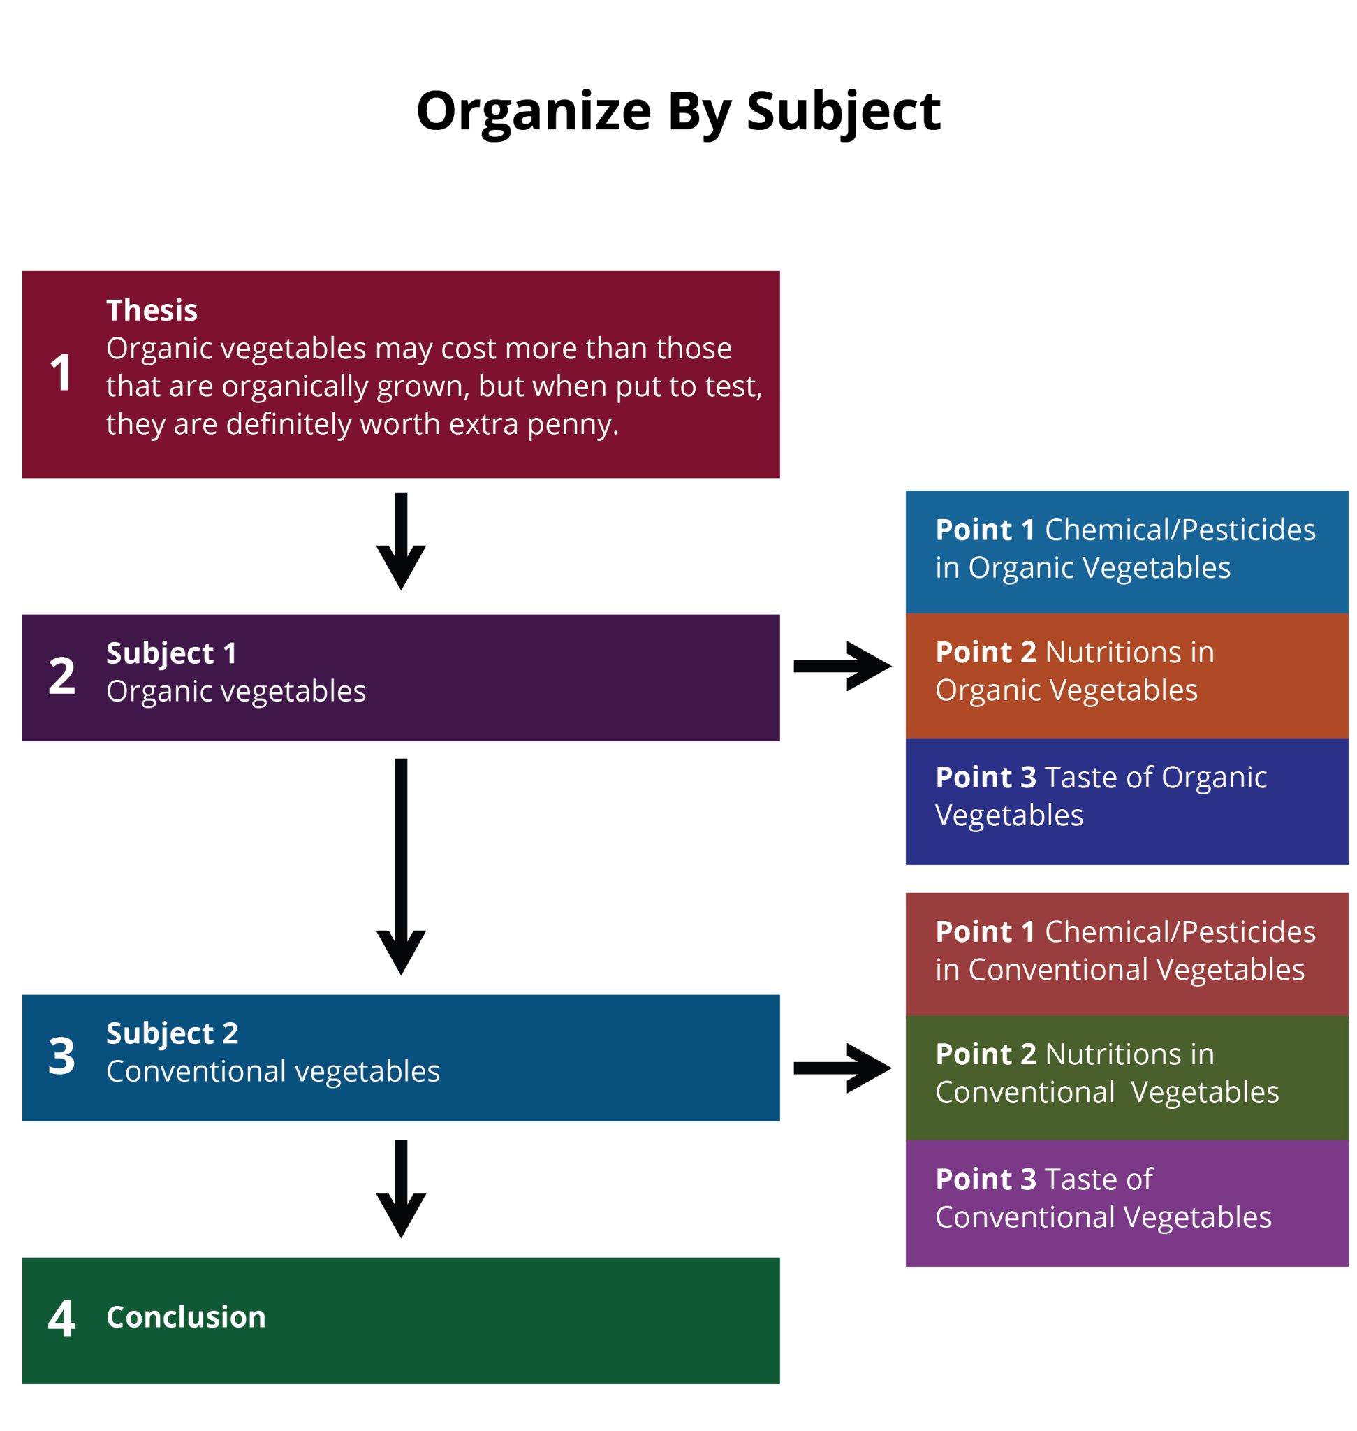
Organize by Subject Diagram
Source: Compare and contrast – organize by subject by University of Minnesota is licensed under CC BY-NC-SA. / Colours adjusted/images remade by Shaima.
Notes:
Organize by subject:
Thesis (Organic vegetables may cost more than those that are conventionally grown, but when put to the test, they are definitely worth every extra penny).
Subject 1: Organic Vegetables
Chemicals/Pesticides
Nutrition
Taste
Subject 2: Conventional Vegetables
Chemicals/Pesticides
Nutrition
Taste
Conclusion
Source: Compare and contrast – organize by subject by University of Minnesota is licensed under CC BY-NC-SA. / Colours adjusted/images remade by Shaima.

Slide 9
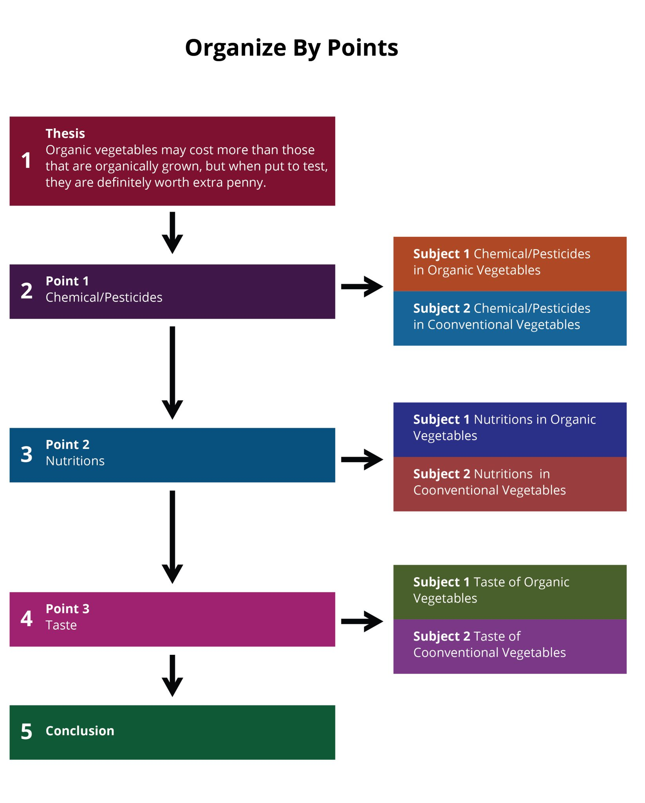
Organize by Points Diagram
Source: Compare and contrast – organize by points by University of Minnesota is licensed under CC BY-NC-SA. / Colours adjusted/images remade by Shaima.
Notes:
Organize by Points:
Thesis (Organic vegetables may cost more than those that are conventionally grown, but when put to the test, they are definitely worth every extra penny).
Point One 1: Chemical/Pesticides
Subject 1: Organic Vegetables
Subject 2: Conventional Vegetables
Point 2: Nutrition
Subject 1: Organic Vegetables
Subject 2: Conventional Vegetables
Point 3: Taste
Subject 1: Organic Vegetables
Subject 2: Conventional Vegetables
Conclusion
Source: Compare and contrast – organize by points by University of Minnesota is licensed under CC BY-NC-SA. / Colours adjusted/images remade by Shaima.

Slide 10
Writing a Comparison and Contrast Essay
Decide if you will be comparing subjects that appear different, contrasting subjects that appear similar or if you will be comparing and contrasting a subject
Begin your essay with introducing subjects in an engaging way and add your thesis in the end of introduction
Your thesis should establish the subjects discussed in the paper and if you will be comparing and or contrasting them
(Booth et al., 2022).
Notes:
Writing a Comparison and Contrast Essay was taken directly from Chapter 5.1 of Communication Essentials for College by Jen Booth, Emily Cramer & Amanda Quibell under a CC BY-NC 4.0 License. Some changes were made.

Slide 11
Writing a Comparison and Contrast Essay (Continued)
Body of essay can be organized by subject or individual points depending on audience and purpose of your writing
Use comparison and contrast phrases to depict relation between subjects
Your conclusion will end the essay by summarizing the main points and reiterating the thesis

Slide 12
5.1 - Key Takeaways
A compare-and-contrast essay analyzes two subjects by either comparing them, contrasting them, or both.
The purpose of writing a comparison or contrast essay is not to state the obvious but rather to illuminate subtle differences or unexpected similarities between two subjects.
Notes:
Key Takeaways were taken directly from Chapter 5.1 of Communication Essentials for College by Jen Booth, Emily Cramer & Amanda Quibell under a CC BY-NC 4.0 License. No changes were made.

Slide 13
5.1 - Key Takeaways (Continued 1)
The thesis should clearly state the subjects that are to be compared, contrasted, or both, and it should state what is to be learned from doing so.
There are two main organizing strategies for compare-and-contrast essays.
Organize by the subjects themselves, one then the other.
Organize by individual points, in which you discuss each subject in relation to each point.
Notes:
Key Takeaways were taken directly from Chapter 5.1 of Communication Essentials for College by Jen Booth, Emily Cramer & Amanda Quibell under a CC BY-NC 4.0 License. No changes were made.

Slide 14
5.1- Key Takeaways (Continued 2)
Use phrases of comparison or phrases of contrast to signal to readers how exactly the two subjects are being analyzed.
Notes:
Key Takeaways were taken directly from Chapter 5.1 of Communication Essentials for College by Jen Booth, Emily Cramer & Amanda Quibell under a CC BY-NC 4.0 License. No changes were made.

Slide 15
5.2 – Cause And Effect
Learning Objectives
Determine the purpose and structure of cause and effect in writing.
Understand how to write a cause-and-effect essay.
Notes:
Learning Objectives were taken directly from Chapter 5.2 of Communication Essentials for College by Jen Booth, Emily Cramer & Amanda Quibell under a CC BY-NC 4.0 License. No changes were made.

Slide 16
The Purpose of Cause and Effect in Writing
Cause is something that produces an event or condition
Effect is what results from an event or condition.
A cause-and-effect essay helps to determine connections between the origin and result of an event. These connections aren’t always clear.
(Booth et al., 2022).
Notes:
Cause and effect definitions were taken directly from Chapter 5.2 of Communication Essentials for College by Jen Booth, Emily Cramer & Amanda Quibell under a CC BY-NC 4.0 License. No changes were made.

Slide 17
The Structure of a Cause-and-Effect Essay
Begins with general introduction of the topic followed by the thesis stating the main causes and effects of an event
There are two ways to organize a cause-and-effect essay:
Start with the cause and then talk about the effects.
Start with the effect and then talk about the causes.
(Booth et al., 2022).
Notes:
The Structure of a Cause-and-Effect Essay were taken directly from Chapter 5.2 of Communication Essentials for College by Jen Booth, Emily Cramer & Amanda Quibell under a CC BY-NC 4.0 License. Some changes were made.

Slide 18
The Structure of a Cause-and-Effect Essay (Continued)
Explain every element of essay in detail regardless of the way you decide to organize the essay and provide evidence to support your explanation
Examples of phrases of causation include: as a result, because, due to, since, and therefore.

Slide 19
Writing a Cause-and-Effect Essay
Decide on an event that has an interesting cause-and-effect relationship you would like to write about
Introduce this topic in a way that captures reader’s attention and end with a thesis that addresses the main causes and effects
Organize the structure of your paper to follow the cause-then-effect structure or the effect-then-cause structure
(Booth et al., 2022).
Notes:
Writing a Cause-and-Effect Essay was taken directly from Chapter 5.2 of Communication Essentials for College by Jen Booth, Emily Cramer & Amanda Quibell under a CC BY-NC 4.0 License. Some changes were made.

Slide 20
Writing a Cause-and-Effect Essay (Continued 1)
Each section should clearly explain and use evidence to support causes and effects
If there are multiple causes or effects prioritize them from least to most important, or vice versa
(Booth et al., 2022).
Notes:
Writing a Cause-and-Effect Essay was taken directly from Chapter 5.2 of Communication Essentials for College by Jen Booth, Emily Cramer & Amanda Quibell under a CC BY-NC 4.0 License. Some changes were made.

Slide 21
Writing a Cause-and-Effect Essay (Continued 2)
Use proper phrases of causation to show relationship between the cause and effect
The conclusion should summarize the main points from essay and reiterating the thesis
(Booth et al., 2022).
Notes:
Writing a Cause-and-Effect Essay was taken directly from Chapter 5.2 of Communication Essentials for College by Jen Booth, Emily Cramer & Amanda Quibell under a CC BY-NC 4.0 License. Some changes were made.

Slide 22
5.2- Key Takeaways
The purpose of the cause-and-effect essay is to determine how various phenomena are related.
The thesis states what the writer sees as the main cause, main effect, or various causes and effects of a condition or event.
Notes:
Key Takeaways were taken directly from Chapter 5.2 of Communication Essentials for College by Jen Booth, Emily Cramer & Amanda Quibell under a CC BY-NC 4.0 License. No changes were made.

Slide 23
5.2- Key Takeaways (Continued 1)
The cause-and-effect essay can be organized in one of these two primary ways:
Start with the cause and then talk about the effect.
Start with the effect and then talk about the cause.
Notes:
Key Takeaways were taken directly from Chapter 5.2 of Communication Essentials for College by Jen Booth, Emily Cramer & Amanda Quibell under a CC BY-NC 4.0 License. No changes were made.

Slide 24
5.2 - Key Takeaways (Continued 2)
Strong evidence is particularly important in the cause-and-effect essay due to the complexity of determining connections between phenomena.
Phrases of causation are helpful in signaling links between various elements in the essay.
Notes:
Key Takeaways were taken directly from Chapter 5.2 of Communication Essentials for College by Jen Booth, Emily Cramer & Amanda Quibell under a CC BY-NC 4.0 License. No changes were made.

Slide 25
5.3 - Persuasion
Learning Objectives
Determine the purpose and structure of persuasion in writing.
Identify bias in writing.
Assess various rhetorical devices.
Distinguish between fact and opinion.
Understand the importance of visuals to strengthen arguments.
Write a persuasive essay.
Notes:
Learning Objectives was taken directly from Chapter 5.3 of Communication Essentials for College by Jen Booth, Emily Cramer & Amanda Quibell under a CC BY-NC 4.0 License. No changes were made.

Slide 26
The Purpose of Persuasive Writing
A persuasive essay is used to convince or present a different perspective on a topic, this implies that more than one opinion can be had on the topic
In writing, an argument is a well-structured opinion backed by evidence and reasoning

Slide 27
The Structure of a Persuasive Essay
The following five features make up the structure of a persuasive essay:
Introduction and thesis
Opposing and qualifying ideas
Strong evidence in support of claim
Style and tone of language
A compelling conclusion
(Booth et al., 2022).
Notes:
Features of persuasive essay was directly from Chapter 5.3 of Communication Essentials for College by Jen Booth, Emily Cramer & Amanda Quibell under a CC BY-NC 4.0 License. No changes were made.

Slide 28
Creating an Introduction and Thesis
Decide on a topic
Begin your essay with introducing topic and add your thesis somewhere in the introduction paragraph along with your point of view

Slide 29
Acknowledging Opposing Ideas and Limits to Your Argument
Arguments can involve multiple perspectives on a topic; be sure to acknowledge these and address them respectfully early in your paper to build credibility
By addressing opposing point of views in the initial paragraphs you can end with your own thoughts

Slide 30
Bias in Writing
Everyone has a bias on one topic or the other
Handling bias is an important skills to have and allows you to articulate your point of view
Acknowledge your bias, but do not let it take over your essay, and build a strong argument using evidence

Slide 31
The Use of “I” in Writing
Using “I” in writing is a topic of debate so confirm with your instructor what they prefer
Keep the message (the subject) and the messenger (the writer) separate to keep the focus on the subject
(Booth et al., 2022).
Notes:
The Use of “I” in Writing was taken directly from Chapter 5.3 of Communication Essentials for College by Jen Booth, Emily Cramer & Amanda Quibell under a CC BY-NC 4.0 License. Some changes were made.

Slide 32
The Use of “I” in Writing (Continued)
Two reasons to avoid using “I”:
Repeating “I” will catch readers attention in a negative way
It may alter the composition of sentence displacing the main subject in to secondary position
(Booth et al., 2022).
Notes:
The Use of “I” in Writing was taken directly from Chapter 5.3 of Communication Essentials for College by Jen Booth, Emily Cramer & Amanda Quibell under a CC BY-NC 4.0 License. Some changes were made.

Slide 33
Developing Sound Arguments - Checklist
Does my essay contain the following elements?
An engaging introduction.
A reasonable , specific thesis that is able to support by evidence.
A varied range of evidence from credible sources
Acknowledgement of the argument’s limits
A conclusion that will adequately summarize the essay.
(Booth et al., 2022).
Notes:
Developing Sound Arguments – Checklist was taken directly from Chapter 5.3 of Communication Essentials for College by Jen Booth, Emily Cramer & Amanda Quibell under a CC BY-NC 4.0 License. No Changes made.

Slide 34
Fact and Opinion
Facts are statements that can be definitely proven using objective data, can be identified as true or false
Opinions are anyone’s perspective, judgement or personal belief on a subject
When arguing an opinion it must be supported with evidence and credibility, ie. the credibility of an expert opinion
(Booth et al., 2022).
Notes:
Fact and Opinion was taken directly from Chapter 5.3 of Communication Essentials for College by Jen Booth, Emily Cramer & Amanda Quibell under a CC BY-NC 4.0 License. Some changes were made.

Slide 35
Using Visual Elements to Strengthen Arguments
Visual elements enhance the effect of a persuasive argument
Two main type of visual elements are:
Quantitative visuals: Graphical representation of data
Qualitative visuals: Using images to appeal audience’s emotion
(Booth et al., 2022).
Notes:
Using Visual Elements to Strengthen Arguments was taken directly from Chapter 5.3 of Communication Essentials for College by Jen Booth, Emily Cramer & Amanda Quibell under a CC BY-NC 4.0 License. Some changes were made.

Slide 36
Writing a Persuasive Essay
Select a topic and decide on your argument
Start your essay with an engaging introduction that includes your thesis
Begin by stating your own argument and respectfully acknowledging opposing arguments while concede limitations of your point of view; this gains the reader’s trust and sets a responsible tone

Slide 37
Writing a Persuasive Essay (Continued)
Include your perspective and back your argument with reliable evidence
Make sure to keep your style and tone consistent
The conclusion should summarize the paper’s main argument reinforce the thesis

Slide 38
5.3- Key Takeaways
The purpose of persuasion in writing is to convince or move readers toward a certain point of view, or opinion.
An argument is a reasoned opinion supported and explained by evidence. To argue, in writing, is to advance knowledge and ideas in a positive way.
Notes:
Key Takeaways were taken directly from Chapter 5.3 of Communication Essentials for College by Jen Booth, Emily Cramer & Amanda Quibell under a CC BY-NC 4.0 License. No changes were made.

Slide 39
5.3- Key Takeaways (Continued 1)
A thesis that expresses the opinion of the writer in more specific terms is better than one that is vague.
It is essential that you not only address counterarguments but also do so respectfully.
It is also helpful to establish the limits of your argument and what you are trying to accomplish through a concession statement.
Notes:
Key Takeaways were taken directly from Chapter 5.3 of Communication Essentials for College by Jen Booth, Emily Cramer & Amanda Quibell under a CC BY-NC 4.0 License. No changes were made.

Slide 40
5.3 - Key Takeaways (Continued 2)
To persuade a skeptical audience, you will need to use a wide range of evidence. Scientific studies, opinions from experts, historical precedent, statistics, personal anecdotes, and current events are all types of evidence that you might use in explaining your point.
Make sure that your word choice and writing style is appropriate for both your subject and your audience.
Notes:
Key Takeaways were taken directly from Chapter 5.3 of Communication Essentials for College by Jen Booth, Emily Cramer & Amanda Quibell under a CC BY-NC 4.0 License. No changes were made.

Slide 41
5.3 - Key Takeaways (Continued 3)
You should let your reader know your bias, but do not let that bias blind you to the primary components of good argumentation: sound, thoughtful evidence and respectfully and reasonably addressing opposing ideas.
You should be mindful of the use of I in your writing because it can make your argument sound more biased than it needs to.
Notes:
Key Takeaways were taken directly from Chapter 5.3 of Communication Essentials for College by Jen Booth, Emily Cramer & Amanda Quibell under a CC BY-NC 4.0 License. No changes were made.

Slide 42
5.3 - Key Takeaways (Continued 4)
Facts are statements that can be proven using objective data.
Opinions are personal views, or judgments, that cannot be proven.
In writing, you want to strike a balance between credible facts and authoritative opinions.
Notes:
Key Takeaways were taken directly from Chapter 5.3 of Communication Essentials for College by Jen Booth, Emily Cramer & Amanda Quibell under a CC BY-NC 4.0 License. No changes were made.

Slide 43
5.3 - Key Takeaways (Continued 5)
Quantitative visuals present data graphically. The purpose of using quantitative visuals is to make logical appeals to the audience.
Qualitative visuals present images that appeal to the audience’s emotions.
Notes:
Key Takeaways were taken directly from Chapter 5.3 of Communication Essentials for College by Jen Booth, Emily Cramer & Amanda Quibell under a CC BY-NC 4.0 License. No changes were made.

Slide 44
References & Attributions
Compare and contrast – organize by points by University of Minnesota is licensed under CC BY-NC-SA. / Colours adjusted/images remade by Shaima.
Compare and contrast – organize by subject by University of Minnesota is licensed under CC BY-NC-SA. / Colours adjusted/images remade by Shaima.
Cramer, E., Quibell, A., & Booth, J. (2022, February 28). Communication Essentials for College. eCampus Ontario Open Library. https://ecampusontario.pr essbooks.pub/gccomm/

