Slide 1
Communication Essentials for College
Chapter 4
Summary slides created to accompany Communication Essentials for College Jen Booth, Emily Cramer & Amanda Quibell, Georgian College.
Slide Design by: Shaima, Georgian College OER Design Studio, funded by eCampus Ontario/VLS 2
Except where otherwise noted, all material is licensed under CC BY NC 4.0

Slide 2
Chapter 4: Writing Essays From Start To Finish
4.1 – Developing a Strong, Clear Thesis Statement
4.2 – Writing Body Paragraphs
4.3 – Organizing Your Writing
4.4 – Writing Introductory and Concluding Paragraphs
4.5 – Writing Essays: Exercises
Notes:
Chapter 4: Writing Essays From Start To Finish was taken directly from Chapter 4 of Communication Essentials for College by Jen Booth, Emily Cramer & Amanda Quibell under a CC BY-NC 4.0 License. No changes were made.

Slide 3
4.1 – Developing a Strong, Clear Thesis Statement
Learning Objectives
Develop a strong, clear thesis statement with the proper elements.
Revise your thesis statement.
Notes:
Learning Objectives were taken directly from Chapter 4.1 of Communication Essentials for College by Jen Booth, Emily Cramer & Amanda Quibell under a CC BY-NC 4.0 License. No changes were made.

Slide 4
Elements of a Thesis Statement
A thesis statement summarizes the entire essay and tells the reader the point it will make.
A thesis is your interpretation of the topic or question.
It one sentence long, appears towards the end of your introduction, and focuses on three points of a single idea that is developed within the essay
(Booth et al., 2022).
Notes:
Elements of a Thesis Statement was taken directly from Chapter 4.1 of Communication Essentials for College by Jen Booth, Emily Cramer & Amanda Quibell under a CC BY-NC 4.0 License. Some changes were made.

Slide 5
A Strong Thesis Statement
A strong thesis statement should have the following qualities:
Specificity
Precision
Ability to be argued
Ability to be demonstrated
Forcefulness
Confidence
(Booth et al., 2022).
Notes:
A Strong Thesis Statement was taken directly from Chapter 4.1 of Communication Essentials for College by Jen Booth, Emily Cramer & Amanda Quibell under a CC BY-NC 4.0 License. Some changes were made.

Slide 6
Examples of Appropriate Thesis Statements
Educating newcomers to Canada about historical Indigenous treaties is an important way to implement the Truth and Reconciliation Commission’s Call to Action.
Shakespeare’s use of dramatic irony in Romeo and Juliet spoils the outcome for the audience and weakens the plot.
(Cramer, et al., 2022).
Notes:
Examples of Appropriate Thesis Statements was taken directly from Chapter 4.1 of Communication Essentials for College by Jen Booth, Emily Cramer & Amanda Quibell under a CC BY-NC 4.0 License. No changes were made.

Slide 7
Examples of Appropriate Thesis Statements (Continued)
Avoid doing the following when writing your thesis statement:
Do not simply declare the subject of your essay or describe what will be discussed
Do not make any arbitrary claim
Do not include an obvious fact in your thesis statement that nobody can disagree with
Do not make your thesis statement too broad
(Booth et al., 2022).
Notes:
Examples of Appropriate Thesis Statements was taken directly from Chapter 4.1 of Communication Essentials for College by Jen Booth, Emily Cramer & Amanda Quibell under a CC BY-NC 4.0 License. Some changes were made.

Slide 8
Thesis Statement Revision
Writing a thesis statement is a continuous process. It will evolve over time
It will begin as a working thesis statement which will become stronger as you paper comes together and you revise it
Ensure that your thesis matches what is written in your paper

Slide 9
Ways to Revise Your Thesis
Revise your thesis by:
Replacing nonspecific words with precise words to reduce vagueness
Clarify ideas that need explanation by asking yourself questions that narrow your thesis.
Replace any linking verbs with action verbs
Remove general claims that are difficult to support
(Booth et al., 2022).
Notes:
Ways to Revise Your Thesis was taken directly from Chapter 4.1 of Communication Essentials for College by Jen Booth, Emily Cramer & Amanda Quibell under a CC BY-NC 4.0 License. Some changes were made.

Slide 10
4.1 - Key Takeaways
Proper essays require a thesis statement to provide a specific focus and suggest how the essay will be organized.
A thesis statement is your interpretation of the subject, not the topic itself.
A strong thesis is specific, precise, forceful, confident, and is able to be demonstrated.
Notes:
Key Takeaways were taken directly from Chapter 4.1 of Communication Essentials for College by Jen Booth, Emily Cramer & Amanda Quibell under a CC BY-NC 4.0 License. No changes were made.

Slide 11
4.1 - Key Takeaways (Continued 1)
A strong thesis challenges readers with a point of view that can be debated and can be supported with evidence.
A weak thesis is simply a declaration of your topic or contains an obvious fact that cannot be argued.
Notes:
Key Takeaways were taken directly from Chapter 4.1 of Communication Essentials for College by Jen Booth, Emily Cramer & Amanda Quibell under a CC BY-NC 4.0 License. No changes were made.

Slide 12
4.1 - Key Takeaways (Continued 2)
Depending on your topic, it may or may not be appropriate to use first person point of view.
Revise your thesis by ensuring all words are specific, all ideas are exact, and all verbs express action.
Notes:
Key Takeaways were taken directly from Chapter 4.1 of Communication Essentials for College by Jen Booth, Emily Cramer & Amanda Quibell under a CC BY-NC 4.0 License. No changes were made.

Slide 13
4.2 - Writing Body Paragraphs
Learning Objectives
Select primary support related to your thesis.
Support your topic sentences.
Notes:
Learning Objectives was taken directly from Chapter 4.2 of Communication Essentials for College by Jen Booth, Emily Cramer & Amanda Quibell under a CC BY-NC 4.0 License. No changes were made.

Slide 14
Select Primary Support for Your Thesis
Primary support are the major points that you will expand on in your paper and are needed to make your argument convincing.
Major points are supported by the supporting details which appear in the body paragraphs of your essay
Body paragraphs present evidence to support your thesis

Slide 15
Identify the Characteristics of Good Primary Support
A good primary support should:
Be specific
Be relevant to the thesis
Be detailed

Slide 16
Prewrite to Identify Primary Supporting Points for a Thesis Statement
Make a list of points about why you support the main idea
Breakdown the list into further detailed points
After prewriting, select best points to use in your body paragraphs

Slide 17
Select the Most Effective Primary Supporting Points for a Thesis Statement
Once you have your working thesis statement prewritten, omit any unrelated information that does not relate to your main idea directly
Choose the three most persuasive point for your essay which will becomes your topic sentences
Evidence is used to support your thesis

Slide 18
Select the Most Effective Primary Supporting Points for a Thesis Statement (Continued)
Evidence can be in the form of:
Facts
Judgements
Testimony
Personal Observation

Slide 19
Choose Supporting Topic Sentences
Every body paragraph should contain a topic sentence that states one key point from your thesis and expands on it
Body paragraph should include a topic sentence and supporting details, such as examples, reasons or arguments
Topic sentences are vital as they refer back to and support your thesis
(Booth et al., 2022).
Notes:
Choose Supporting Topic Sentenceswas taken directly from Chapter 4.2 of Communication Essentials for College by Jen Booth, Emily Cramer & Amanda Quibell under a CC BY-NC 4.0 License. Minimal changes were made.

Slide 20
Draft Supporting Detail Sentences for Each Primary Support Sentence
The primary support points will become your topic sentences, but you need to add more detail (examples, facts, evidence) to support and clarify each of them

Slide 21
4.2 - Key Takeaways
Your body paragraphs should closely follow the path set forth by your thesis statement.
Strong body paragraphs contain evidence that supports your thesis.
Primary support comprises the most important points you use to support your thesis.
Notes:
Key Takeaways were taken directly from Chapter 4.2 of Communication Essentials for College by Jen Booth, Emily Cramer & Amanda Quibell under a CC BY-NC 4.0 License. No changes were made.

Slide 22
4.2 - Key Takeaways (Continued 1)
Strong primary support is specific, detailed, and relevant to the thesis.
Prewriting helps you determine your most compelling primary support.
Evidence includes facts, judgments, testimony, and personal observation.
Notes:
Key Takeaways were taken directly from Chapter 4.2 of Communication Essentials for College by Jen Booth, Emily Cramer & Amanda Quibell under a CC BY-NC 4.0 License. No changes were made.

Slide 23
4.2 - Key Takeaways (Continued 2)
Reliable sources may include newspapers, magazines, academic journals, books, encyclopedias, and firsthand testimony.
A topic sentence presents one point of your thesis statement while the information in the rest of the paragraph supports that point.
A body paragraph comprises a topic sentence plus supporting details.
Notes:
Key Takeaways were taken directly from Chapter 4.2 of Communication Essentials for College by Jen Booth, Emily Cramer & Amanda Quibell under a CC BY-NC 4.0 License. No changes were made.

Slide 24
4.3 - Organizing Your Writing
Learning Objectives
Understand how and why organizational techniques help writers and readers stay focused.
Assess how and when to use chronological order to organize an essay.
Recognize how and when to use order of importance to organize an essay.
Determine how and when to use spatial order to organize an essay.
Notes:
Learning Objectives was taken directly from Chapter 4.3 of Communication Essentials for College by Jen Booth, Emily Cramer & Amanda Quibell under a CC BY-NC 4.0 License. No changes were made.

Slide 25
Organizing Body Paragraphs
The structure of the essay helps the reader connect the body of your paper to the thesis
Three ways to organize your body paragraphs are:
Chronological order
Order of importance
Spatial order

Slide 26
Chronological Order
Generally used for expository writing which is a form of writing that narrates, describes, informs, or explains a process.
Arrange events in the order that they happened or will happen if you are providing instruction
Appropriate for essays with heavy research, listing, explaining, or analyzing literary work etc.
Uses transitional words such as: first, finally, and later.
Notes:
Chronological Order was taken directly from Chapter 4.3 of Communication Essentials for College by Jen Booth, Emily Cramer & Amanda Quibell under a CC BY-NC 4.0 License. Some changes were made.

Slide 27
Order of Importance
Organize ideas from least to most important points to make a strong essay
Persuasive essay: organize ideas from most to least important points to get reader’s attention
Commonly used transitional words include: most importantly, just as importantly, and finally

Slide 28
Spatial Order
Create picture with words to help reader visualize how objects are arranged in your space
To have a smooth flow, it is important to have a specific starting and end point
Commonly used transitional words include: behind, between, turning left or right, and across from

Slide 29
4.3 - Key Takeaways
The way you organize your body paragraphs ensures you and your readers stay focused on and draw connections to, your thesis statement.
A strong organizational pattern allows you to articulate, analyze, and clarify your thoughts.
(Booth et al., 2022).
Notes:
Key Takeaways were taken directly from Chapter 4.3 of Communication Essentials for College by Jen Booth, Emily Cramer & Amanda Quibell under a CC BY-NC 4.0 License. No changes were made.

Slide 30
4.3 - Key Takeaways (Continued 1)
Planning the organizational structure for your essay before you begin to search for supporting evidence helps you conduct more effective and directed research.
Chronological order is most commonly used in expository writing. It is useful for explaining the history of your subject, for telling a story, or for explaining a process.
Notes:
Key Takeaways were taken directly from Chapter 4.3 of Communication Essentials for College by Jen Booth, Emily Cramer & Amanda Quibell under a CC BY-NC 4.0 License. No changes were made.

Slide 31
4.3 - Key Takeaways (Continued 2)
Order of importance is most appropriate in a persuasion paper as well as for essays in which you rank things, people, or events by their significance.
Spatial order describes things as they are arranged in space and is best for helping readers visualize something as you want them to see it; it creates a dominant impression.
Notes:
Key Takeaways were taken directly from Chapter 4.3 of Communication Essentials for College by Jen Booth, Emily Cramer & Amanda Quibell under a CC BY-NC 4.0 License. No changes were made.

Slide 32
4.4 - Writing Introductory And Concluding Paragraphs
Learning Objectives
Recognize the importance of strong introductory and concluding paragraphs.
Learn to engage the reader immediately with the introductory paragraph.
Practice concluding your essays in a more memorable way.
Notes:
Learning Objectives were taken directly from Chapter 4.4 of Communication Essentials for College by Jen Booth, Emily Cramer & Amanda Quibell under a CC BY-NC 4.0 License. No changes were made.

Slide 33
Attracting Interest in Your Introductory Paragraph
The purposes of an introduction is to:
Establishes your voice and tone, or your attitude, toward the subject
Introduces the general topic of the essay
States the thesis that will be supported in the body paragraphs
(Booth et al., 2022).
Notes:
Attracting Interest in Your Introductory Paragraph was taken directly from Chapter 4.4 of Communication Essentials for College by Jen Booth, Emily Cramer & Amanda Quibell under a CC BY-NC 4.0 License. No changes were made.

Slide 34
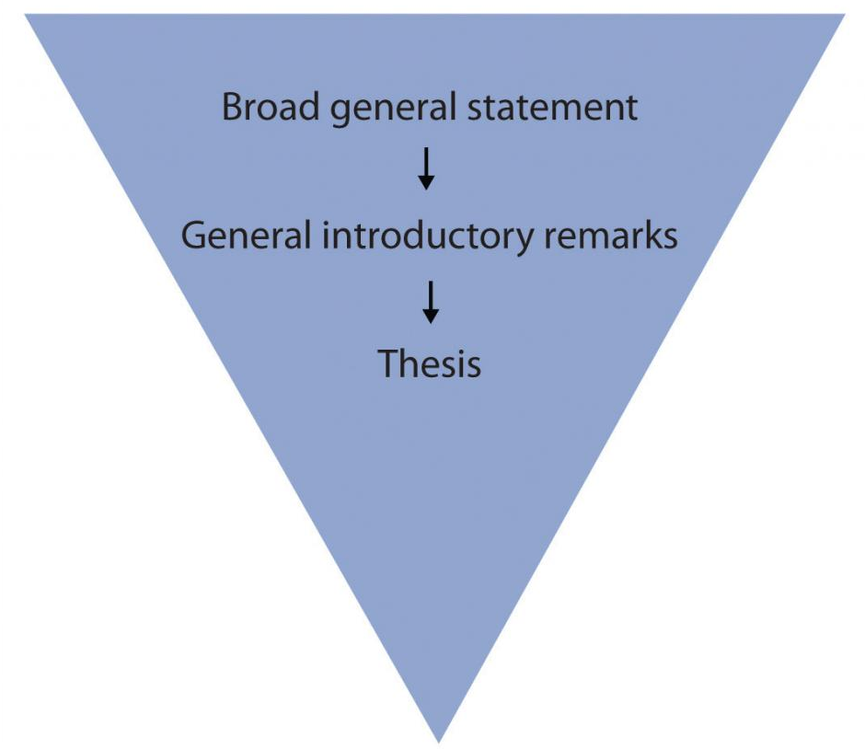
Attracting Interest in Your Introductory Paragraph (Continued 1)
Funnel Technique: Using the funnel technique, a broad general statement is funneled down to general introductory remarks, and then to a more specific thesis. Image Credit: Figure 1 – Funnel Technique by Amanda Quibell, Emily Cramer, and Georgian College, licensed under CC BY-NC- 4.0.
Notes:
Figure 1 – Funnel Technique was taken directly from Chapter 4.4 of Communication Essentials for College by Jen Booth, Emily Cramer & Amanda Quibell under a CC BY-NC 4.0 License. No changes were made.
Figure 1 – Funnel Technique by Jen Booth, Emily Cramer & Amanda Quibell, Georgian College, licensed under CC BY-NC- 4.0.

Slide 35
Attracting Interest in Your Introductory Paragraph (Continued 2)
There are many methods to get reader’s attention these include:
Appealing to the reader’s emotions
Use logic
Begin the essay with a provocative question or opinion
Begin with a startling statistic or surprising fact
(Booth et al., 2022).
Notes:
Attracting Interest in Your Introductory Paragraph was taken directly from Chapter 4.4 of Communication Essentials for College by Jen Booth, Emily Cramer & Amanda Quibell under a CC BY-NC 4.0 License. Some changes were made.

Slide 36
Writing a Conclusion
Conclusion requires equal amount of attention as the introduction or any other paragraph
Unorganized or incomplete conclusions can cause doubts and raise questions about the essay

Slide 37
The Anatomy of a Strong Conclusion
Conclusion must confirm the ideas discussed in rest of your essay
Restate your thesis in the beginning of conclusion to reiterate the main points and topic. Paraphrase your thesis and main ideas
Strong closing statement will make your readers think and leave a strong impression

Slide 38
4.4 - Key Takeaways
A strong opening captures your readers’ interest and introduces them to your topic before you present your thesis statement.
An introduction should restate your thesis, review your main points, and emphasize the importance of the topic.
Notes:
Key Takeaways were taken directly from Chapter 4.4 of Communication Essentials for College by Jen Booth, Emily Cramer & Amanda Quibell under a CC BY-NC 4.0 License. No changes were made.

Slide 39
4.4 - Key Takeaways (Continued 1)
The funnel technique to writing the introduction begins with generalities and gradually narrows your focus until you present your thesis.
A good introduction engages people’s emotions or logic, questions or explains the subject, or provides a striking image or quotation.
Notes:
Key Takeaways were taken directly from Chapter 4.4 of Communication Essentials for College by Jen Booth, Emily Cramer & Amanda Quibell under a CC BY-NC 4.0 License. No changes were made.

Slide 40
4.4 - Key Takeaways (Continued 2)
Carefully chosen diction in both the introduction and conclusion prevents any confusing or boring ideas.
A conclusion that does not connect to the rest of the essay can diminish the effect of your paper.
Notes:
Key Takeaways were taken directly from Chapter 4.4 of Communication Essentials for College by Jen Booth, Emily Cramer & Amanda Quibell under a CC BY-NC 4.0 License. No changes were made.

Slide 41
4.4 - Key Takeaways (Continued 3)
The conclusion should remain true to your thesis statement. It is best to avoid changing your tone or your main idea and avoid introducing any new material.
Closing with a final emphatic statement provides closure for your readers and makes your essay more memorable.
Notes:
Key Takeaways were taken directly from Chapter 4.4 of Communication Essentials for College by Jen Booth, Emily Cramer & Amanda Quibell under a CC BY-NC 4.0 License. No changes were made.

Slide 42
References & Attributions
Cramer, E., Quibell, A., & Booth, J. (2022, February 28). Communication Essentials for College. eCampus Ontario Open Library. https://ecampusontario.pre ssbooks.pub/gccomm/
Figure 1 – Funnel Technique by Amanda Quibell, Emily Cramer, and Georgian College, licensed under CC BY-NC- 4.0.

