Slide 1
Communication Essentials for College
Chapter 2
Summary slides created to accompany Communication Essentials for College by Jen Booth, Emily Cramer & Amanda Quibell, Georgian College.
Slide Design by: Shaima, Georgian College OER Design Studio, funded by eCampus Ontario/VLS 2
Except where otherwise noted, all material is licensed under CC BY NC 4.0

Slide 2
Chapter 2: Reading & Writing For College
2.1 – Reading for College
2.2 – Note-Taking
2.3 – Writing for College
2.4 – Purpose, Audience, Tone, and Content
2.5 – Effective Means for Writing a Paragraph
2.6 – Writing Paragraphs: Exercises
Notes:
Chapter 2: Reading & Writing for College were taken directly from Chapter 2 of Communication Essentials for College by Jen Booth, Emily Cramer & Amanda Quibellunder a CC BY-NC 4.0 License. No changes were made.

Slide 3
2.1 - Reading for College
Learning Objectives
Understand the expectations for reading and writing assignments in post-secondary courses
Understand and apply general strategies to complete college-level reading assignments efficiently and effectively
Notes:
Reading for College were taken directly from Chapter 2.1 of Communication Essentials for College by Jen Booth, Emily Cramer & Amanda Quibellunder a CC BY-NC 4.0 License. No changes were made.

Slide 4
High School versus Post-Secondary Assignments
College academic expectations increase compared to those in high school
Higher quality of work and more effort is required. You are expected to engage with new ideas, reflect, analyze, make new connections and think out of the box

Slide 5
Setting Goals
Stay focused and determine your short and long term goals
Working on these goals gradually and consistently will help you to excel in your career and life

Slide 6
Reading Strategies
As you continue to study your courses in college, you will work on and enhance both your reading and writing skills
Most part of your writing assignments will depend on how well you read and understand course material and research

Slide 7
Reading Strategies (Continued)
Three reading strategies to improve your skill
Planning strategy
Comprehension strategy
Active reading strategy

Slide 8
Planning Your Reading
Determine the purpose for the required readings
Plan in advance the resources you have to read and manage time accordingly

Slide 9
Managing Your Reading Time
Block small chunks of time in your day to do the reading for your courses instead of leaving all the reading for last minute
Identify the reading material, whether it is text heavy or easy to read, and plan accordingly. Text heavy reading materials usually require more time

Slide 10
Managing Your Reading Time (Continued)
Set a purpose of your reading:
What do you wish to achieve after the reading assignment?
How in-depth do you need to understand the reading material?
How much does it relate to your coursework or assignment?
Setting a purpose will help you to identify how much time you could spend on that reading material

Slide 11
Improving Your Comprehension
After setting a plan and managing time, you must work on assessing the process to understand the reading and writing
For expository writing, it is ideal to identify the main points and assess how well you understand the material you are reading
Take time to think about what reading strategy works best for you

Slide 12
Identifying the Main Points
Your first goal towards your comprehension will always be to identify main points, regardless of the type of reading material
Reading material could be in the form of textbook, non-fiction trade book, magazine, newspaper or a scholarly journal/article etc.
After finding the main point you then identify the supporting points and explanations that develop and clarify it

Slide 13
Identifying the Main Points (Continued)
The most important idea is generally stated by the author in the beginning or the introductory paragraphs. Look for main points in summary, key objectives, introductions or conclusions
Headings and subheadings will show how the author has organized supporting points
Main points will give you a general overview and context of the reading material

Slide 14
Monitoring Your Comprehension
Try answering comprehension questions at the end of each chapter to assess your reading
Summarize main points at the end of reading each section
Identify questions you should be able to answer at the end of the chapter section
Do not read in a vacuum: discuss the readings with classmates to determine if you understand the main points

Slide 15
Taking It to the Next Level: Active Reading
Two common strategies for active reading are:
Applying the four reading strategies
SQ3R

Slide 16
Four Reading Stages
Using these reading strategies will help you understand and remember the content
The four reading stages are:
Survey reading
Close reading
Inquiry reading
Critical reading

Slide 17
Four Reading Stages (Continued)
All the reading stages focus on “reading as thinking” which means you need to read actively to understand and remember. To do this you need to reflect on the relevance of ideas and their usefulness.

Slide 18
Survey reading
Skimming through text, spending 2 to 10 minutes per chapter, gives you overall picture of the text. Some benefits are:
You have a better understanding of how long it will take you to study the text thoroughly
You can highlight key topics and how they are relevant
Improves concentration

Slide 19
Close reading
This reading stage allows you to concentrate and make decisions about how relevant content is, to ensure you understand the content, and makes it easier to remember
You read to remember at least 75 to 80% of information
Identify main points, key details of each section in a chapter, and summarize
You should be able to give a test immediately after reading
(Booth et al., 2022)
Notes:
Close reading were taken directly from Chapter 2.1 of Communication Essentials for College by Jen Booth, Emily Cramer & Amanda Quibellunder a CC BY-NC 4.0 License. Some changes were made.

Slide 20
Inquiry reading
Also known as ‘Discovery Reading’
Increased focus: This is a more involved reading stage. You ask interpretative questions and search for answers while you read.
Increased retention: You are able to retain more information from reading material because of active involvement

Slide 21
Inquiry reading (Continued)
Stimulation of creativity: As you use this stages and raise new question they might inspire you to research further
Match instructors expectations: Instructors are looking for deep understanding of course content

Slide 22
Critical reading
Interpret, analyze and evaluate the content to deepen understanding and make connections to other reading materials
Critically determine the key concepts, relevancy, and the accuracy of arguments to make better judgement about the text
Recognizes the biases, motivations and assumptions and instead relies on evidence and open-mindedness when reading

Slide 23
Using the SQ3R Strategy
Step by step process for various reading purposes like
Getting main concepts only
Flushing out key details
Organizing concepts
Summarizing key points
(Booth et al., 2022)
Notes:
Using the SQ3R Strategy were taken directly from Chapter 2.1 of Communication Essentials for College by Jen Booth, Emily Cramer & Amanda Quibellunder a CC BY-NC 4.0 License. Some changes were made.

Slide 24
Using the SQ3R Strategy (Continued)
The SQ3R follows this process:
Survey or skim the text before reading.
Create questions before you start reading.
Read the text.
Recite and/or record important points during and after reading.
Review and reflect on the text after you read.
(Booth et al., 2022)
Notes:
Using the SQ3R Strategy were taken directly from Chapter 2.1 of Communication Essentials for College by Jen Booth, Emily Cramer & Amanda Quibellunder a CC BY-NC 4.0 License. Some changes were made.

Slide 25
Using Other Active Reading Strategies
Connect what you know to what you are reading, relate it to your own life
Visualize and try to create a picture or narrative to describe the text
Pay attention to graphics (photos, diagrams, charts, tables)
Understand the text in context (who wrote it, where was it written, are there an assumptions or agendas)
Plan to discuss what you are reading

Slide 26
2.2 - Note-Taking
Learning Objectives
Understand and apply strategies for taking notes efficiently.
Determine the specific study and note-taking strategies that work best for you individually.
Notes:
Note-Taking was taken directly from Chapter 2.2 of Communication Essentials for College by Jen Booth, Emily Cramer & Amanda Quibellunder a CC BY-NC 4.0 License. No changes were made.

Slide 27
Two Purposes for Taking Notes
External storage: note-taking to keep a record of information shared in class as a learning tool.
As a way to review information shared in class when studying for an exam
(Kwantlen Polytechnic University , 2018, as cited in Booth et al., 2022)
Notes:
“Take Notes from Lectures – That You’ll Actually Use” in University 101: Study, Strategize and Succeed by Kwantlen Polytechnic University licensed under CC BY-SA 4.0.

Slide 28
How Note-Taking Supports Learning
Focus attention – avoid distraction
Engaged learning by identifying main points and organizing ideas
Supports your learning and a record to review later
(Kwantlen Polytechnic University , 2018, as cited in Booth et al., 2022)
Notes:
“Take Notes from Lectures – That You’ll Actually Use” in University 101: Study, Strategize and Succeed by Kwantlen Polytechnic University licensed under CC BY-SA 4.0.

Slide 29
Note-taking methods
The List Method:
Most commonly used method by students
Sequential list of ideas
Short phrases or complete paragraphs
Requires a lot of writing at fast pace to keep up with instructor

Slide 30
Note-taking methods (Continued 1)
The Outline Method:
Easy to use when taking notes on computer and course material is organized
Most important ideas along the left margin numbered with roman numerals
Supporting ideas and concepts are indented with capital letters
Details are added under each idea for further explanation

Slide 31
Note-taking methods (Continued 2)
Concept Map Method:
Central idea is placed in the centre of page
Add lines and new circles to depict new ideas and associations between them
Great way to show connection between topic and to get an overview when reviewing

Slide 32
Note-taking methods (Continued 3)
Cornell Method:
Follows four box format: header, two column and a footer
Header identifies course name and date
Left column is known as “cue” or “recall”. Contains main points or key ideas to review after class. Takes up one-third of page.
Right column is for notes and could utilize any of the three note-taking methods discussed earlier. Takes two thirds of the page.
Footer is a summary of the course

Slide 33
Instructor Handouts
Most instructors handout or post notes and PowerPoint slides online for each lecture
Consider them as complimentary learning material and make your own notes

Slide 34
General Tips on Note-Taking
DO’S
Be Prepared
Write on only one side of the paper
Label, number, and date all notes at the top of each page
Position your laptop so you can see the instructor and while board right over your screen
Copy anything the instructor writes on the board
Leave space between ideas
(Booth et al., 2022)
Notes:
General Tips on Note-Taking was taken directly from Chapter 2.2 of Communication Essentials for College by Jen Booth, Emily Cramer & Amanda Quibellunder a CC BY-NC 4.0 License. Some changes were made.

Slide 35
General Tips on Note-Taking (Continued)
DO’S
Use signals and abbreviations
Write a summary of the main ideas of the class in your own words
Review notes soon after class and use notes to prepare for tests and doing assignments
DON’T
Try to capture everything that is said
(Booth et al., 2022)
Notes:
General Tips on Note-Taking (Continued) was taken directly from Chapter 2.2 of Communication Essentials for College by Jen Booth, Emily Cramer & Amanda Quibellunder a CC BY-NC 4.0 License. Some changes were made.

Slide 36
What If You Miss Class?
Review lecture recording or reading material
Check with instructor to attend an alternate section to catchup
Ask your classmates for notes
If nothing else works, then check the syllabus to see what you have missed, do your reading and contact instructor for any questions

Slide 37
2.2 - Key Takeaways
Good note-taking is a key strategy for academic success.
Choose among effective note-taking styles for what works best for you and modify it to meet the needs of a specific class or instructor.
List notes are generally less effective and not prioritized.
Notes:
Key Takeaways was taken directly from Chapter 2.2 of Communication Essentials for College by Jen Booth, Emily Cramer & Amanda Quibellunder a CC BY-NC 4.0 License. No changes were made.

Slide 38
2.2 - Key Takeaways (Continued 1)
Outlines work well for taking notes on a laptop when the instructor is well organized.
Concept map notes are good for showing the relationships among ideas.
The Cornell method is effective for calling out key concepts and organizing notes for review.
Notes:
Key Takeaways was taken directly from Chapter 2.2 of Communication Essentials for College by Jen Booth, Emily Cramer & Amanda Quibellunder a CC BY-NC 4.0 License. No changes were made.

Slide 39
2.2 - Key Takeaways (Continued 2)
Instructor handouts and PowerPoint presentations help with—but do not replace the need for—personal note-taking.
If you miss a class, explore your options for replacing your missing notes.
Keep your notes organized in a way that makes it easy to study for tests and other uses in the future.
Notes:
Key Takeaways was taken directly from Chapter 2.2 of Communication Essentials for College by Jen Booth, Emily Cramer & Amanda Quibellunder a CC BY-NC 4.0 License. No changes were made.

Slide 40
2.3 - Writing for College
Learning Objectives
Identify common types of college writing assignments.
Recognize the purpose of each type of writing assignment.
Notes:
Learning Objectives were taken directly from Chapter 2.3 of Communication Essentials for College by Jen Booth, Emily Cramer & Amanda Quibellunder a CC BY-NC 4.0 License. No changes were made.

Slide 41
Common Writing Assignments
Personal Response Paper
Summary
Position Paper
Problem-Solution Paper
Literary Analysis
Research Review or Survey
Case Study or Case Analysis
Laboratory Report
Research Journal
Research Paper

Slide 42
2.4 - Purpose, Audience, Tone, And Content
Learning Objectives
Identify the four common academic purposes.
Identify audience, tone, and content.
Apply purpose, audience, tone, and content to a specific assignment.
Notes:
Learning Objectives were taken directly from Chapter 2.4 of Communication Essentials for College by Jen Booth, Emily Cramer & Amanda Quibellunder a CC BY-NC 4.0 License. No changes were made.

Slide 43
Three Elements of a Paragraph
Three elements shape the content of each paragraph:
Purpose: The reason the writer composes the paragraph.
Tone: The attitude the writer conveys about the paragraph’s subject.
Audience: The individual or group whom the writer intends to address.
Notes:
Three elements of a paragraph was taken directly from Chapter 2.4 of Communication Essentials for College by Jen Booth, Emily Cramer & Amanda Quibellunder a CC BY-NC 4.0 License. No changes were made.

Slide 44
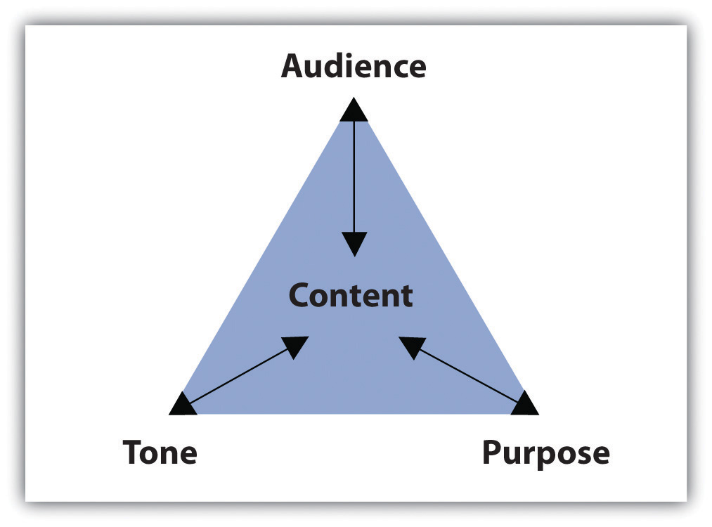
Key Elements of Paragraph
Content is at the center of the triangle, audience at the top corner, tone on the left corner and purpose on the right corner. Arrows point from audience, tone and purpose to content in the center, and back.
(Booth et al., 2022)
Notes:
Image description was taken directly from Chapter 2.4 of Communication Essentials for College by Jen Booth, Emily Cramer & Amanda Quibellunder a CC BY-NC 4.0 License. No changes were made.
Purpose, Audience, Tone, and Content Triangle by Amanda Quibell, Emily Cramer, and Georgian College, licensed under CC BY-NC- 4.0.

Slide 45
Identifying Common Academic Purposes
Find the reason of writing. Why are you writing?
Academic learning has four common purposes of writing:
Summarize
Analyze
Synthesize
Evaluate

Slide 46
Summary Paragraphs
Condenses a large amount of information focusing on the key points
Summary does not require all the facts and figures. It is an overview of the main content.

Slide 47
Summary Paragraphs (Continued)
To achieve a great summary:
Identify the title, author and main purpose of text
Focus on the main key points
Avoid including reader’s opinion
Keep it short

Slide 48
Analysis Paragraphs
Breaks down the main reading material to simplify understanding
Pulls apart primary source into main points which are examined individually to determine how they relate to each other

Slide 49
Synthesis Paragraphs
Combines two or more items to create a new item –blending of individual documents into a new one
It considers the main points from multiple sources and links them together to create a new idea
A good synthesis does not repeat information

Slide 50
Evaluation Paragraphs
Academic evaluation conveys your opinion about a topic and justifies it
It is often subjective based on person’s opinion, belief and prior experience
More critical thinking is required in addition to other skills like summarizing, analyzing and synthesizing

Slide 51
Identifying the Audience
How you present information changes based on your audience
To enhance your writing identify the audience’s:
Education
Demographic
Prior knowledge
Expectations

Slide 52
Identifying the Audience (Continued)
Depending on the subject, engage with the audience and build an appropriate relationship
Writing style decisions depend on content, purpose and audience

Slide 53
Selecting an Appropriate Tone
Tone identifies the attitude of a speaker or writer towards a subject and changes to convey different emotions
Writer’s use devices such as word choice and sentence structure to convey attitude and emotion the same way a speaker does through their voice

Slide 54
Selecting an Appropriate Tone (Continued)
It is important for a writer’s attitude to match the audience and purpose

Slide 55
Choosing Appropriate, Interesting Content
Once the audience and purpose are identified, you determine what goes in the essay
Content is everything written in a document such as statistics, examples, or other types of information and it must be appropriate for the audience and purpose
Tone also shapes content: matching tone with content builds a relationship with the reader

Slide 56
2.4 - Key Takeaways
Paragraphs separate ideas into logical, manageable chunks of information.
The content of each paragraph and document is shaped by purpose, audience, and tone.
The four common academic purposes are to summarize, to analyze, to synthesize, and to evaluate.
Notes:
Key Takeaways was taken directly from Chapter 2.4 of Communication Essentials for College by Jen Booth, Emily Cramer & Amanda Quibellunder a CC BY-NC 4.0 License. No changes were made.

Slide 57
2.4 - Key Takeaways (Continued 1)
Identifying the audience’s demographics, education, prior knowledge, and expectations will affect how and what you write.
Devices such as sentence structure, word choice, punctuation, and formal or informal language communicate tone and create a relationship between the writer and his or her audience.
Notes:
Key Takeaways was taken directly from Chapter 2.4 of Communication Essentials for College by Jen Booth, Emily Cramer & Amanda Quibellunder a CC BY-NC 4.0 License. No changes were made.

Slide 58
2.4 - Key Takeaways (Continued 2)
Content may consist of examples, statistics, facts, anecdotes, testimonies, and observations. All content must be appropriate and interesting for the audience, purpose and tone.
Notes:
Key Takeaways was taken directly from Chapter 2.4 of Communication Essentials for College by Jen Booth, Emily Cramer & Amanda Quibellunder a CC BY-NC 4.0 License. No changes were made.

Slide 59
2.5 - Effective Means For Writing A Paragraph
Learning Objectives
Identify characteristics of a good topic sentence.
Identify the three parts of a developed paragraph.
Apply knowledge of topic sentences and parts of a developed paragraph in an assignment.
Notes:
Learning Objectives were taken directly from Chapter 2.5 of Communication Essentials for College by Jen Booth, Emily Cramer & Amanda Quibellunder a CC BY-NC 4.0 License. No changes were made.

Slide 60
A Strong Paragraph
A strong paragraph contains three components:
Topic sentence. The topic sentence is the main idea of the paragraph.
Body which is composed of supporting sentences that develop the main point.
Conclusion which is the final sentence that summarizes the main point.
(Booth et al., 2022)
Notes:
A Strong Paragraph was taken directly from Chapter 2.5 of Communication Essentials for College by Jen Booth, Emily Cramer & Amanda Quibellunder a CC BY-NC 4.0 License. Minimal changes were made.

Slide 61
Developing a Topic Sentence
A topic sentence sets the reader’s expectation and gives an overview of the content
An effective topic sentence combines a main idea with the writer’s personal attitude or opinion
(Booth et al., 2022)
Notes:
Developing a Topic Sentence was taken directly from Chapter 2.5 of Communication Essentials for College by Jen Booth, Emily Cramer & Amanda Quibellunder a CC BY-NC 4.0 License. Some changes were made.

Slide 62
Main Idea versus Controlling Idea
A topic sentence has a main idea (subject or topic) and a controlling idea (writer’s stance on the topic and a way to direct the paragraph).
Multiple writers may use the same main idea, but their controlling idea may indicate a different stance and take the paragraph in another direction.

Slide 63
Characteristics of a Good Topic Sentence
Five characteristics define a good topic sentence:
Provides clear overview of paragraph’s remaining content
Has a main and controlling idea
Clear and concise
Supporting details are not included
Engages reader’s attention

Slide 64
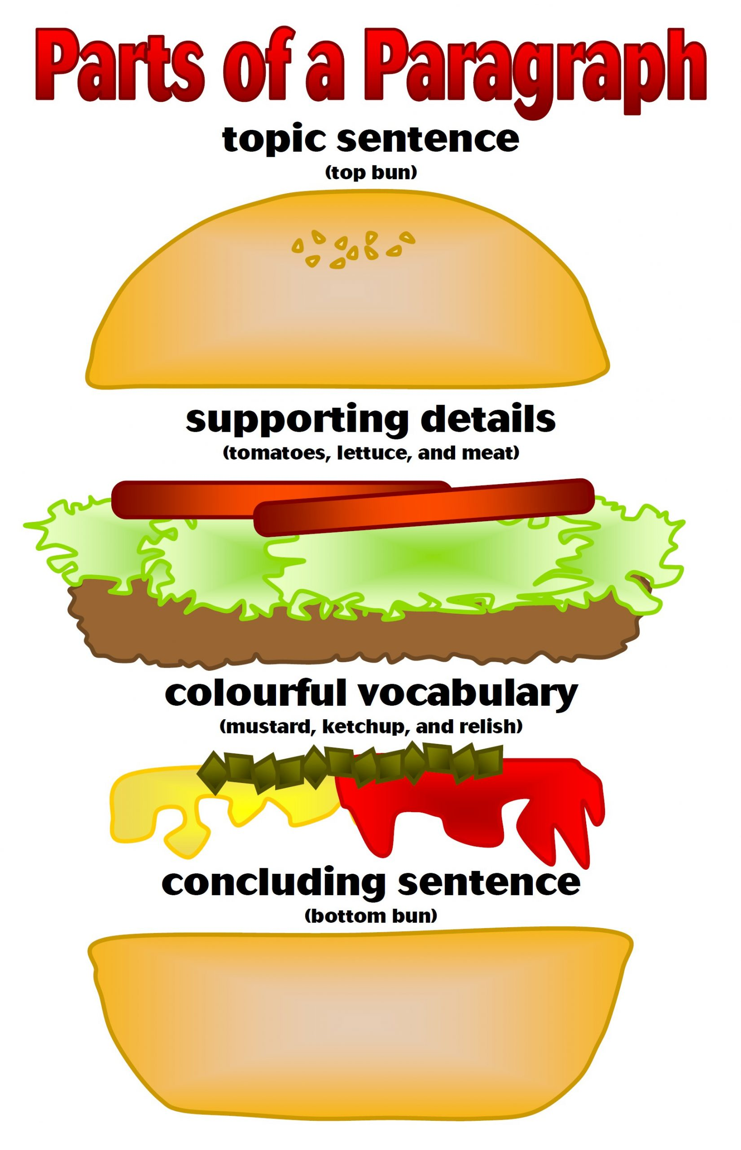
Developing Paragraphs That Use Topic Sentences, Supporting Ideas, and Transitions Effectively
Photo by Enokson is licensed under CC BY 2.0
Notes:
Image credit: Photo by Enokson is licensed under CC BY 2.0

Slide 65
Identifying Parts of a Paragraph
An effective paragraph has three main parts:
Topic Sentence
Body
Concluding sentence
The body paragraph contains supporting sentences and provides more information about the topic to prove the topic sentence
Last sentence is the concluding sentence and restates the main point in different words
(Booth et al., 2022)
Notes:
Three main parts of paragraph were taken directly from Chapter 2.5 of Communication Essentials for College by Jen Booth, Emily Cramer & Amanda Quibellunder a CC BY-NC 4.0 License. No changes were made.

Slide 66
Supporting Sentences
Supporting sentence is the content of the paper that proves the controlling idea of the topic sentence and can be an example, testimony, or fact
Paragraphs usually contain three to six supporting sentences
Supporting sentences could be found in various resources like newspapers, books, articles etc.

Slide 67
Concluding Sentences
Concluding sentence summarizes the whole paragraph in one or two sentences
Reader gets a thorough idea of what was discussed in the paragraph
It reiterates the main idea without repeating the same words in topic sentence

Slide 68
Transitions
A transition is a connecting word that describes a relationship between ideas.
A strong paragraph transitions from the topic sentence to supporting sentence and concluding sentence seamlessly using transitional words and phrases to connect ideas.
Notes:
The definition for transition was taken directly from Chapter 2.5 of Communication Essentials for College by Jen Booth, Emily Cramer & Amanda Quibellunder a CC BY-NC 4.0 License. No changes were made.

Slide 69
2.5 - Key Takeaways
A good paragraph contains three distinct components: a topic sentence, body, and concluding sentence.
The topic sentence expresses the main idea of the paragraph combined with the writer’s attitude or opinion about the topic.
Notes:
Key Takeaways were taken directly from Chapter 2.5 of Communication Essentials for College by Jen Booth, Emily Cramer & Amanda Quibellunder a CC BY-NC 4.0 License. No changes were made.

Slide 70
2.5 - Key Takeaways (Continued 1)
Good topic sentences contain both a main idea and a controlling idea, are clear and easy to follow, use engaging vocabulary, and provide an accurate indication of what will follow in the rest of the paragraph.
Topic sentences may be placed at the beginning, middle, or end of a paragraph. In most academic essays, the topic sentence is placed at the beginning of a paragraph.
Notes:
Key Takeaways were taken directly from Chapter 2.5 of Communication Essentials for College by Jen Booth, Emily Cramer & Amanda Quibellunder a CC BY-NC 4.0 License. No changes were made.

Slide 71
2.5 - Key Takeaways (Continued 2)
Supporting sentences help explain, prove, or enhance the topic sentence by offering facts, reasons, statistics, quotations, or examples.
Concluding sentences summarize the key points in a paragraph and reiterate the main idea without repeating it word for word.
Transitional words and phrases help organize ideas in a paragraph and show how these ideas relate to one another.
Notes:
Key Takeaways were taken directly from Chapter 2.5 of Communication Essentials for College by Jen Booth, Emily Cramer & Amanda Quibellunder a CC BY-NC 4.0 License. No changes were made.

Slide 72
References & Attributions
Cramer, E., Quibell, A., & Booth, J. (2022, February 28). Communication Essentials for College. eCampus Ontario Open Library. https://ecampusontario.pr essbooks.pub/gccomm/
“Take Notes from Lectures – That You’ll Actually Use” in University 101: Study, Strategize and Succeed by Kwantlen Polytechnic University licensed under CC BY-SA 4.0.
Photo by Enokson is licensed under CC BY 2.0
Purpose, Audience, Tone, and Content Triangle by Amanda Quibell, Emily Cramer, and Georgian College, licensed under CC BY-NC- 4.0.

