Slide 1

Essentials of Project Management
Chapter 5 - Project Planning (Scheduling)
Unless otherwise noted, this work is licensed under a Creative Commons Attribution-NonCommercial-ShareAlike 4.0 International (CC BY-NC-SA 4.0) license. Feel free to use, modify, reuse or redistribute any portion of this presentation.

Slide 2
5.1. Learning Objectives
Define terms related to scheduling.
Calculate parametric estimates.
Describe how cost and time are summarized in a WBS.
Outline the process of decomposition is used to create a WBS.
Identify the difference between a deliverable and work package.
Describe the WBS numbering system.
Outline top-down estimation methods.
Outline bottom-up estimation methods.
Be able to calculate learning curves and apply them.
Discuss issues related to moving from the planning phase of a project to the scheduling phase.
Explain concepts related to the critical path method including schedule compression.

Slide 3
5.2. Scheduling Terms
Milestone
Activity
Duration
Resource
Cost
Slack
Notes:
Making sure all stakeholders use the same terminology is crucial in all phases of project management, but it’s especially important when you are trying to get a group of diverse people to agree to a schedule.

Slide 4
5.3 Defining Activities
The activity definition process is a further breakdown of the work package elements of the work breakdown structures (WBS).
It documents the specific activities needed to fulfill the deliverables detailed in the WBS. These activities are not the deliverables themselves but the individual units of work that must be completed to fulfill the deliverables.
Notes:
Activity definition uses everything we already know about the project to divide the work into activities that can be estimated.

Slide 5
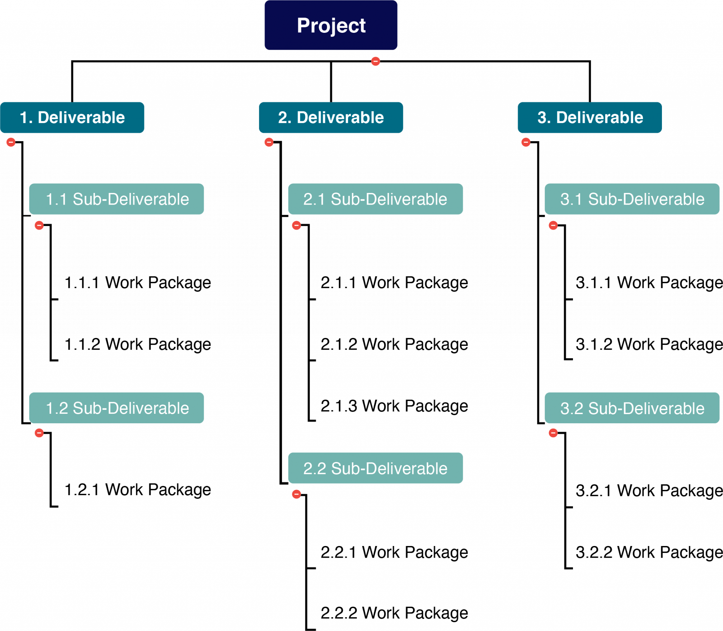
5.4. Work Breakdown Structures
Notes:
The WBS is a hierarchical outline of all the deliverables involved in completing a project. The WBS is part of a project scope statement. The creation of a WBS is one of the first steps in organizing and scheduling the work for a project.

Slide 6
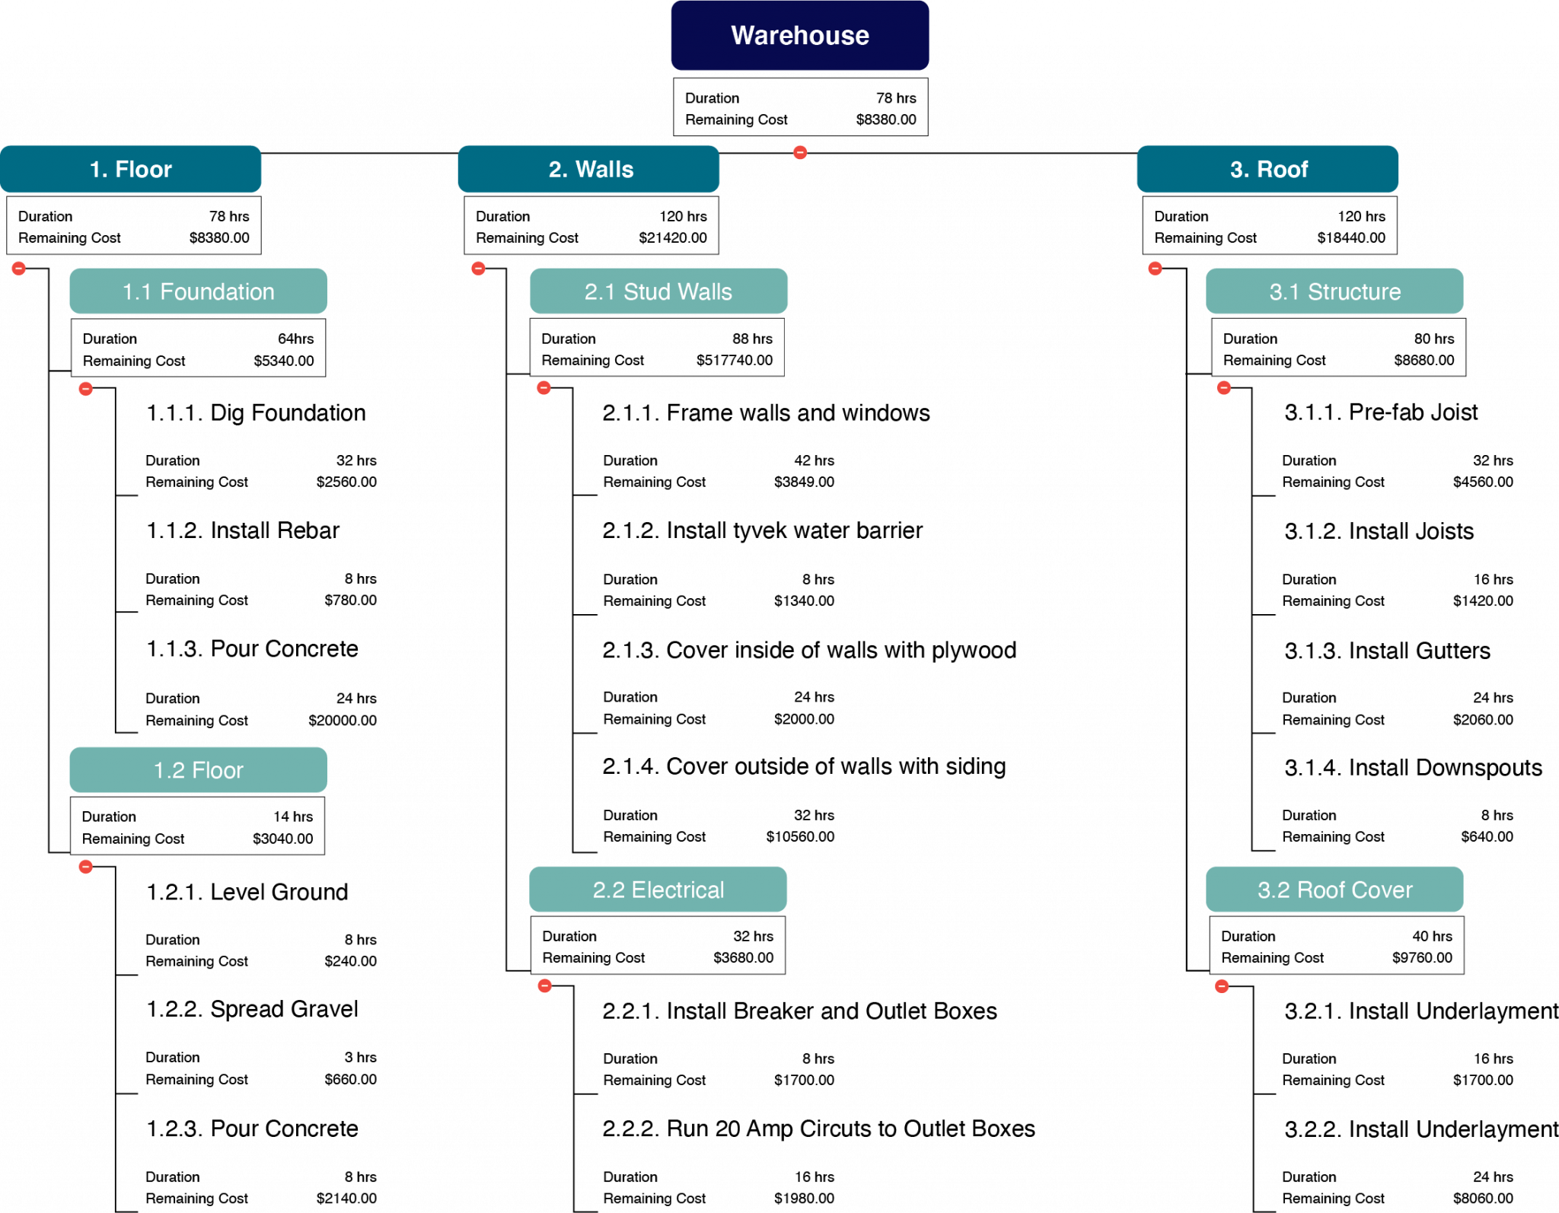
5.4. WBS – continued

Slide 7
Deliverables vs. Work Packages
Deliverables and sub-deliverables are things such as physical objects, software code, or events. In a WBS, deliverables and sub-deliverables are represented by NOUNS
Work packages are assignable units of work that will be performed to create the related deliverable. Work packages are action oriented and will be represented by phrases containing VERBS
Notes:
A work package can be assigned to one particular project team member, one outside contractor, or another team. The work packages maybe further broken down into activities or tasks by the project team or the experts who will perform that work (see WBS dictionary later in this section).

Slide 8
Numbering
Project managers use the WBS during project execution to track the status of deliverables and work packages. The items in a WBS are numbered so it is easy to understand the deliverable, or sub-deliverable, to which any particular work package is related.

Slide 9
Decomposition
Decomposition is the process used to break the project scope of work into the deliverables, sub-deliverables, and work packages involved in completing the project.
Notes:
The process of decomposition begins with identifying the highest-level deliverables. These deliverables are then broken into sub-deliverables. Many layers of sub-deliverables may be needed for a project.

Slide 10
5.5. Time Estimation
Estimates have a huge influence on a project and are a large source of project risk.

Slide 11

Time Estimation
Top-down, or macro, estimation methods are used to determine if a project is feasible, to calculate funding requirements, and to determine the resources needed to complete a project
Notes:
These methods are not extremely accurate but provide a relatively fast way to make an estimate of the time and costs required for a project.
Top-down, or macro, estimation methods allow for a quick estimate of project costs based on historical information.

Slide 12

Time Estimation I
Bottom-up, or micro, estimation methods are used to provide a detailed, and more accurate, estimate and are usually derived from the detailed list of work packages or activities found in the work-breakdown structure.
Notes:
All estimates contain risk. If estimates are too low, then a project will take more time and money to complete than what was budgeted.
Bottom up, or micro, estimation techniques are used when the project is approved or is very likely to be approved.

Slide 13
Time Estimation II
These basic guidelines should be followed when generating bottom up estimates:
Have people familiar with the work make the estimate.
If possible, use several people to make estimates.
Estimates should be based on normal conditions and a normal level of resources.
Estimates should not make allowances for contingencies.

Slide 14
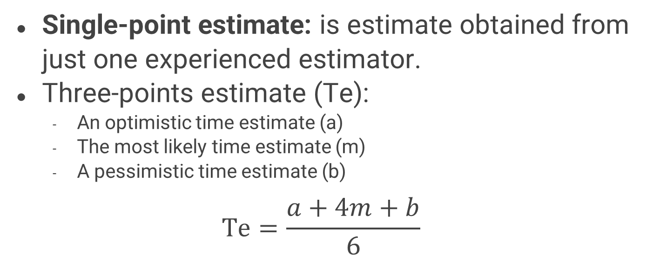
Single Vs Three-Points Estimate
Single-point estimate: is estimate obtained from just one experienced estimator.
Three-points estimate (Te):
  An optimistic time estimate (a)
  The most likely time estimate (m)
  A pessimistic time estimate (b)
$$Te=\frac{a+4m+b}{6}$$

Slide 15
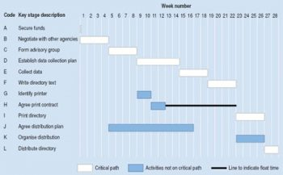
5.6. Managing the Schedule
The Gantt Chart
A Gantt chart is a type of bar chart, developed by Henry Gantt, that illustrates a project schedule.
Notes:
Gantt charts are easy to read and are commonly used to display schedule activities.
These charts display the start and finish dates of the terminal elements and summary elements of a project. Terminal elements and summary elements comprise the work breakdown structure of the project.

Slide 16
Network Information Chart (NIC)

Slide 17
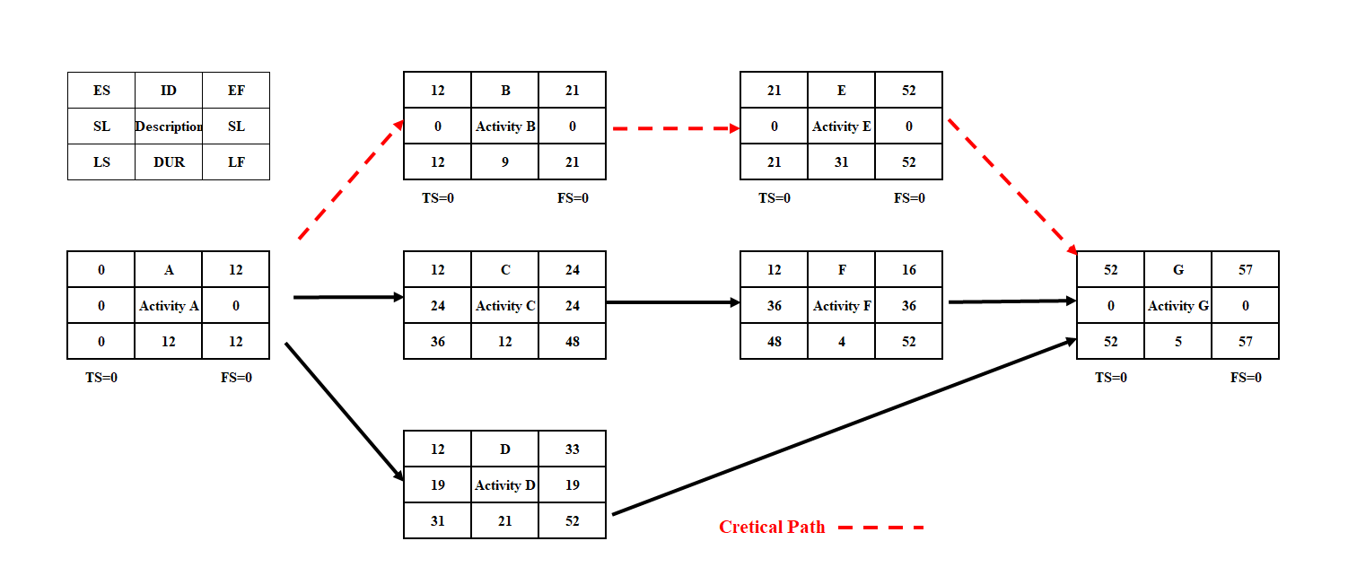
Network Diagram (AON)

Slide 18
Key Takeaways
The creation of a WBS is one of the first steps in organizing and scheduling the work for a project.
Activity definition uses everything we already know about the project to divide the work into activities that can be estimated.
Estimates have a huge influence on a project and are a large source of project risk.

