Slide 1
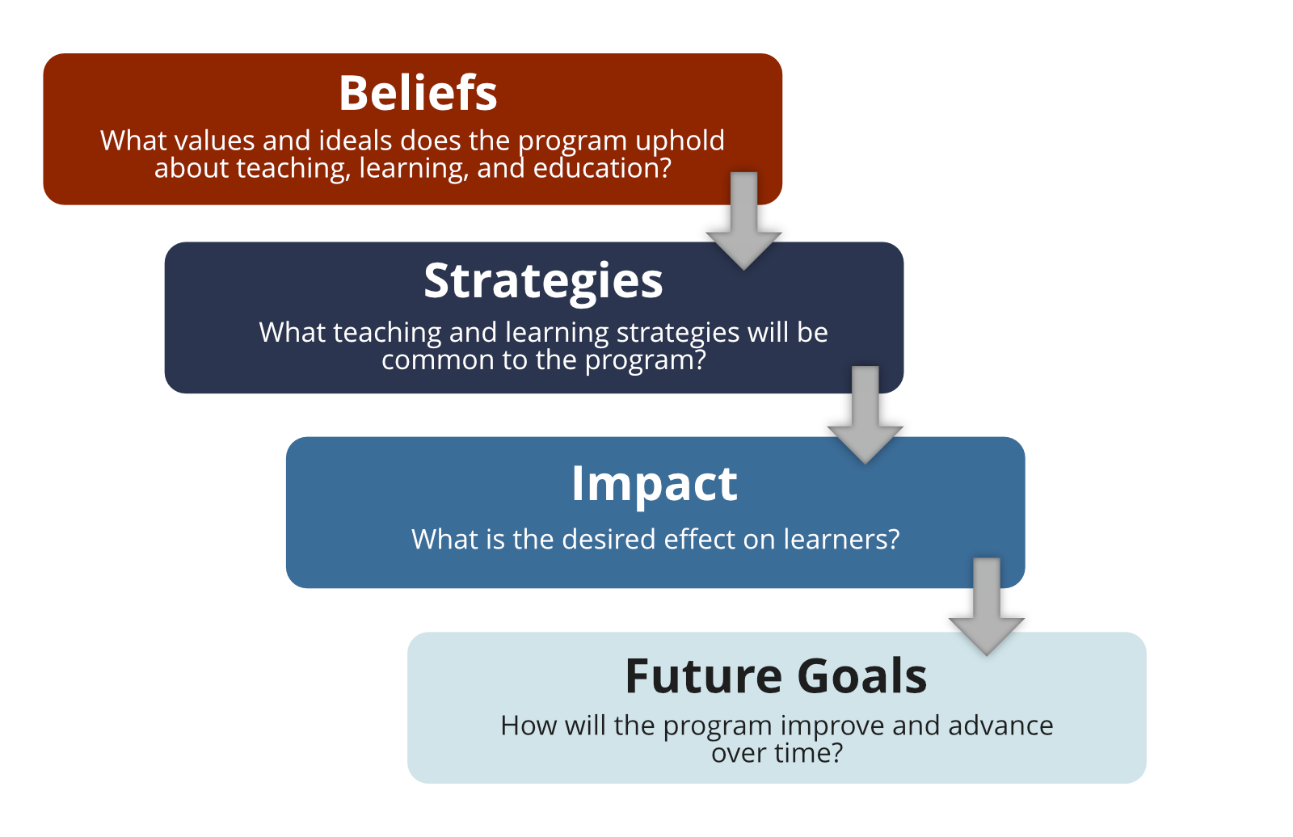
Key Components of a Program Philosophy

Slide 2
Beliefs
What are our beliefs about teaching and learning in this program?
Why do we hold these beliefs?
What values do we wish to impart to students?
What code of ethics guides teaching in the program?

Slide 3
Strategies
What does good teaching look like in this program?
What kinds of student–teacher relationships do we strive for in this program?
What themes pervade teaching in the program?
Under what opportunities and parameters will enable students to learn effectively in this program?

Slide 4
Impact
How will we measure successful teaching in the program?
What does successful teaching look like?
What habits, attitudes, methods will mark successful teaching in the program?
What are we trying to achieve with our students?

Slide 5
Future Goals
What are our future goals and aspirations for the program?
Where will we be in 7 years?

Slide 6
References
The Key Components of a Program Philosophy and corresponding questions are adapted from:
Kenny, N., Berenson, C., Jeffs, C., Nowell, L., &Grant, K. (2018) Teaching Philosophies and Teaching Dossiers Guide. Calgary, AB: Taylor Institute for Teaching and Learning. Retrieved from: http://www.ucalgary.ca/taylorinstitute/resources/
Schönwetter, D. J., Sokal, L., Friesen, M. & Taylor, K. L. (2002). Teaching philosophies reconsidered: A conceptual model for the development and evaluation of teaching philosophy statements, International Journal for Academic Development, 7(1), 83-97

