Slide 1
Curriculum Design Models

Slide 2
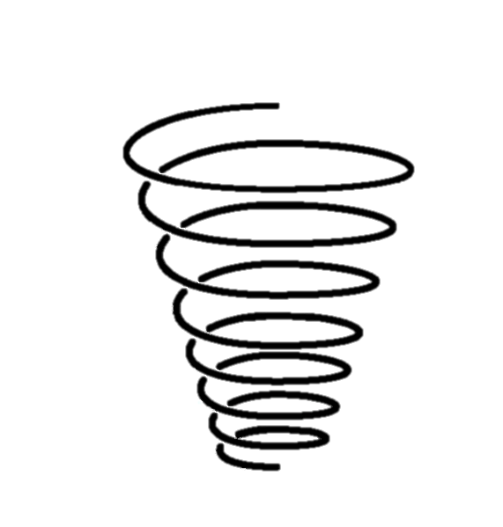
Spiral Curriculum
A spiral curriculum is organized around key concepts/skills that are introduced and revisited for deeper understanding or mastery as learners moves through the program of study.
Mastery
Deepening
Integrating
The topics visited are addressed in successive levels of difficulty. They are introduced to foundations, then build on prior knowledge as they revisit and deepen learning.
Revisiting
Introduction
Notes:
The topics visited are addressed in successive levels of difficulty. Each return visit has added objectives and presents fresh learning opportunities leading to the final overall objectives. Every visit can bring: new knowledge or skills relating to the theme or topic; more advanced applications of areas The topics visited are addressed in successive levels of difficulty. previously covered; increased proficiency or expertise through further practical experience.
A move from simple to complex: Students are introduced in a controlled way at a level at which they are not overwhelmed, and at which they can master the subject. They then go on to build new knowledge on prior knowledge. Students achieve a better understanding by exploring the same topics at deepening levels.

Slide 3
Spiral Curriculum
Every spiral visit can bring:
new knowledge or skills relating to the theme or topic;
more advanced applications of areas;
successive levels of difficulty;
complexity or application increased proficiency;
or, expertise through further practical experience
Mastery
Extensions
Mastery
Deepening
Integrating
Connections
Reinforcement
Revisiting
Introduction
Ideas
Foundations
Notes:
The topics visited are addressed in successive levels of difficulty. Each return visit has added objectives and presents fresh learning opportunities leading to the final overall objectives. Every visit can bring: new knowledge or skills relating to the theme or topic; more advanced applications of areas The topics visited are addressed in successive levels of difficulty. previously covered; increased proficiency or expertise through further practical experience.
A move from simple to complex: Students are introduced in a controlled way at a level at which they are not overwhelmed, and at which they can master the subject. They then go on to build new knowledge on prior knowledge. Students achieve a better understanding by exploring the same topics at deepening levels.

Slide 4
Linear Curriculum
The linear curriculum proceeds in a sequential manner from beginning to end, with the intention of building knowledge, skills, and/or values progressively.
This curriculum design is often represented as a pyramid made of blocks. Blocks might represent concepts, ideas, or component skills students are learning.
concepts, ideas, skills, content areas
Notes:
Content is divided into different section but sections are interconnected in some way, they are building blocks upon one another. Links between content are emphasized and encouraged. Key concepts and skills underpin the course. Assignments or exams might draw on various elements of the course and evaluate students on their ability to integrate learning.

Slide 5
Linear Curriculum
Aha! Moment
The curriculum starts with introductory concepts/ideas/skills.
Then gradually builds on knowledge and skills over time.
This learning might lead to a culminating point, sometimes thought of as the a-ha moment, or capstone.
Building of Knowledge, Skills
Foundations
Notes:
Content is divided into different section but sections are interconnected in some way, they are building blocks upon one another. Links between content are emphasized and encouraged. Key concepts and skills underpin the course. Assignments or exams might draw on various elements of the course and evaluate students on their ability to integrate learning.

Slide 6
Linear Curriculum
The curriculum could also start with a problem.
Then build upon the skills required to solve it.
Students build on component knowledge, skills with increasing complexity.
Grand Problem
Notes:
Content is divided into different section but sections are interconnected in some way, they are building blocks upon one another. Links between content are emphasized and encouraged. Key concepts and skills underpin the course. Assignments or exams might draw on various elements of the course and evaluate students on their ability to integrate learning.

Slide 7
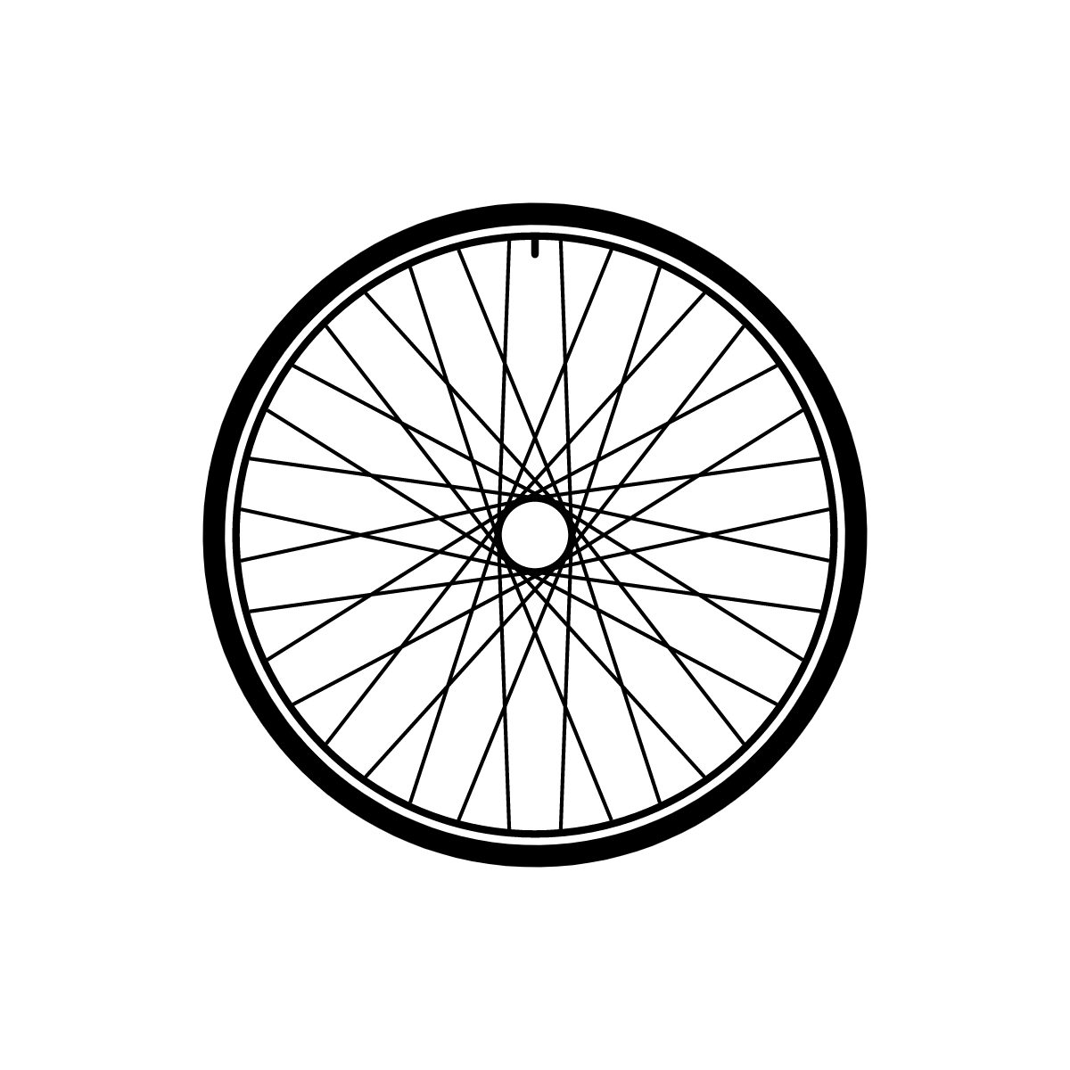
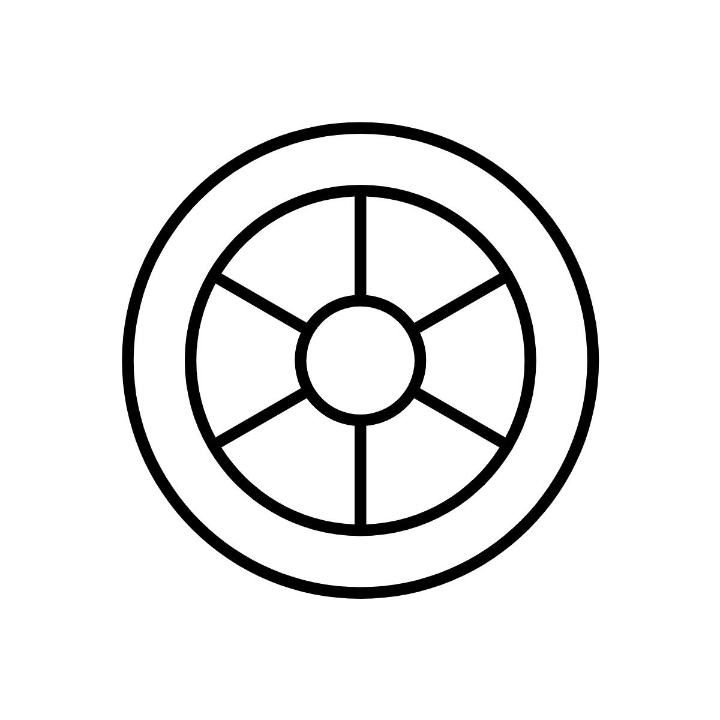
Wheel Curriculum
A wheel curriculum is circular. It organizes learning around interconnected themes that intersect to comprise a whole.
For some, the wheel may represent the Anishinaabe Medicine Wheel.
For others, the wheel represents a hub and spoke.

Slide 8
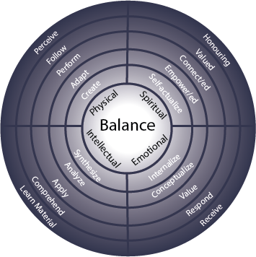
Medicine Wheel
Curriculum
A Medicine Wheel curriculum might be designed in such a way that weaves together intellectual, physical, emotional, and spiritual aspects of learning in ways that are not linear or modularized but interconnected, braided, and cyclical in nature.
Four domain learning framework. LaFever, M. (2017). Using the medicine wheel for curriculum design in intercultural communication: rethinking learning outcomes. In G. M. García-Pérez & C. Rojas-Primus, Promoting Intercultural Communication Competencies in Higher Education, p. 168-199 doi: 10.4018/978-1-5225-1732-0.ch007
Notes:
a program might be designed in such a way that weaves together cognitive, physical, emotional, and spiritual aspects of learning in ways that are not linear or modularized but interconnected, braided, and cyclical in nature.

Slide 9
Hub and Spoke Curriculum
A hub and spoke curriculum might be designed with the central hub or core in mind in relation to the surrounding spokes.
The core might be the foundational, shared, inter-disciplinary, intersectional components of learning.
While the spokes might be special topics, interdisciplinary inquiries, applications, or related concepts.
Shared core
Related concepts, ideas, practices

Slide 10
Modular Curriculum
A modular curriculum is structured into distinct modules that are relatively autonomous to one another.
Units have well-defined and precise boundaries. Content is divided into a number of chunks with no links between topics.
Students can be summatively evaluated on the unit at the end of that series.
Gaps – Little to No Link
Module 1
Module 2
Module 3
Topic 1.1
Topic 2.1
Topic 3.1
Topic 1.2
Topic 2.2
Topic 3.2
Notes:
Content is divided into a number of self-contained units
Units have well-defined and precise boundaries
Content is divided into a number of chunks with no links between topics
Each unit focuses on a specific range of concepts of skills
Students can be summatiely evaluated on the unit at the end of that series

