Slide 1
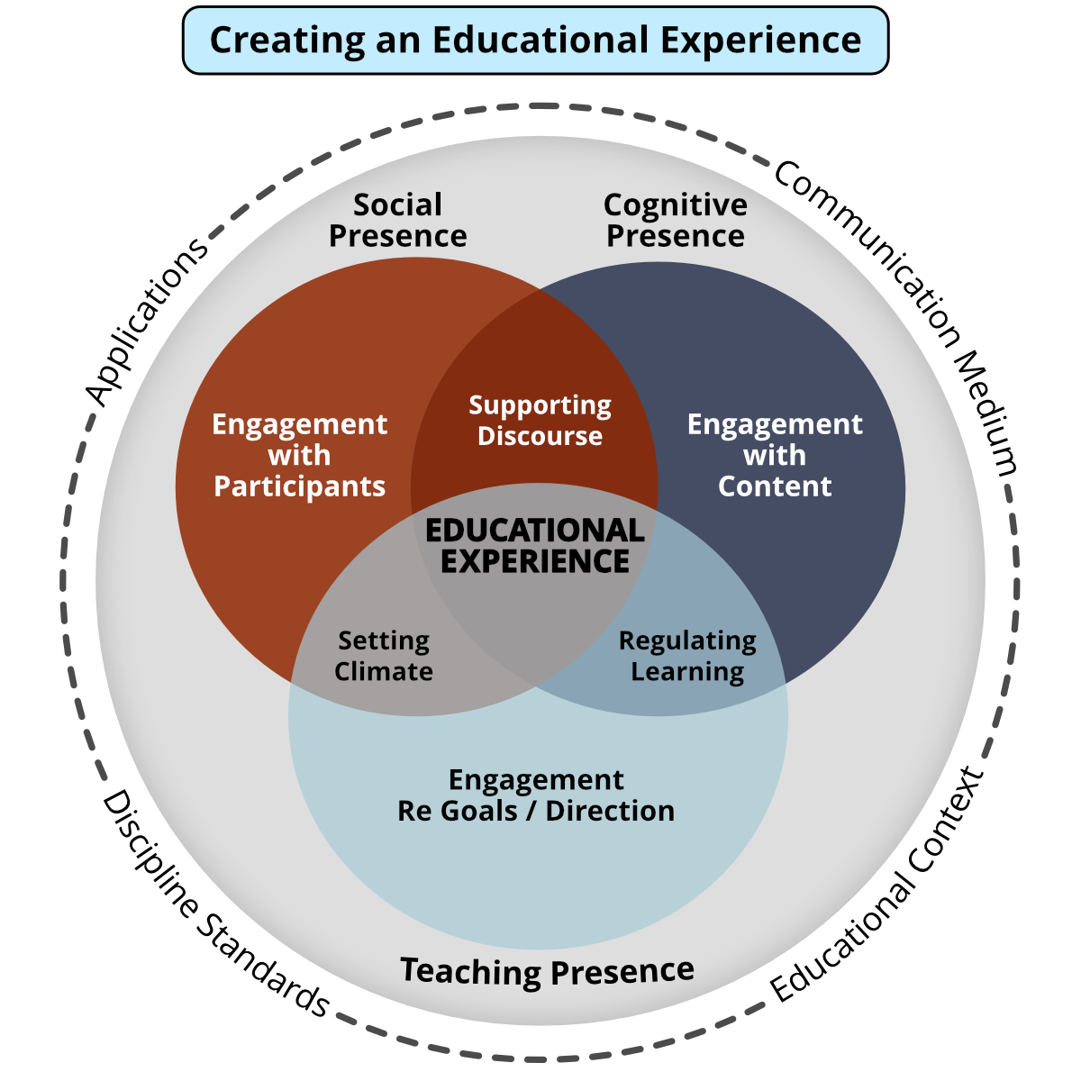
Community of Inquiry Framework

Slide 2
Teaching Presence
What course design elements could be commonly used to support teaching presence through design, facilitation, and direct instruction?​
​
How and when throughout the program will instructors directly facilitate and instruct students? What does this look like for the program? ​
​
Generally, how might instructors facilitate discourse within the program? Are there common characteristics between instructors or times when unique instructor qualities most closely align with the overall intentions of the program?​
​
How will learners receive feedback from their instructors throughout the program?​

Slide 3
Social Presence
What course design elements could be commonly used to support social presence, (emotional affective) expressions, open communication, and group cohesion?​
​
How will students be supported to develop trust and interact among peers?​
​
What etiquette or moral guidelines characterize what open and effective communication between learners looks like for the program?​
​
When and how will students work together?

Slide 4
Cognitive Presence
What course design elements could be commonly used to support students’ exploration, construction, resolution and confirmation of understanding through collaboration and reflection?​
How will students be supported to move deliberately from understanding the problem or issue through to exploration, integration and application both within courses and across courses?​
When and how will learners be first introduced to concepts and how will they be encouraged to explore those concepts?​
When and how will learners engage in analysis and synthesis?​
When and how will learners pause to reflect on learning?​
How will learners both identify and engage with vocationally/workplace specific skills, knowledge and attitudes?​

Slide 5
References
Fiock, H. (2020). Designing a Community of Inquiry in Online Courses. The International Review of Research in Open and Distributed Learning, 21(1), 135-153. https://doi.org/10.19173/irrodl.v20i5.3985
Garrison, D. R. (2007). Online community of inquiry review: Social, cognitive, and teaching presence issues. Journal of Asynchronous Learning Networks, 11(1), 61-72. Retrieved from https://files.eric.ed.gov/fulltext/EJ842688.pdf
Garrison, D. R., Cleveland-Innes, M., Vaughan, N., Befus, M., Akyol, Z., Stenbom, S. (n.d.). CoI Framework. https://coi.athabascau.ca/coi-model/

