Slide 1
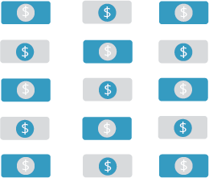
Course Title
OVERVIEW/WEEKLY TOPICS
Course Code / Semester / Year
• Week 1
• Week 2
• Week 3
• Week 4
• Week 5
• Week 6
• Week 7
• Week 8
• Week 9
• Week 10
• Week 11
• Week 12
• Week 13
• Week 14
• Week 15
Assignment 1
Exam
Assignment 2
“Leadership is unlocking people’s potential to
become better."
-Bill Bradley
Midterm
Required
Materials
Important Policies
Instructor Name
• Item 1
• Item 2
• Item 3
• Policy 1
• Policy 2
• Policy 3
name@emailaddress.ca
(555) 555-5555 ext.
“Innovation Syllabus Template” by Cambrian College is licensed under CC BY-NC-SA 4.0

